Slide 1
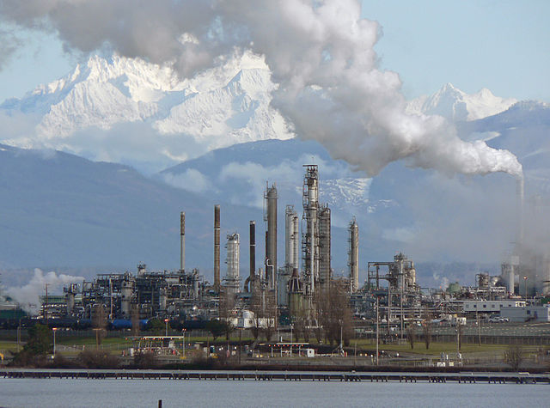

Yale-UNIDO Train-the-Facilitator Workshop in Green Chemistry
Waste Prevention
CENTER for GREEN CHEMISTRY
and GREEN ENGINEERING at YALE
Image: Wikimedia Commons, Anacortes Refinery, Author: Walter Siegmund

Slide 2

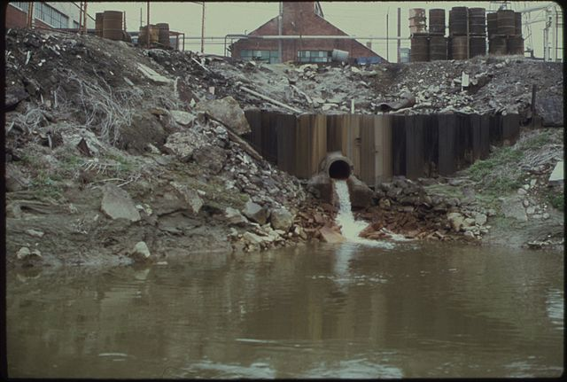
Waste Prevention
It is better to prevent waste than to treat or clean up waste after it is formed.
Image: Harshaw Chemical Company discharges waste water into the Cuyahoga river
Source: National Archives and Records Administration

Slide 3
Topics To Be Covered
Approaches to deal with Environmental Challenges
The Waste Treatment Pyramid
Reduced Solvent Use
Waste as a Feedstock
Biodegradation of Waste
Designing Processes to Include Biodegradation of Waste

Slide 4
Approaches to deal with Environmental Challenges
Common Effluent Treatment Plant (CETP)
- Capital intensive
- Cost centric approach
- Ineffective – same treatment to wide variety of effluents
End-of-the-pipe Treatment (ETP)
- Capital intensive
- Cost centric approach
- Converts one type of effluent in to another
Industrial Ecology
- Low value creation
- Logistics & capacity mismatch
- Better than ETP, Doesn’t
address problem at source
Green Chemistry
- Address problem at source
- Profit centric approach, high value creation
- Less capital intensive
Economics & Environmental Footprint

Slide 5
Approaches to deal with Environmental Challenges
Impact of End-of-Pipe: huge threat to water bodies & human health
Quantity : Billions of kgs of liquid effluents from Chemical Industries
include solid & gaseous effluents
include all wastes from all other sectors (mining, steel, power,…..)
Practice : End-of-pipe-treatment (converting one kind of effluent in to other)
Issue : Toxicity not fully known (Ecotoxicity data available for less than 1% of human pharmaceuticals…Ref: journal “Regulatory
Toxicology Pharmacology, April’2004)”
Degradation : very slow, impact unknown after degradation
Impact on Economics
Direct Cost : loss of solvent, raw material & finished product, loss of utilities, treatment cost, higher overheads, loss of business…
Indirect Cost : unreliable supplies, loss of credibility in market, anxiety, etc.

Slide 6
Waste treatment pyramid: The 4 Rs
Reduce, Reuse, Recycle, Recover
Prevention
We need various types of technology to reduce and reuse waste.
Ultimately, the production of waste should be prevented.
Most favored option
Reduction
Reuse
Recycling
Energy recovery
Disposal
Recycling
Composting
Incineration
Least favored option
Landfill
Notes:
Need for technologies to Reduce and Reuse waste. Ultimately, the waste production should be Prevented

Slide 7
Landfills
Reduction
Reuse
Recycling
Energy recovery
Disposal
  Consolidated material is buried with mud and other sealing agents to enable chemical, bacteriological, and physical degradation.
  Semi-anaerobic conditions lead to production of methane and CO₂.
  If captured, landfill gas (methane) from decomposing garbage can be used to produce electricity, heat, and fuels.
Image: Wikimedia Commons

Slide 8
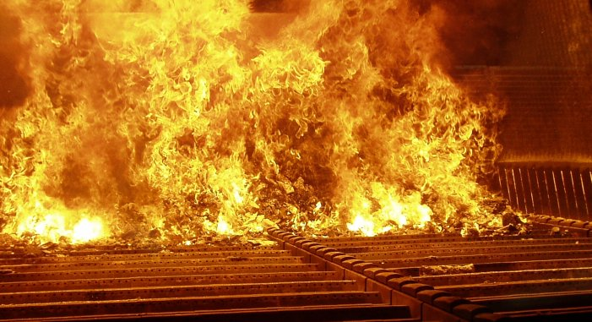
Incineration
Reduction
Reuse
Recycling
Energy recovery
Disposal
Thermal decomposition of wastes through Combustion (in presence of oxygen)
Better than landfills
Reduces solid waste mass by 95 - 96%
Converts wastes in to:
    Heat – (Use: electricity, steam)
    Flue Gas – (Use: indirect heating)
    Ash – (cement, etc)
Disadvantages
    Releases gases such as CO2
    Emits hazardous end products
    No recycling possible
Image: Wikimedia Commons

Slide 9
Recycling and Composting
Gasification:
  Converts organic based materials into CO, H₂ and CO₂.
  Achieved by reacting the material at high temperatures (>700 °C), without combustion, with a controlled amount of oxygen and/or steam.
  The resulting gas mixture is called syngas.
  Syngas is combustible and often used as a fuel.
Pyrolysis:
  Thermal decomposition at 200-300°C occurring in the absence of oxygen.
  Precursor of both the combustion and gasification processes.
  The products of biomass pyrolysis include biochar, bio-oil, and gases - such as methane, hydrogen, carbon monoxide, and carbon dioxide.
Reduction
Reuse
Recycling
Energy recovery
Disposal

Slide 10
Recycling and Composting
Reduction
Reuse
Recycling
Energy recovery
Disposal
Composting
  Organics undergo a biological decomposition to form a material (compost) that is non-toxic to plant growth.
  By-product of the reaction are CO₂, water and heat.
Anaerobic conditions and biogas production
  Adopted for farm waste.
  Can reduce greenhouse gas emissions and can provide a cost-effective source of renewable energy.
  Recovered biogas can be an energy source for electricity, heating or transportation fuel.

Slide 11
Recycling (Aqueous Wastes)
Reduction
Reuse
Recycling
Energy recovery
Disposal
Solvent & Water contribute more than 90% of the Reaction Mass
Source Data: ACS GCI Pharmaceutical Roundtable benchmarking exercise 2007
Most cases, average composition of Effluents will be close to composition of reaction & extraction medium.
Recycle of reaction & extraction medium can take care of 90% of effluent problems.

Slide 12
Recycling (Aqueous Wastes)
Process for a Dye-Stuff Intermediate (high volume, 50 TPM)
Reaction Medium – Fresh Water
Step 1 – Reduction of Dinitro to Diamine
Step 2 – Neutralization with Soda Ash, Diamine solubilizes
Step 3 – Filtration of iron Oxide, Filtrate contains product
Step 4 – Isolation of Product using NaCl for Salting
Step 5 – Filtration of product, High TDS Mother Liquor taken for
effluent treatment (multiple effect evaporation, incineration, etc)
Reduction
Reuse
Recycling
Energy recovery
Disposal
Dinitro, Acid & Iron
Soda Ash
NaCl
Fresh
Water
Reduction
Neutralization
Filtration
Isolation
Iron Oxide
Product Filtration
Product
Effluent Treatment
Mother Liquor
Colour Reddish
pH 6 - 7
TDS 20-25%
COD > 15000
MPDSA 2.5-3.0%
Source: Newreka

Slide 13
Recycling (Aqueous Wastes)
Reduction
Reuse
Recycling
Energy recovery
Disposal
Dinitro, Acid & Iron
Soda Ash
NaCl
Fresh
Water
Reduction
Neutralization
Filtration
Isolation
Iron Oxide
Recycled ML (Solution containing NaCl & Product)
Product Filtration
Product
RCat
Spent RCat Filtration
RCat Treatment
ML Storage
Patented Technology
More than 10 recycles
E-Factor = 90% reduced
Yield = 8 - 10%
Salt Savings
Mother Liquor (ML)
Spent RCat
Source: Newreka

Slide 14
Reuse and Repurpose
Reduction
Reuse
Recycling
Energy recovery
Disposal
Reuse and Repurpose
  Converting waste materials into new materials and objects.
  Available for metals, plastic, paper, glass.
  E.g. PET reuse and repurposing
Material | Energy savings
Aluminum | 95%
Cardboard | 24%
Glass | 5-30%
Paper | 40%
Plastics | 70%
Steel | 60%
Cost-benefit of recycling: energy savings
http://www.packagingtoday.co.uk/news/newsgermans-recycle-more-and-more-effectively-success-in-pet-bottle-recycling-according-to-study-5699219

Slide 15

Recovery of Sodium Sulphate from Brine
Industry : Caustic Soda/Chlor-Alkali
Problem Definition :
  Sulphate is an impurity (introduced from raw material – Sodium Chloride)
  Current Treatment Method: (a) Sulphate containing stream is purged from system (b) Barium Salt used to precipitate Barium Sulphate which is then disposed to landfill.
Geist’s Solution
  Sulphate is recovered as Anhydrous Sodium Sulphate - a White, Crystalline & Free Flowing Powder meeting all the quality specifications.
  Sale of Anhydrous Sodium Sulphate generates revenue & save on the existing treatment cost such as Brine Purging & Barium Treatment.
  Final Aqueous Stream is completely recycled to the parent process thus achieving a Zero Discharge
Present Installation: Gujarat Alkalies & Chemicals Limited, Dahej, India

Slide 16
The Reduction and Elimination of Waste
Reduction
Reuse
Recycling
Energy recovery
Disposal
Reduced solvent or solventless processes
Process intensification
Material deposition
Self separation
Use waste as a feedstock
Notes:
Process Intensification - simple definition of Stankiewicz and Moulijn (2000), PI is ‘Any chemical engineering development that leads to a substantially smaller, cleaner, safer, and more energy efficient technology.
Material Deposition – deposition of powder-sized materials on various surfaces

Slide 17
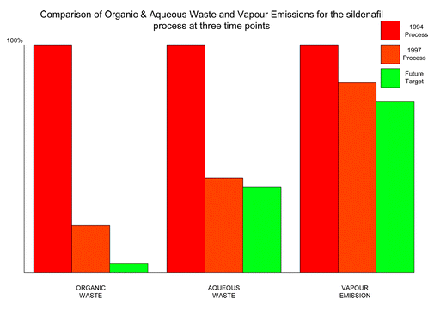
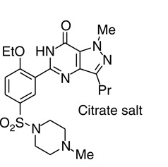
Reduced Solvent: Sildenafil Citrate Production
Sildenafil citrate, commonly known as Viagra, is a selective inhibitor of phosphodiesterase 5 (PDE5). This new drug has immediately became a major seller, achieving sales of more than $1 billion during its first year on the market. With such a rapid sales take off it was critical that the environmental performance of the synthesis was good from the outset.
Average yield of last three steps = 97% yield.
Reduction of the ratio of solvent waste/kg product over 17 years from 1300 L/kg to only 7 L/kg by minimizing solvent use, increasing solvent recovery, improving solvent selection, and telescoping steps.
Only the solvents t-butanol, ethyl acetate, 2-butanone, and a trace of toluene still require disposal.
Comparison of organic and aqueous waste and vapor emissions for the sildenafil citrate process at three time points
Dunn, P.J et al Green Chem., 2004, 6, 43-48

Slide 18
Utilizing Waste as a Feedstock – Industrial Ecology
Some examples:
Waste cooking oil for biodiesel
Glycerol for lactic acid using catalyst
Red mud for bricks
Crustacean (crab, lobster, shrimp, etc) shell waste for chitosan based products
Gypsum/Gluaber’s Salt used in Cement manufacturing

Slide 19
Utilizing Waste as a Feedstock – Industrial Ecology
Kalundborg, Denmark provides currently best known example of industrial symbiosis in action.
An oil refinery, a power station, gypsum board manufacturer, a pharma company, a cement company, etc – they share ground water, surface water, waste water, steam, and fuel and exchange a variety of byproducts that become in other processes.
http://www.ehrn.co.za/publications/download/09.pdf

Slide 20
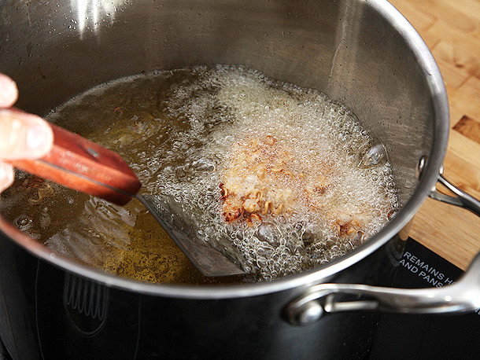
Example: Used oils as biofuel source
Biodiesel from virgin vegetable oil is considered first generation biofuel because it competes with food
=> Turning to waste can offer a solution: frying oil can be used instead.
Used frying oil
Current treatment:
  Dispose / Combust as fuel.
“Waste”
Bio-diesel
Leung, D. Y. C., & Guo, Y. (2006). Transesterification of neat and used frying oil: optimization for biodiesel production. Fuel processing technology, 87(10), 883-890.

Slide 21
Glycerol: a waste of biodiesel
Skin exfoliating reagent
Polylactic acid
Industrial chemical precursors
Valuable medicinal product
Sunless tanning product
Anti-freeze
Notes:
There are just a handful of examples of what we could do with glycerol so BURNING it is definitely not the most efficient way to use the limited resources nature offers.

Slide 22
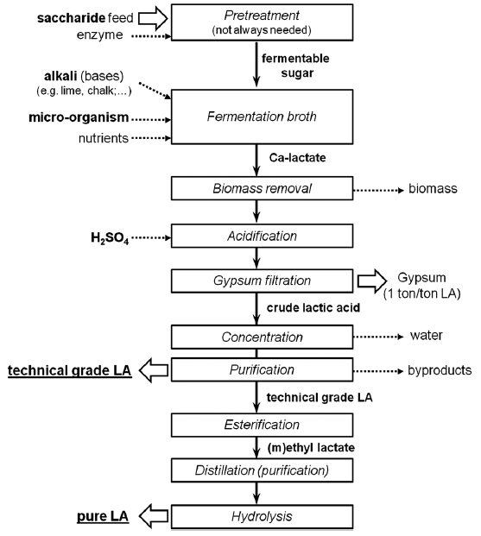
Production and Applications of Lactic Acid- Conventional process
  Other applications of Lactic Acid:
  Food preservatives
  Edible pH modifier
  Textile industry
  Cosmetic and pharmaceutical industries
90% of lactic acid comes from anaerobic fermentation of hexose sugar (e.g. corn starch).
Compete with food sources.
Slow and requires a lot of purifications.
Dusselier, M.; Van Wouwe, P.; Dewaele, A.; Makshina, E.; Sels, B. F., Energy & Environmental Science 2013, 6 (5), 1415-1442.

Slide 23
Water Electrolysis with Earth Abundant Metal Catalyst
e⁻
Power
Supply
e⁻
e⁻
e⁻
e⁻
e⁻
e⁻
2H₂O ---> O₂ + 4H⁺ + 4e⁻
2H⁺ + 2e⁻ ---> H₂
Cathode:
Any conductive materials
Anode:
Expansive platinum group metals
Anode
Cathode
Cobalt 1,2‐bis(diphenylphosphino)ethane
(Co-DPPE)
Bloomfield, A. J.; Sheehan, S. W.; Collom, S. L.; Crabtree, R. H.; Anastas, P. T., A heterogeneous water oxidation catalyst from dicobalt octacarbonyl and 1,2-bis(diphenylphosphino)ethane. New J. Chem. 2014, 38 (4), 1540-1545.
Notes:
Also, this catalyst works well in alkaline environment

Slide 24
Electrocatalytic Oxidation of Glycerol
e⁻
Power
Supply
e⁻
e⁻
e⁻
Water-compatible
Atmospheric pressure
Room temp. or above
Very low current / voltage
e⁻
e⁻
e⁻
2H⁺ + 2e⁻ ---> H₂
2H₂O ---> O₂ + 4H⁺ + 4e⁻
Anode
Cathode

Slide 25
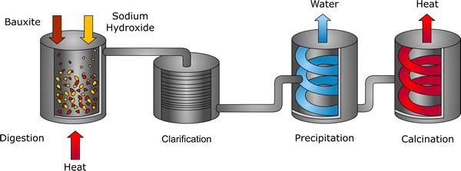
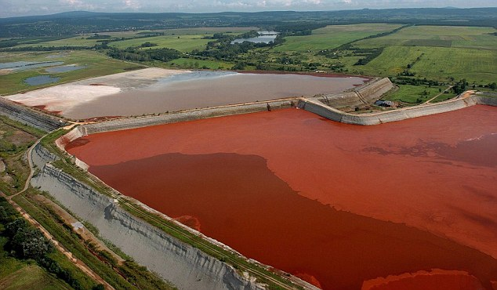
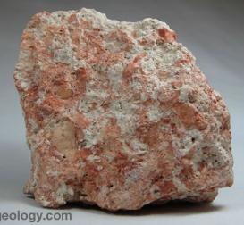
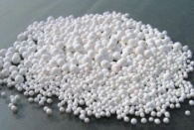
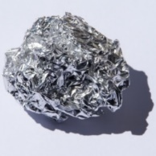
Example: Neutralization of Red Mud through generation of biofuels
The Bayer Process (Karl Bayer, 1887)
Bayer Process: industrial process that refines bauxite, raw aluminum ore, into aluminum oxide, or alumina.
NaOH, 170 – 180 °C
1 – 6 atm
Sodium aluminate
Na⁺ Al(OH)₄⁻
Red Mud
Precipitation
Element | Composition
Fe₂O₃ | 30-60wt%
Al₂O₃ | 10-20wt%
SiO₂ | 3-50wt%
Na₂O | 2-10wt%
CaO | 2-8wt%
TiO₂ | trace-25wt%
K, Cr, V, Ni, Ba, Cu, Mn, Pb, Zn, Sc | Traces
Bauxites
(4 – 5 tonne)
Alumina
Al₂O₃
(~2 tonne)
Red mud
toxic sludge (highly basic pH=14)
byproduct of Bayer process
1 ton of Al₂O₃ => 1/3 to 2 tons of red mud.
Electrolytic Reduction
Aluminum
(~1 tonne)
Source: http://www.aluminiumleader.com/production/aluminum_production
Notes:
http://www.aluminiumleader.com/production/aluminum_production/

Slide 26
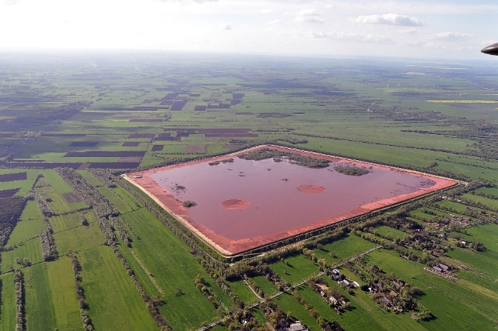
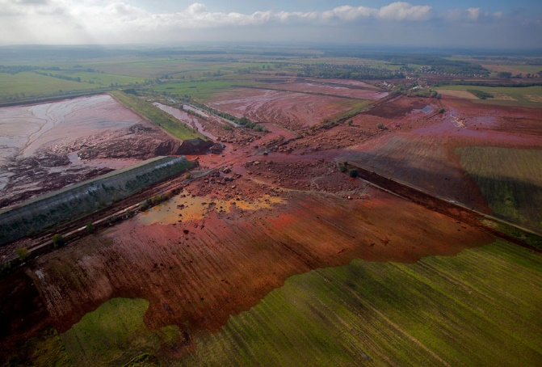
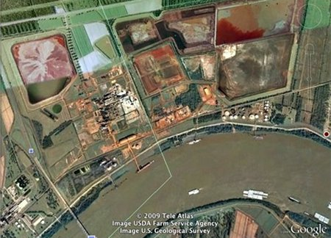
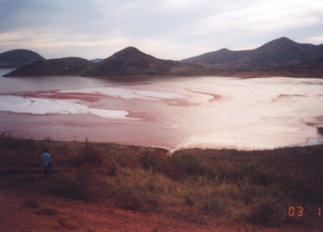
Red Mud: Pollution and Accidents
The red mud is kept in reservoirs
Oct. 4, 2010: A hungarian village, Kolontar, is flooded with toxic red mud.
one million cubic metres of red mud
Ten people died, and 150 people were injured
About 40 square kilometres (15 sq mi) of land affected
3 days later the spill reached the Danude
The base is strong enough to kill plant and animal life, and to cause burns and damage to airways if the fumes are breathed.
Stade, Germany
Kolontar, Hungary
Noranda Alumina plant at Gramercy - located alongside the Mississippi River
Damandjodi, India
Notes:
http://www.theguardian.com/environment/2014/jan/08/devecser-hungary-eco-town
http://www.theatlantic.com/photo/2011/09/a-flood-of-red-sludge-one-year-later/100158/
http://lacoastpost.com/blog/?p=13160
http://redmud.org/red-mud/disposal/

Slide 27

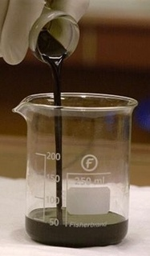
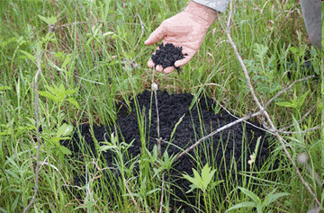
Example: Neutralization of Red Mud through generation of biofuels
Pyrolysis of biomass
Pyrolysis of biomass (500°C) affords a mixture of solid, liquid and gas carbonaceous materials
See class on renewable feedstock
CO/H₂/CO₂
Gas (10-20 %)
→ Energy
500°C
Further treatments are needed for fuel production => highly acidic (pH 2)
Bio-crude (60-75%)
→ Fuel
Bio-coal (15-20 %)
→ Soil improvement
Notes:
http://www.aluminiumleader.com/production/aluminum_production/

Slide 28
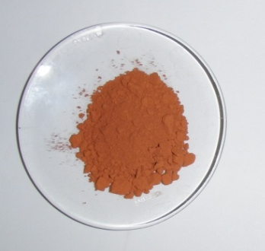
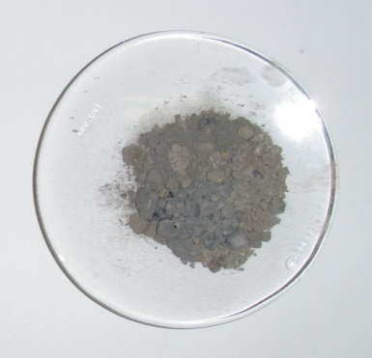
Example: Neutralization of Red Mud through generation of biofuels
Prof. Marcel Schlaf, University of Guelph mixed the two waste streams
Neutralization takes place by mixing the waste streams together
Metals present in the red mud catalyze the reduction of the biofuels to obtain higher quality fuel
H₂
Bio-crude: biowaste
Red mud: industrial waste
Neutral, magnetic powder could be used to make cement.
Fuel
pH 2
pH 14
C source
Source of metals for catalytic reduction
Karimi, E.; Gomez, A.; Kycia, S. W.; Schlaf, M. Energy & Fuels 2010, 24, 2747.

Slide 29

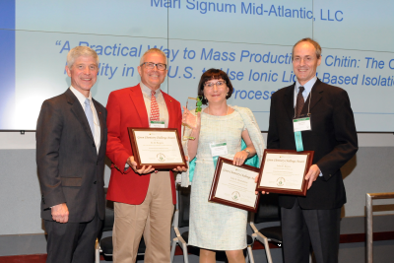

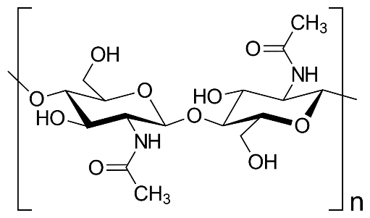
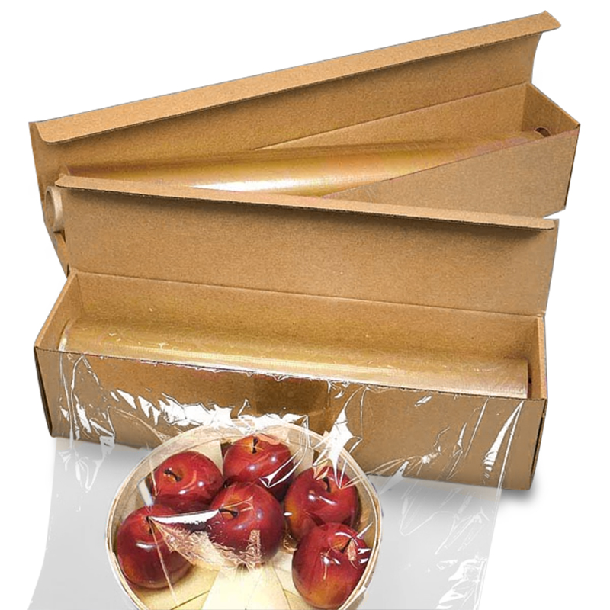
Example: Extracting chitin with an ionic liquid
Robin Rogers and Mari Signum Mid-Atlantic, LLC, are commercializing a safe, environmentally friendly, low energy-demanding and overall less costly process to produce chitin from seafood waste. Chitin is used in a variety of applications, such as food processing, biodegradable plastics and biomedical applications. This zero-discharge process produces a very high-grade and pure chitin, making use of and monetizing this seafood processing waste.
Dr. Connelly (ACS), Robin Rogers, Julia Shamshina and John Keyes (awardees)
Ionic liquid
chitin
https://communities.acs.org/community/science/sustainability/green-chemistry-nexus-blog/blog/2018/10/18/american-chemical-society-announces-2018-green-chemistry-challenge-award-winners
Notes:
Conventional process to manufacture Chitin – Demineralization of Shells using HCl in huge quantity of water, then treating demineralized shells with NaOH solution to extract all the proteins. The Chitin/deproteinized shells are removed & dried. Huge quantity of HCl and NaOH containing wastes. Chitin obtained still not of very high purity.

Slide 30
Biodegrade the Waste
Biodegradation - "A process by which microbial organisms transform or alter (through metabolic or enzymatic action) the structure of chemicals introduced into the environment." – US EPA, 2009
“Ready” biodegradability – remove 70% of dissolved organic carbon AND achieve 60% theoretical oxygen demand or CO₂ production within a 10-day window in a 28-day test. – OECD
“Ultimate” biodegradability – 60-70% of organic carbon converted to CO₂ within 28 days.

Slide 31
Aerobic Versus Anaerobic Digestion
Difference in oxygen supply, organism types, and products formed.

Slide 32
Aerobic Digestion
Bacteria consume organic matter.
Needs a constant supply of oxygen, pH adjustments, and mixing.
Byproducts: heat, CO₂, and H₂O.
Frequently used by water treatment plants or in composting.

Slide 33
Anaerobic Digestion
Bacteria consume organic matter in the absence of oxygen.
Common in fermentation and landfill; produces biogas consisting of methane, ammonia, hydrogen sulfide.
Biogas is considered a renewable energy.

Slide 34
Digestion versus Chemical Structure
Not all chemicals will biodegrade at the same rate (think plastic vs paper).
The rate of biodegradation depends on the microorganism, but also a chemical structure of the molecule.
Some parts of the molecule are known to be more biodegradable than the others.
There is a publically available software that analyses the chemical structure and predicts whether the molecule will degrade slower (days) or slower (months, years).

Slide 35
Some chemical structures favor biodegradation
Tertiary amine
Aromatic NO2
Aliphatic ether
Pyridine
Aromatic Cl
Aliphatic Cl
Aromatic Br
ketone
nitrile
Aromatic ether
phenyl
Aromatic OH
Aliphatic OH
Aromatic acid
Aliphatic Acid
Aldehyde
Ester
Poorly degraded
Favors biodegradation
OH
Linear chains
Cyclo
Esters
- Low molecular weight
Disfavors biodegradation
- High molecular weight
Halogens (F, Cl)
Tertiary carbon
Side chains and branching
Ethers
Readily degraded

Slide 36
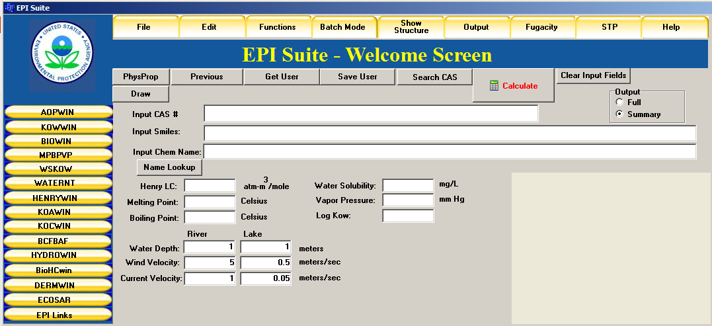
Predicting Biodegradation: EPA, EPISuite
EPI = Estimation Programs Interface http://www.epa.gov/oppt/exposure/pubs/episuitedl.htm

Slide 37
BIOWIN Models Based on Molecular Fragment Contributions
Aerobic degradation models
Anaerobic degradation model
The program analyses the chemical structure of each molecule within the group, and assesses its biodegradation potential based on the molecule fragment and functional groups. The result is presented as a probability for degradation. If the number is greater or equal to 0.5, then the molecule will degrade faster. In contrast, values less than 0.5 indicate persistence and low biodegradation potential.

Slide 38
Ring structures
1.
Increasing number of rings & molecular weight
2.
Favors biodegradation
- OH
- Low molecular weight
Disfavors biodegradation
- High molecular weight
- Cl
3.
4.
5.
Notes:
Increasing number of rings

Slide 39
Ring structures
1.
Aerobic: 0.4468
Anaerobic: -0.1909
Increasing number of rings & molecular weight
2.
Aerobic: 0.0677
Anaerobic: -0.3091
Favors biodegradation
- OH
- Low molecular weight
Disfavors biodegradation
- High molecular weight
- Cl
3.
Aerobic: 0.0213
Anaerobic: -0.4999
Most biodegradable (aerobic)
Least biodegradable
4.
Aerobic: 0.0102
Anaerobic: 0.9093
1>2>4>3>5
Aerobic: 0.000
Anaerobic: -2.9547
Most biodegradable (anaerobic)
Least biodegradable
5.
4>1>2>3>5
Notes:
Increasing number of rings

Slide 40
Bisphenol A derivatives
1.
Bisphenol A derivatives: Halogenated and BPS
2.
Favors biodegradation
- Low molecular weight
Disfavors biodegradation
- High molecular weight
Tertiary carbon
Halogens, but Cl better than F
3.
4.
5.
6.

Slide 41
Bisphenol A derivatives
1.
Aerobic: 0.1559
Anaerobic: -0.2593
Bisphenol A derivatives: Halogenated and BPS
2.
Aerobic: 0.000
Anaerobic: 0.1224
Favors biodegradation
- Low molecular weight
Disfavors biodegradation
- High molecular weight
Tertiary carbon
Halogens, but Cl better than F
3.
Aerobic: 0.0009
Anaerobic: -1.4867
Poor biodegradation due to high MW
Aerobic: 0.0051
Anaerobic: 0.1224
4.
Most biodegradable (aerobic)
Least biodegradable
1>6>3>4>2>5
5.
Aerobic: 0.000
Anaerobic: 0.1224
Most biodegradable (anaerobic)
Least biodegradable
6.
Aerobic: 0.0594
Anaerobic: 0.2341
6>2>4=5>3>1

Slide 42
Plasticizers
Different plasticizers
Linear and branched;
Two green plasticizers: Reduced ring to cyclo and isosorbide ring
1.
2.
Favors biodegradation
Linear chains
Saturated cyclo
Esters
Disfavors biodegradation
Side chains and branching
Ethers
arenes
3.
4.
5.

Slide 43
Plasticizers
Different plasticizers
Linear and branched;
Two green plasticizers: Reduced ring to cyclo and isosorbide ring
1.
Aerobic: 0.9355
Anaerobic: 0.3673
2.
Aerobic: 0.6892
Anaerobic: -0.2275
Favors biodegradation
Linear chains
Saturated cyclo
Esters
Disfavors biodegradation
Side chains and branching
Ethers
arenes
3.
Aerobic: 0.3258
Anaerobic: -1.2826
Most biodegradable (aerobic)
Least biodegradable
4.
1>4>2>3>5
Aerobic: 0.6960
Anaerobic: -0.2469
Most biodegradable (anaerobic)
Least biodegradable
5.
1>5>2>4>3
Aerobic: 0.2626
Anaerobic: 0.1410

Slide 44
Explosives
1.
Explosives (TNT, nitroglycerine)
2.
Favors biodegradation
Small molecular weight
OH
Disfavors biodegradation
CH₃
Large MW
NNO₂CH₃
3.
4.
5.

Slide 45
Explosives
1.
Aerobic: 0.0000
Anaerobic: -0.3687
Explosives (TNT, nitroglycerine)
2.
Aerobic: 0.000
Anaerobic: 0.0837
Favors biodegradation
Small molecular weight
OH
Disfavors biodegradation
CH₃
Large MW
NNO₂CH₃
3.
Aerobic: 0.000
Anaerobic: -0.0765
Most biodegradable (aerobic)
Least biodegradable
4>5>1=2=3
4.
Aerobic: 0.0366
Anaerobic: 0.7222
Degrades faster due to small MW
Most biodegradable (anaerobic)
Least biodegradable
4>5>2>1>3
5.
Aerobic: 0.0112
Anaerobic: 0.6058

Slide 47
Design for Biodegradation?
Since we know the chemical moieties, functional groups, and types of bonds which make the molecule biodegradable, can we build-in biodegradability into chemical products?
YES!

Slide 48
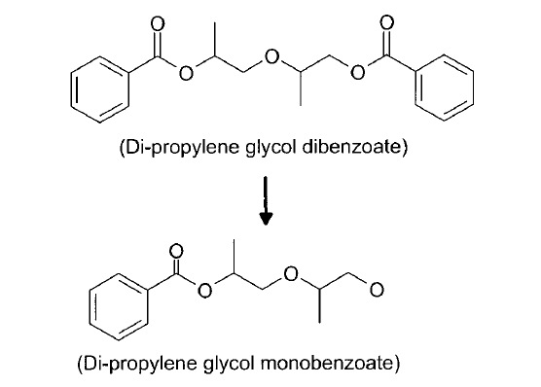
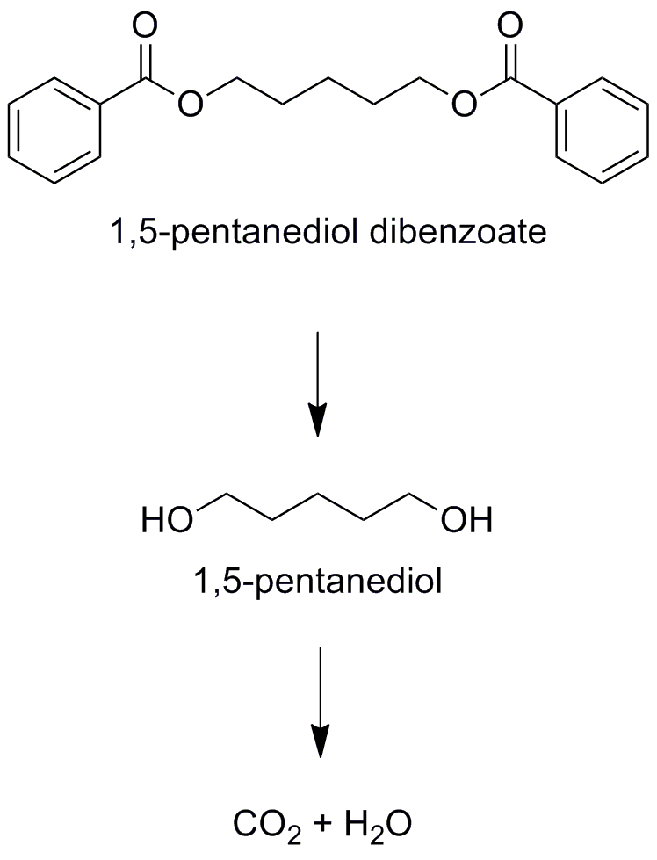
Example: Plasticizers
kills bacteria,
biodegradation halts
Plasticizers are additives in plastic applications. Almost 90% of plasticizers are used in PVC, giving this material improved flexibility and durability.
Di-propylene glycol dibenzoate decomposes into a product which is toxic to bacteria, and therefore stops the biodegradation process.
With slightly changed structure, 1,5-pentanediol dibenzoate biodegrades into CO₂ and H₂O
complete degradation to CO₂ + H₂O

Slide 49
Example: Pesticides
DDT – Dichlorodiphenyltrichloroethane, which was used as agricultural pesticide, is persistent in the environment.
Not only does it bioaccumulates, but it undergoes a reaction to DDE which is even more toxic than DDT.
DDT
DDE
Slow degradation
Methoxychlor shares many insecticidal properties as DDT and it’s potency, but it is not persistent.
It degrades into methoxychlor phenol, which has also low toxicity and it is easily excreted.
Fast degradation
methoxychlor
Methoxychlor phenol

Slide 50
Example: Detergents
Low biodegradation
Tetrapropylene alkylbenzene sulfonate (TPPS) was used as a surfactant for laundry detergents and accumulated into the water supply due to incomplete degradation.
Water tended to foam when coming out of the tap.
High biodegradation
TPPS was replaced by linear alkylbenzene sulfonate (LAS).
Replacing the methyl branched chain of TPPS by a linear carbon chain reduces the biopersistence.

Slide 51
Example: Antibacterial Products
Triclosan is an antibacterial and antifungal agent found in some consumer products, including toothpaste, soaps, detergents, toys, and surgical cleaning treatments.
It persists in the environment.
Low biodegradation
Chlorophene is a bacteriocide and fungicide in cosmetics.
It is very biodegradable in the media and entirely removeable from the wastewater.
High biodegradation

Slide 52
Topics Covered
Approaches to deal with Environmental Challenges
The Waste Treatment Pyramid
Reduced Solvent Use
Waste as a Feedstock
Biodegradation of Waste
Designing Processes to Include Biodegradation of Waste

Slide 53
Sponsored by Yale-UNIDO Initiative
QUESTIONS?
CENTER for GREEN CHEMISTRY
and GREEN ENGINEERING at YALE

