Slide 1
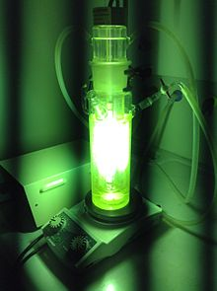
Yale-UNIDO Train-the-Facilitator Workshop in Green Chemistry
Energy delivery in Chemistry
CENTER for GREEN CHEMISTRY
and GREEN ENGINEERING at YALE
Source: wikipedia

Slide 2
Topics To Be Covered
Role of energy in a chemical process
Microwaves
Flow chemistry
Photochemistry
Electrochemistry
Mechanochemistry

Slide 3
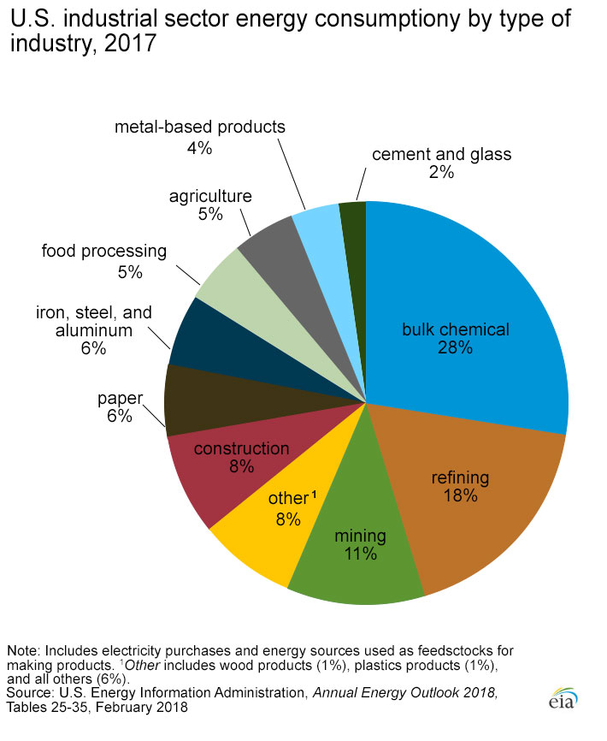
Use of energy in the chemical industry
Chemical industry energy use in the US
Chemistry accounts for a large portion of energy use
E.g. the Haber Bosch process alone (production of ammonia) represents 1% all al energy consumption in the world.
N. Notman, Haber-Bosch power consumption slashed, Chem. World, Oct 2012
https://www.eia.gov/energyexplained/index.php?page=us_energy_industry

Slide 4
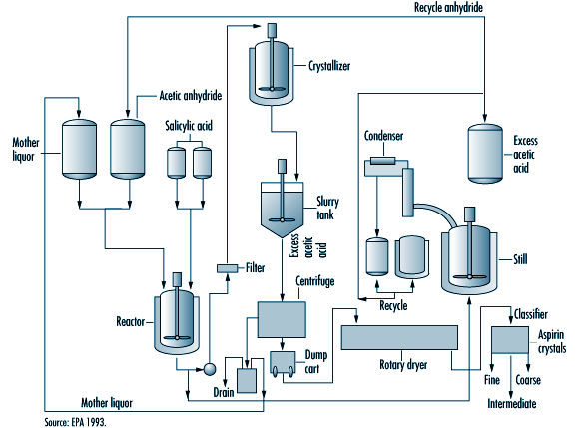
Use of energy in a chemical process
reaction heating (if endothermic)
reaction cooling (if exothermic)
agitation, pumping…
work-up
distillation
drying
filtrations
etc…

Slide 5
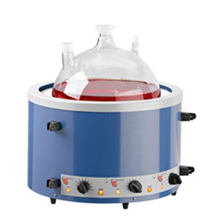
Use of energy: Activation reaction
Thermal heating
Delivered from natural gas or other fossil fuel
either using the heat of combustion directly or superheated steam.
in the lab: electricity with hot plates or mantles
http://www.medicalexpo.com/prod/electrothermal/product-80796-510114.html

Slide 6
Use of energy: Activation reaction
Thermal heating in batch: limitations:
Solvent needs to be heated to activate the molecules: it’s a loss of energy
Homogeneity issues: there is a gradient of temperatures in the batch
Heating of products after reaction… potential degradation
reacted
degraded

Slide 7
Use of energy: Activation reaction
Thermal heating in batch: limitations:
Solvent needs to be heated to heat the molecule: it’s a loss of energy
Green solution: a solventless processes
Advantage | Disadvantage
no solvent heating/distilling | high viscosity/solubility problems
easy separation | thermal runaway risk

Slide 8
Use of energy: Activation reaction
Thermal heating in batch: limitations:
Solvent needs to be heated to heat the molecule: it’s a loss of energy
Green solution: direct energy better towards the reaction and only the reaction.
• Microwaves (heats up only polar molecules)
• Sonochemistry (localized bursts of energy)
• Electrochemistry (electronic activation)
• Photochemistry (photonic activation)
• Mechanochemistry (to reaction solids together: no solvent heating)

Slide 9
Use of energy: Activation reaction
Thermal heating in batch: limitations:
Homogeneity issues:
Degradation issues:
Green solution: Flow chemistry
• The reaction can be heated only on a small volume (homogeneous)
• The reaction can be heated only when needed, avoiding overheating of products
reacted
degraded

Slide 10
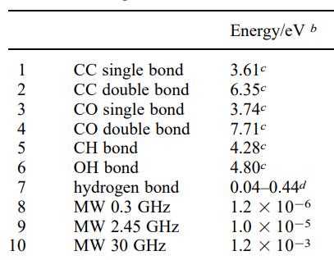
Microwave Heating: Mechanism
Principal mechanism for microwave heating: Dipolar Polarization Mechanism
Molecule must be polar
Alignment of the molecule with the electric field...
Molecule must be protic or viscous
water; ethanol
DMSO; DMF
CH₂Cl₂
Dipole realigns to the field, generating heat through molecular friction/dielectric loss...
Bad MW reaction solvents:
benzene, CCl₄ and ethers.
Dipole again realigns to the field, generating heat through molecular friction/dielectric loss... etc

Slide 11
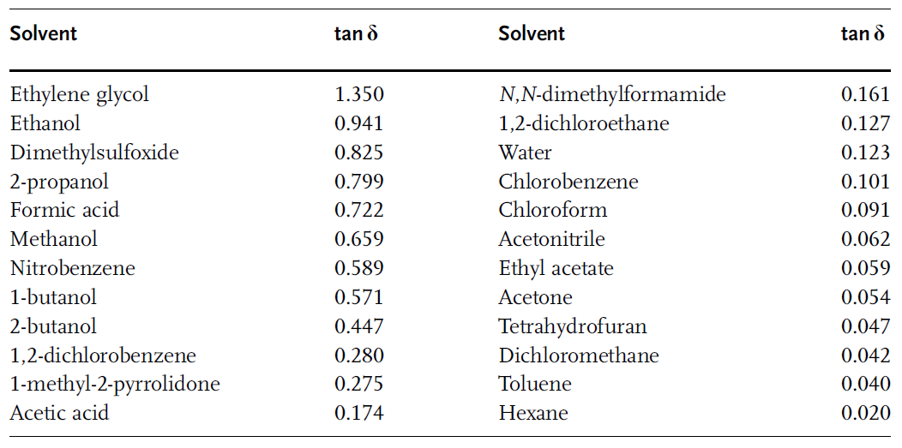
Solvents for MW Reactions
Solvents may be ranked for their microwave performance
the higher tan δ, the better the microwave heating

Slide 12
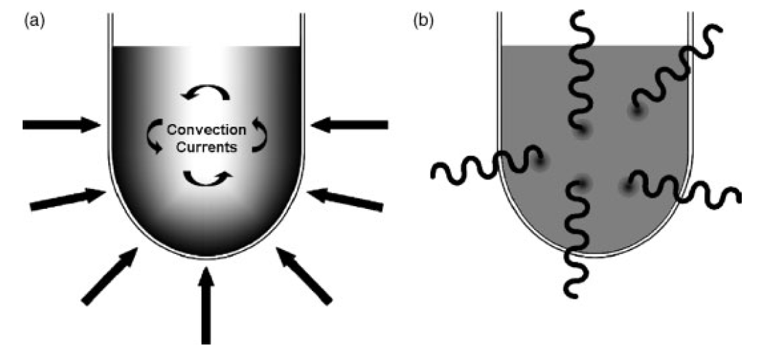
CHEM 462: 20. Energy input reduction (I)
MW Reactions
Advantages of microwave heating:
• Heating uniformity: (conduction, convection and radiation are secondary)
• Heating speed: Target temperature easier to reach fast, especially in small volumes
• Effect of super-heating: heating above the boiling point of the solvent
• Selective heating: polar molecules could be heated without solvent heating
• Ohmic heating for metals and magnetic materials: local extreme heatings
Notes:
Viscocity of water (1cP), methanol (0.59 cP), DCM (0.44 cP), ether (0.224 cP)

Slide 13
CHEM 462: 20. Energy input reduction (I)
Microwave: industry applications
Devulcanization of rubber (recycling process): advantageous because no solvent needed, good heat repartition
Dupont process for HCN production: gaseous reaction, so only the solid catalyst is heated. Locally, temperature is 1200°C!
Pt
Local Ohmic heating
Al₂O₃
Notes:
Viscocity of water (1cP), methanol (0.59 cP), DCM (0.44 cP), ether (0.224 cP)

Slide 14
Flow chemistry
Flow chemistry: Chemical method taking place in a flow tube. The chemical reaction is performed in a continuous fashion.
The volume in which the reaction takes place is small (a few mm³ to cm³)
=> it’s easy to monitor reactions and control conditions within this volume (temperature, pressure…)
Chem. Commun., 2011, 47, 4583–4592

Slide 15
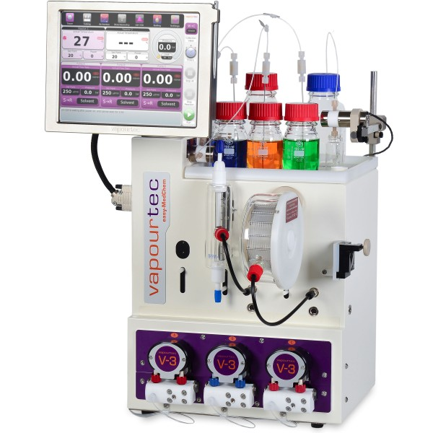
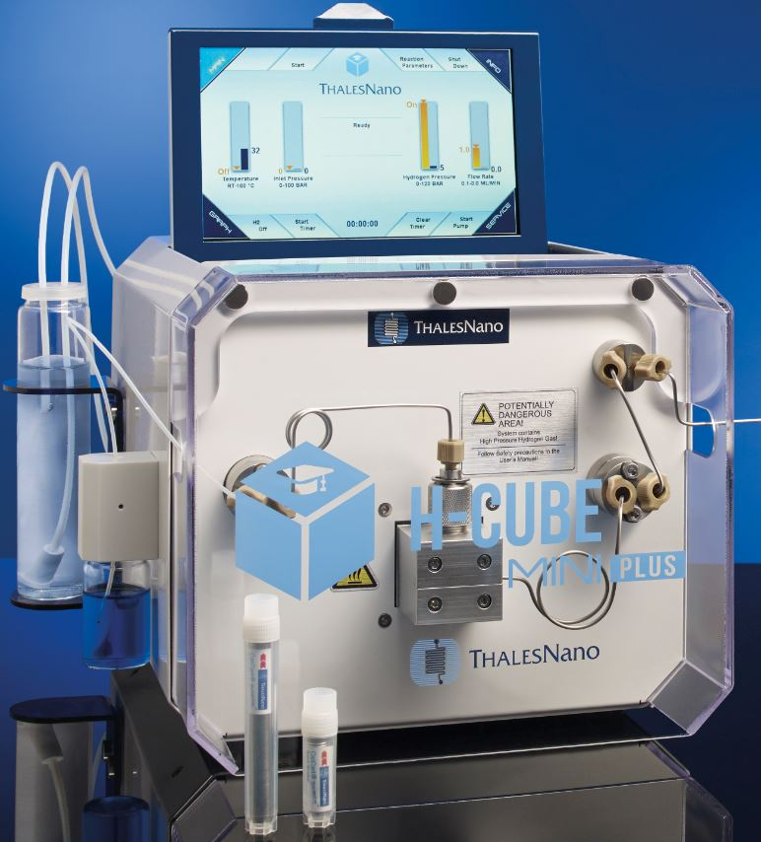
Flow chemistry
Advantages of flow methodology:
• reactions that can not be scaled up.
• good heat transfer
• mass transfers
• continuous production
• constant quality
• safety (reactive reagents, better control of dangerous reactions)
• easier scale-up
Can be combined with:
• Photochemistry
• Microwave
• Electrochemistry
In such systems, high pressure can take place in a very small volume => improved safety

Slide 16
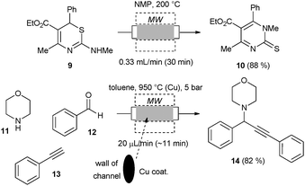
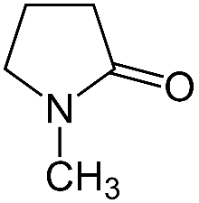
Flow chemistry/microwave
Combining flow with microwave heating
NMP
Example of an A³ coupling
(amine, aldehyde, alkyne)
Shore et al. Chem.–Eur. J. 2010, 16, 126.

Slide 17
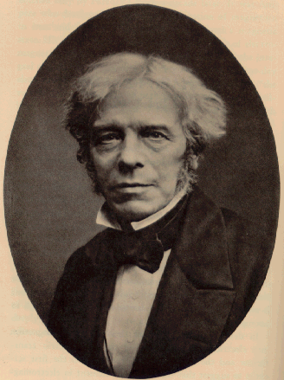
Electrochemistry: principles
• for electrolysis to occur, electrons must pass from the anode to the cathode through an external, electrical circuit interconnecting the two electrodes.
• there must be a mechanism for charge transport between the electrodes within the cell
There may or may not be a separator
Michael Faraday
Pletcher & Walsh “Organic electrosynthesis” in: Industrial Electrochemistry; Springer Netherlands: Dordrecht (1993) pp 294–330.

Slide 18
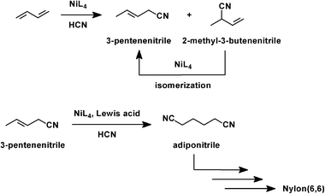
Electrochemistry: Applications
Industrial electroorganic synthesis: Monsanto hydrodimerization of acrylonitrile to adiponitrile
A precursor to the diamine used in the synthesis of Nylon-6,6.
400 000 metric tons of adiponitrile in 2014, or ∼30% of the adiponitrile market
competitive with the conventional route starting from butadiene.
Monsanto process
See: Pletcher & Walsh, Organic electrosynthesis. In Industrial Electrochemistry; Springer Netherlands: Dordrecht (1993); pp 294–330.
Dupont process

Slide 19
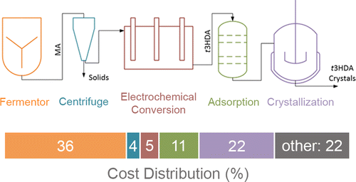
Electrochemistry: Applications
Merging electrochemistry with biocatalysis for muconic acid production
Electro step: 94% yield and 100% faradaic efficiency
Bioengineered Saccharomyces cerevisiae
bio
electro
Glucose
Matthiesen et al ACS Sustain. Chem. Eng. 2016, 4, 7098–7109

Slide 20
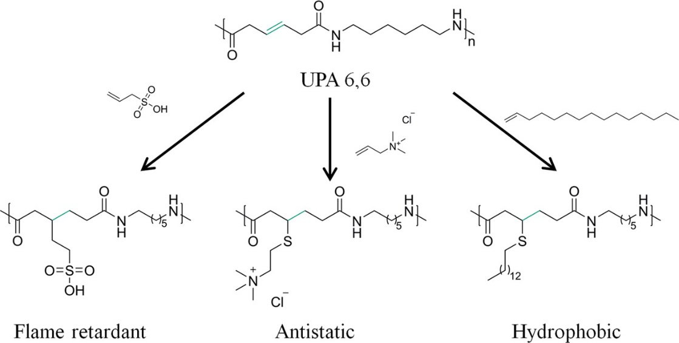
Electrochemistry: Applications
Specialty Nylon 6,6 for improved performance
Matthiesen et al ACS Sustain. Chem. Eng. 2016, 4, 7098–7109

Slide 21
Facilitating Chemical Reactions
Harvest sun light?
Use light to activate reactions?
catalyst

Slide 22
“On the arid lands there will spring up industrial colonies without smoke and without smokestacks; forests of glass tubes will extend over the plains and glass buildings will rise everywhere; inside of these will take place the photochemical processes that hitherto have been the guarded secret of the plants, but that will have been mastered by human industry which will know how to make them bear even more abundant fruit than nature, for nature is not in a hurry and mankind is. And if in a distant future the supply of coal becomes completely exhausted, civilization will not be checked by that, for life and civilization will continue as long as the sun shines.” (Sciences, 1912)
-Giacomo Luigi Ciamician

Slide 23
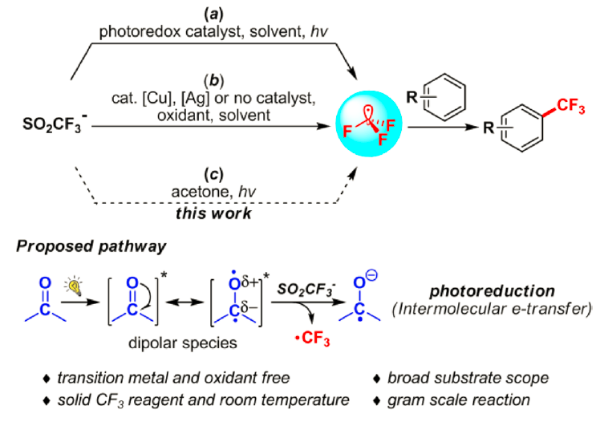
Approaches to the Generation of CF₃ Radicals from Sodium Triflinate
L. Li, X. Mu, W. Liu, Y. Wang, Z. Mi and C. -J. Li, J. Am. Chem. Soc., 2016, 138, 5809.

Slide 24
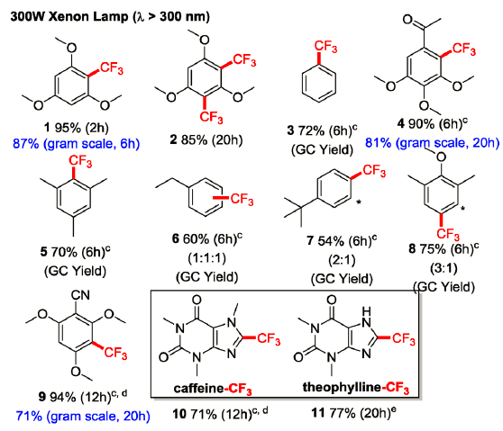
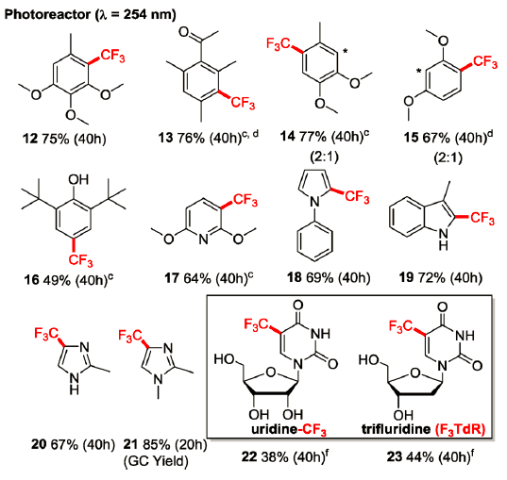
Substrate Scope (UV Light)
L. Li, X. Mu, W. Liu, Y. Wang, Z. Mi and C. -J. Li, J. Am. Chem. Soc., 2016, 138, 5809.

Slide 25
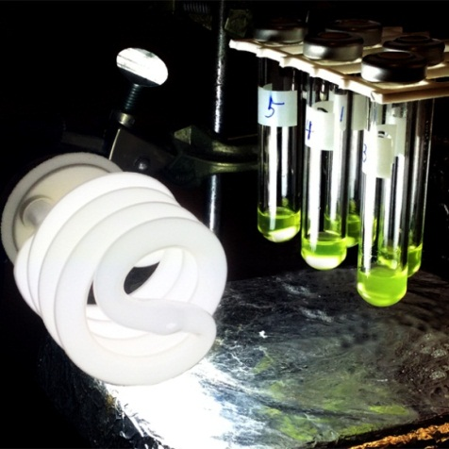
From UV to Visible Light
Control Experiment
L. Li, X. Mu, W. Liu, Y. Wang, Z. Mi and C. -J. Li, J. Am. Chem. Soc., 2016, 138, 5809.

Slide 26
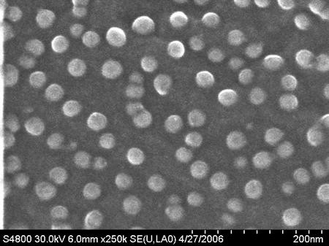
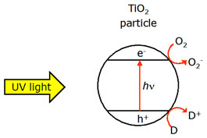
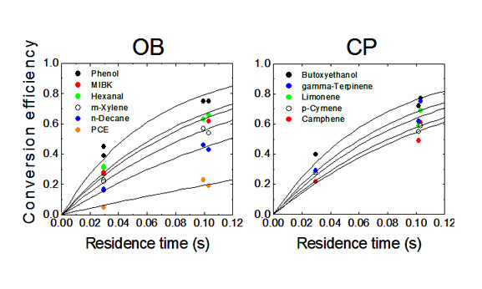
Photochemistry: application for depollution
Titanium dioxide nanoparticles
Nanoparticles of TiO₂ absorb visible light, resulting in electron-hole separation
Conduction electrons
Valence electrons
D here can be a pollutant

Slide 27
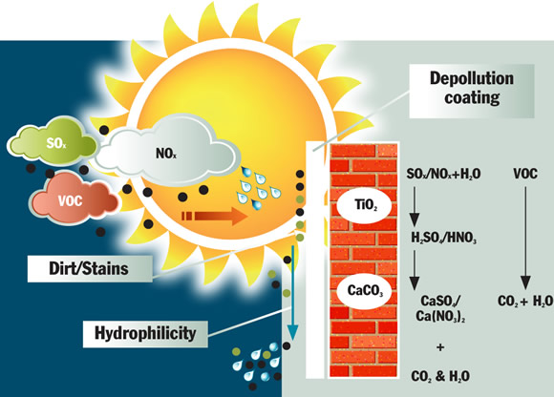
Photochemistry: application for depollution
Photoactive materials
http://cristalactiv.com/ourproducts/

Slide 28
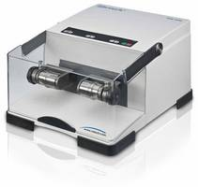
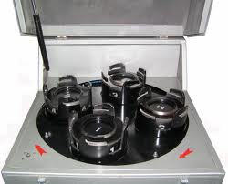
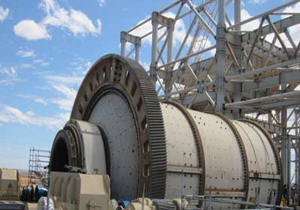
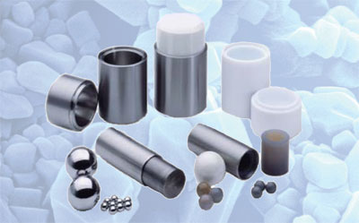
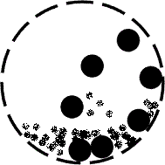
Mechanochemistry
Planetary Mill
Vibrational (Shaker) Mill

Slide 29
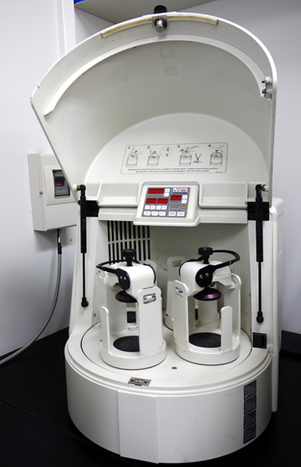
“shaker” or “mixer mill
planetary mill: a benchtop version of an industrial gravity-based mill

Slide 30
Michael Brand (University of Cardiff) & Jean-Louis Do (McGill University)

Slide 31
Topics Covered
Role of energy in a chemical process
Microwaves
Flow chemistry
Photochemistry
Electrochemistry
Mechanochemistry

Slide 32
Sponsored by Yale-UNIDO Initiative
QUESTIONS?
CENTER for GREEN CHEMISTRY
and GREEN ENGINEERING at YALE

