Slide 1
Introduction to Toxicology
Lecture #21
Date:
Course #

Slide 2
Outline
Toxicology definition
Toxicity types
Factors affecting chemical toxicity
Toxicology and the periodic table

Slide 3
Outline
Toxicology definition
Toxicity types
Factors affecting chemical toxicity
Toxicology and the periodic table

Slide 4
Did you know?
Mercury is a naturally occurring heavy metal. Methylmercury , the most common organic mercury compound, can be formed in water and soil by bacteria. It builds up in the tissues of fish. Exposure to high levels of mercury and mercury compounds can cause death or permanently damage the brain and kidneys.
In the late 1950s, people living around Japan's Minamata Bay developed symptoms of severe methylmercury poisoning, some of whom died. Children exposed in utero were born with disabilities. Investigations showed that heavily contaminated sludge from a factory had been released into the bay, contaminating fish and shellfish. People who ate the fish and shellfish became ill. The events led to a better understanding of industrial pollution and how heavy metals can accumulate in systems.
In January 2013 the Minamata Convention on Mercury global treaty was agreed to by an intergovernmental committee. It seeks to protect human health and the environment from the adverse effects of mercury.
Toxicologyschools.com
Toxtutor.nml.nih.gov

Slide 5
What is Toxicology?
The traditional definition of toxicology is "the science of poisons“.
A more descriptive definition of toxicology is
"the study of the adverse effects of chemicals or physical agents on living organisms".

Slide 6
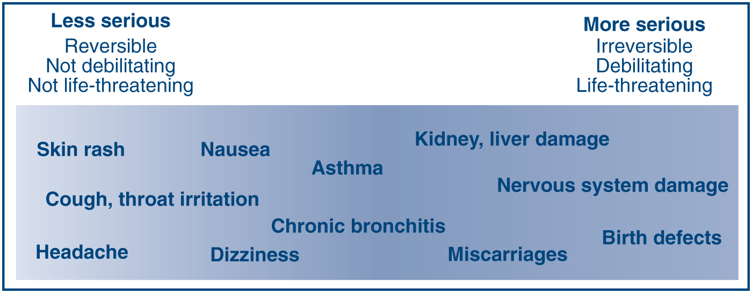
What Counts as Toxic?
Mihelcic, J. R.; Zimmerman, J. B., Environmental engineering: Fundamentals, sustainability, design. Wiley Global Education: 2014.

Slide 7
Outline
Toxicology definition
Toxicity types
Factors affecting chemical toxicity
Toxicology and the periodic table

Slide 8
Definitions
A toxic agent is anything that can produce an adverse biological effect.
It may be chemical, physical, or biological in form.
For example, toxic agents may be
chemical (such as cyanide)
physical (such as radiation)
biological (such as snake venom)

Slide 9
Definitions
Toxins
Peptides or proteins produced by living organisms
Venoms are toxins injected by a bite or sting
Poisons
Toxins produced by organisms
This mushroom contains a neurotoxin.
Black Widow spiders produce a poison that is a toxin.
Toxicologyschools.com
Toxtutor.nml.nih.gov

Slide 10
Definitions
Systemic Toxicant
Affects the entire body
Example: potassium cyanide affects every cell and organ
Organ Toxicant
Affects only specific tissue
Example: Benzene affects blood forming tissues; lead affects CNS and kidneys
Toxicologyschools.com
Toxtutor.nml.nih.gov
Systemic toxicant and organ toxicant (Image Source: iStock Photos, ©)

Slide 11
Definitions
Acute toxicity
Chronic toxicity
Carcinogenicity
Developmental toxicity

Slide 12
Acute toxicity
Occurs immediately after exposure; acute exposure is a single dose or multiple doses within 24 hours.
Example – death by carbon monoxide poisoning
Toxicologyschools.com
Toxtutor.nml.nih.gov

Slide 13
Chronic toxicity
Cumulative damage to specific organ systems over months or years.
Example - Chronic bronchitis in long-term cigarette smokers; Pulmonary fibrosis in coal miners (black lung disease)
Toxicologyschools.com
Toxtutor.nml.nih.gov
Image source: wikicommons

Slide 14
Carcinogenicity
Abnormal cell growth resulting from mutation.
Example: colon cancer, breast cancer.
At least two stages are recognized: initiation in which a normal cell undergoes irreversible changes and promotion in which initiated cells are stimulated to progress to cancer. Chemicals can act as initiators or promoters.
Image source: wikicommons
Toxicologyschools.com
Toxtutor.nml.nih.gov

Slide 15
Developmental toxicity
Toxic effects on the embryo that may happen before or during pregnancy.
Example: class III antiarrhythmic drugs led to malformations and death in utero in rats
Toxicologyschools.com
Toxtutor.nml.nih.gov

Slide 16
Outline
Toxicology definition
Toxicity types
Factors affecting chemical toxicity
Toxicology and the periodic table

Slide 17
Factors affecting chemical toxicity
Form and inherent chemical activity
Dosage, especially dose-time relationship
Exposure route
Ability to be absorbed
Metabolism rate
Distribution within the body
Excretion rate
Presence of other chemicals
Species
Life stage
Gender
Toxicologyschools.com
Toxtutor.nml.nih.gov

Slide 18
Form and inherent chemical activity
Chromium Cr³⁺ is relatively nontoxic whereas Cr⁶⁺ causes skin and/or nasal corrosion and lung cancer.
Toxicologyschools.com
Toxtutor.nml.nih.gov
Image source: wikicommons

Slide 19
Dosage and dose-time relationship
All chemicals can be acute toxicants if sufficiently large doses are administered. Often the toxic mechanisms and target organs are different for acute and chronic toxicity.
Toxicant | Acute Toxicity | Chronic Toxic Effects
Ethanol | CNS depression | Liver cirrhosis
Arsenic | Gastrointestinal damage | Skin/liver cancer
Toxicologyschools.com
Toxtutor.nml.nih.gov

Slide 20
Exposure route
Some chemicals may be highly toxic by one route but not by others. Two major reasons are differences in absorption and distribution within the body. For example:
Ingested chemicals, when absorbed from the intestine, distribute first to the liver and may be immediately detoxified.
Inhaled toxicants immediately enter the general blood circulation and can distribute throughout the body prior to being detoxified by the liver.
Courtesy of Molecular Design Research Network and Dr. Karolina Mellor

Slide 21
Ability to be absorbed
Some chemicals are readily absorbed and others are poorly absorbed. For example, nearly all alcohols are readily absorbed when ingested, whereas there is virtually no absorption for most polymers. The rates and extent of absorption may vary greatly depending on the form of a chemical and the route of exposure to it. For example:
Ethanol is readily absorbed from the gastrointestinal tract but poorly absorbed through the skin.
Organic mercury is readily absorbed from the gastrointestinal tract; inorganic lead sulfate is not.
Toxicologyschools.com
Toxtutor.nml.nih.gov

Slide 22
Metabolism rate
Metabolism is a major factor in determining toxicity. The products of metabolism are known as metabolites. There are two types of metabolism:
Detoxification
Bioactivation
In detoxification, a xenobiotic is converted to a less toxic form. This is a natural defense mechanism of the organism. Generally, detoxification converts lipid-soluble compounds to polar compounds.
In bioactivation, a xenobiotic may be converted to more reactive or toxic forms.
Toxicologyschools.com
Toxtutor.nml.nih.gov
Notes:
Cytochrome P-450 (CYP450) is an example of an enzyme pathway used to metabolize drugs. In the elderly, CYP450 metabolism of drugs such as phenytoin and carbamazepine may be decreased. Therefore, the effect of those drugs may be less pronounced. CYP450 metabolism also can be inhibited by many drugs. Risk of toxicity may be increased if a CYP450 enzyme-inhibiting drug is given with one that depends on that pathway for metabolism.

Slide 23
Distribution within the body
The distribution of toxicants and toxic metabolites throughout the body ultimately determines the sites where toxicity occurs. A major determinant of whether a toxicant will damage cells is its lipid solubility.
If a toxicant is lipid-soluble, it readily penetrates cell membranes. Many toxicants are stored in the body. Fat tissue, liver, kidney, and bone are the most common storage sites. Blood serves as the main avenue for distribution. The lymph system also distributes some materials.
Toxicologyschools.com
Toxtutor.nml.nih.gov

Slide 24
Excretion rate
The kidney is the primary excretory organ, followed by the gastrointestinal tract, and the lungs (for gases). Xenobiotics may also be excreted in sweat, tears, and milk.
A large volume of blood serum is filtered through the kidney. Lipid-soluble toxicants are reabsorbed and concentrated in kidney cells. Impaired kidney function causes slower elimination of toxicants and increases their toxic potential.
Toxicologyschools.com
Toxtutor.nml.nih.gov

Slide 25
Presence of other chemicals
Humans are normally exposed to several chemicals at one time rather than to an individual chemical. Some examples are:
Hospital patients on average receive 6 drugs daily.
Home influenza treatment often consists of aspirin, antihistamines, and cough syrup taken simultaneously.
Drinking water may contain small amounts of pesticides, heavy metals, solvents, and other organic chemicals.
Air often contains mixtures of hundreds of chemicals such as automobile exhaust and cigarette smoke.
Gasoline vapor at service stations is a mixture of 40-50 chemicals.

Slide 26
Chemical interactions: synergism
Synergism can have serious health effects. With synergism, exposure to a chemical may drastically increase the effect of another chemical. Some examples are:
The combination of exposure to asbestos and cigarette smoke results in a significantly greater risk for lung cancer than the sum of the risks of each.
The hepatotoxicity of a combination of ethanol and carbon tetrachloride is much greater than the sum of the hepatotoxicity of each.
Toxicologyschools.com
Toxtutor.nml.nih.gov

Slide 27
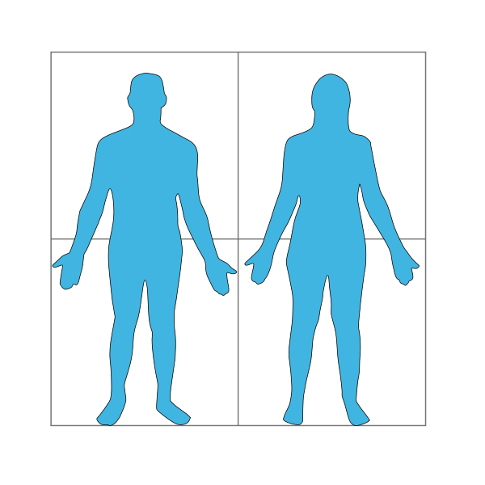
CDC, 2009 National Report on Human Exposure to Environmental Chemicals: tests the US population for 212 chemicals.
polybrominated diphenyl ether (flame retardant) found in nearly all participants
dieldrin
(pesticide)
found in >10% despite ban since 1970
hexachlorobenzene
(fungicide)
found in >50% despite ban since 1984
perfluorooctanoic acid
(teflon intermediate)
found in most participants

Slide 28
Chemical interactions: antagonism
Antagonism is often a desirable effect in toxicology and is the basis for most antidotes.
Drop in blood pressure resulting from a barbiturate overdose can be reversed by administration of vasopressor to increase a blood pressure.
Mercury toxicity can be reduced by binding the mercury ions with dimercaprol.
Swallowed poison can be absorbed by introducing a charcoal into the stomach.
Toxicologyschools.com
Toxtutor.nml.nih.gov

Slide 29
Chemical interactions: additivity
Additivity is the most common type of drug interaction. Examples of chemical or drug additivity reactions are:
Two central nervous system (CNS) depressants taken at the same time, a tranquilizer and alcohol, often cause depression equal to the sum of that caused by each drug.
Organophosphate insecticides interfere with nerve conduction. The toxicity of the combination of two organophosphate insecticides is equal to the sum of the toxicity of each.
Chlorinated insecticides and halogenated solvents both produce liver toxicity. The hepatotoxicity of an insecticide formulation containing both is equivalent to the sum of the hepatotoxicity of each.
Toxicologyschools.com
Toxtutor.nml.nih.gov

Slide 30
Species
Toxic responses can vary substantially depending on the species. Most differences between species are attributable to differences in metabolism. Others may be due to anatomical or physiological differences. For example:
An insecticide is lethal to insects but relatively nontoxic to animals.
Antibiotics are selectively toxic to microorganisms while virtually nontoxic to humans.
Toxicologyschools.com
Toxtutor.nml.nih.gov

Slide 31
Life stage
Some chemicals are more toxic to infants or the elderly than to young adults. For example:
Parathion is more toxic to young animals.
Nitrosamines are more carcinogenic to newborn or young animals.
Toxicologyschools.com
Toxtutor.nml.nih.gov

Slide 32
Gender
Physiologic differences between men and women, including differences in pharmacokinetics and pharmacodynamics, can affect drug activity.
For example:
Slower renal clearance in women, for example, may result in a need for dosage adjustment for drugs such as digoxin that are excreted via the kidneys.
Male rats are 10 times more sensitive than females to liver damage from DDT.
Female rats are twice as sensitive to parathion as are male rats.
Toxicologyschools.com
Toxtutor.nml.nih.gov

Slide 33
Relating Toxic Endpoints to Molecular Features
Acute toxicity | Carcinogenicity | Bioconcentration
Subchronic & chronic toxicity | Neurotoxicity | Degradation & transport
Reproductive toxicity | Immunotoxicity | Aquatic toxicity
Developmental toxicity | Genotoxicity | Terrestrial organism toxicity
Molecular weight | Molecular volume | Dipole moment
Hydrophilic surface area | Hydrophobic surface area | Rotatable bonds
Hydrogen bonds | Ionization potential | Electron affinity
Partition coefficients | Acid/base properties | Polarizability

Slide 34
Structure – Function Relationship
We can derive molecular features from the periodic table arrangement – i.e. from atomic number.
What does this mean?
Atomic and molecular structure determine function (physical and electronic characteristics) of the corresponding atom and molecule.

Slide 35
Outline
Toxicology definition
Toxicity types
Factors affecting chemical toxicity
Toxicology and the periodic table

Slide 36
Trend 1: Effective Nuclear Charge
Electrons closer to the nucleus shield other electrons from the protons’ attraction –
‘shielding electrons’.
The Effective Nuclear charge represents the actual nuclear charge minus the shielding constant.
Image Source: Wikipedia Commons
Notes:
Image Source: https://en.wikipedia.org/wiki/File:Carbon-atom.jpg

Slide 37
Trend 1: Effective Nuclear Charge
Increasing Effective Nuclear Charge
Increasing Effective Nuclear Charge
Image Source: sciencenotes.org

Slide 38
Trend 2: Atomic Radius
Increasing Atomic Radius
Increasing Atomic Radius
Image Source: sciencenotes.org
Notes:
Atomic radius determined mostly by how retained electrons are by the nucleus. – larger the effective nuclear charge, the more retained, smaller radius.

Slide 39
Trend 2: Atomic Radius
The larger the effective nuclear charge, the more retained the electrons will be to the nucleus (positive charge attracts negative charge) →
Everything is tighter – thus smaller.
Larger Effective Nuclear Charge = Smaller Atomic Radius
Why do we care?

Slide 40
Trend 3: Ionization Energy
Ionization Energy is the minimum energy required to remove an electron from a gaseous atom in its ground state.
Image Source: sciencenotes.org

Slide 41
Trend 3: Ionization Energy
Ionization Energy is the minimum energy required to remove an electron from a gaseous atom in its ground state.
Image Source: sciencenotes.org

Slide 42
Trend 4: Electronegativity
Electron Affinity is the energy change that occurs when an electron is gained by an atom.
Electronegativity is the tendency of an atom to attract electrons (that electron isn’t necessarily transferred).
Image Source: sciencenotes.org

Slide 43
Trend 5: Melting and Boiling Points
Melting Point: Temperature at which a substance goes from solid to liquid state.
Boiling Point: Temperature at which a substance goes from liquid to gaseous state.
These temperatures are determined by interatomic forces:
- Stronger Van der Waals forces = higher melting and boiling points

Slide 44
Trend 6: Volatility
Volatility: the tendency of a substance to vaporize.
Vapor Pressure: the pressure of a gas resulting from evaporation of a liquid.
Higher Vapor Pressure = higher volatility.
How is it related to boiling point?
Boiling point is the temperature at which vapor pressure equals atm. Pressure.
The lower the boiling point = the higher the vapor pressure = the higher the volatility.
Volatility has the opposite trend as boiling point.

Slide 45
Trend 7: Acidity
Acidity: the tendency of an anion to release a proton.
→ Higher electron affinity = higher withholding of electrons = better capacity to stabilize an anion = increasing acidity
→ Bigger atomic radius = higher polarizability = higher ability to delocalize negative charge = increasing acidity
Notes:
Higher electronegativity – higher withold of electrons – stabilitzation of anion – acidity increases
Atomic radius – delocolize negative charge – acidity increases.
Polarizability = ease with which electron cloud can be distorted.

Slide 46
Trend 7: Acidity
Acidity: the tendency of an anion to release a proton.
Basicity: the tendency of an anion to host a proton.
= exactly the opposite trend
Image Source: sciencenotes.org
Notes:
Higher electronegativity – higher withold of electrons – stabilitzation of anion – acidity increases
Atomic radius – delocolize negative charge – acidity increases.

Slide 47
Acidity (pKa)
How “willingly” does a molecule give up its H⁺
HA -------- > H⁺ + A⁻
Why is pKa important?
it tells you how good the molecule is at giving up its H⁺, which affects the pH of its surroundings.
Dissociating H⁺ means molecule changes from neutral state to ionic state, which changes the way it behaves in any biological system or chemical system.
Okay willingly
Very willingly
Because Cl⁻ can take the negative charge much better than ethoxy anion.
How much better? Measured by pKa

Slide 48
Acidity (pKa)
How “willingly” does a molecule give up its H⁺
HA -------- > H⁺ + A⁻
Ka
$$K_{a}=\frac{\left[H^{+}\right][A^{−}]}{[HA]}$$
If:
Ka is high, it means HA prefers to stay dissociated, it doesn’t mind giving up its H⁺, HA is very acidic.
Ka is low, it means HA prefers NOT to dissociate, it likes to hang on to its H⁺, HA is not really or not acidic.

Slide 49
Acidity (pKa)
How “willingly” does a molecule give up its H⁺
HA -------- > H⁺ + A⁻
Ka
$$K_{a}=\frac{\left[H^{+}\right][A^{−}]}{[HA]}$$
pK_{a} = -log(K_{a})
Molecule | Ka | pKa
HCl | 10000000 | -7
Acetic Acid | 1.73 x 10⁻⁵ | 4.76
Ethanol | 1.00 x 10⁻¹⁶ | 16
Toluene | 1.00 x 10⁻³⁵ | 35
Relatively Acidic
Relatively Not Acidic
Notes:
For Acetic Acid: HA = 0.99585, A⁻ = 0.004150, H⁺ = 0.004150

Slide 50
Relationship Between pKa and Skin Irritation – Class Exercise
A pKa of a chemical can be a promising indicator of penetration for human skin in vitro and correlate with erythema, edema, and color meter readings.
In Berner et al., researchers found that the severity of irritation from reduced sets of organic acids and bases in humans correlated with the acid and base strengths measured by pKa. Bases with a pKa >8 and acids with pKa ≤ 4 have significant has been previously reported; pKa appears highly predictive of acute skin irritation for acids and bases in man.
See Relationship Between pKa and Skin Irritation Activity
Notes:
In Vitro: performed or taking place in a test tube, culture dish, or elsewhere outside a living organism.
Erythema: superficial reddening of the skin, usually in patches, as a result of injury or irritation causing dilatation of the blood capillaries.
Edema: Swelling most common in the hands, arms, feet, ankles, and legs caused by excess fluid trapped in the body’s tissues.

Slide 51
Summary
Toxicology is the study of the adverse effects of chemicals or physical agents on living organisms
Toxicity types
Acute versus chronic; toxicity affecting a target organ or system
Factors affecting chemical toxicity: many factors to consider from age/race to ability for absorption and exposure
Toxicology and the periodic table

