Slide 1
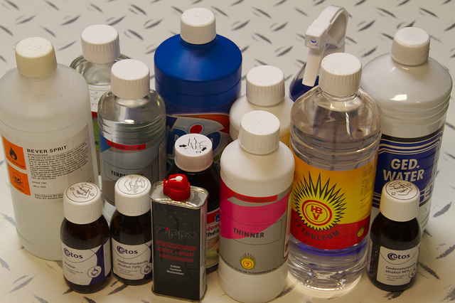
Yale-UNIDO Train-the-Facilitator Workshop in Green Chemistry
Solvents
CENTER for GREEN CHEMISTRY
and GREEN ENGINEERING at YALE
Image: Flikr, Solvents used during the Tamper Evident Seals Workshop, Author: Dennis van Zuijlekom

Slide 2
Safer Solvents and Auxiliaries
The use of auxiliary substances (solvents, separation agents, etc.) should be made unnecessary whenever possible and, when used, innocuous.
Image: thoughtco.com, Author: unknown

Slide 3
Topics To Be Covered
What are solvents and how are they used?
Conventional Solvents
Alternative Solvents
Solvent Selection
Solvent Replacement

Slide 4
What is a solvent?
A solvent is any substance that dissolves another substance(s) so that the resulting mixture is a homogenous solution.
Also conveys energy!
endothermic: brings energy to molecules
exothermic: heat sink

Slide 5
When are solvents used?
Solvents are used in all stages of a product life-cycle:
During manufacturing:
- To facilitate intermolecular chemical reactions via solute molecules & ions.
During processing:
- To aid in manipulation of chemicals, but not as an integral part of the molecule itself.
During extraction/separation:
- To separate or purify the chemical products from co-products, byproducts and impurities.
During cleaning:
- To remove oil, grease and silica from mechanical parts.
During product formulation:
- To design a product and process (quantities, raw materials, mixture design and testing)

Slide 6
Uses of Solvent Liquids
Everything has been touched by a solvent.
Global Industrial Solvent Use: 40-60 million tons!
As a Solvent
Dissolution
Extraction
Degreasing
Inks, dyes, paints, coatings
Dilution, dispersal
Dry cleaning
As Something Else
Fuels
Feedstocks
Beverages
Antifreeze
Nail varnish remover
Pollutants
Source: Int. J. Mol. Sci. 2015, 16(8), 17101-17159

Slide 7
Waste in a “Typical” Pharmaceutical Synthesis

Slide 8
Life Cycle Analysis of a Pharmaceutical
Basis: 1 kg of active pharmaceutical ingredient (API).
Process studied has 7 stages.
26 API materials are directly used in the process.
These 26 API materials are made from 125 commercially available raw materials.
LCA includes:
Process:
Materials
Energy
Transportation
Treatment:
Wastewater treatment
Incineration
Landfill

Slide 9
Key Findings of the Life Cycle Analysis (LCA) of a Pharmaceutical
Solvent use (excluding incineration) is a major contributor to:
Energy (ca. 75%)
Resource utilization (about 80%)
Photochemical ozone creation potential (ca. 70%)
Greenhouse gases (about 50%)
Solvent-related energy use alone contributes to:
30% of the materials
70% of resource depletion
90% of the greenhouse gas emissions
Notes:
Photochemical Ozone Creation Potential measures the production of ozone from a VOC emission through computer modelling of a complex series of chemical reactions in the atmosphere.

Slide 10
Conventional Solvents
Volatile Organic Compounds
Chloroform, carbon tetrachloride, methylene chloride, perchloroethylene (PERC)
Benzene, Toluene, Xylene (BTX)
Acetone, Ethylene Glycol, methylethyl ketone (MEK)
Notes:
VOCs have been linked to atmospheric ozone generation, commonly known as smog.
PERC is used in dry cleaning.
CFCs deplete an ozone layer which results in severe environmental effects

Slide 11
What are the concerns for solvents?
Inherent Toxicity
Methylene chloride, chloroform, carbon tetra chloride and other halogenated solvents are suspected human carcinogens.
Flammability
Because of their physicochemical properties (low flash point and autoignition temperatures), solvents are flammable.
Explosivity
They can explode, and since they are used in large volumes, the explosion can be disastrous.
Stratospheric Ozone Depletion
They reduce the ozone layer which protects the earth from the radiation.
Global Warming Potential
Notes:
In a typical chemical reactions, solvent accounts the majority of the reaction weight and therefore, post-processing solvent removal, which is typically achieved through distillation or vacuum evaporation (Video: solvent distillation) , is a very energy costly procedure for large scale synthesis. Moreover, products that are sensitive to impurities may requires extra cycles of distillations. This contributes to another (expensive) problem to deal with waste. Careless disposal of solvents are also known to pose great threat to the environment since many of which are toxic even at low concentration. To make matters worse, most organic solvents are volatile, possibly explosive and moderately toxic upon exposure, these qualities pose great concerns to any individuals who are involved in handling solvent.

Slide 12
What are the concerns for solvents?
Transportation emissions in the United States and Europe have declined rapidly
The use of volatile chemical products (VCPs)—including pesticides, coatings, printing inks, adhesives, cleaning agents, and personal care products—now constitutes half of fossil fuel VOC emissions in industrialized cities.
Total VOC emission factors for end uses of petrochemical sources considered in his study, including from mobile sources and volatile chemical products.
McDonald et al., Science 2018 359, 760–764

Slide 13
The Need for Alternative Solvents
Play a major role in many areas of technology
Provide many opportunities for improvement of environmental aspects.
Represent a very large proportion of the volatile organic compounds (VOCs) released into the atmosphere.
$1B spent on environmental technology, much of which is end of pipe equipment and associated operating costs to clean up emissions and air.

Slide 14
Need for Alternative Solvents for Synthesis
Widely used throughout the chemical production:
Synthetic Chemistry
Reaction medium on laboratory and industrial scale.
Extensively used in work-up and purification (usually more than for reaction medium).
Analytical Chemistry
Sample extraction and preparation (Spectroscopy).
Chromatography mobile phase (HPLC, TLC etc.).
Separation, purification
Recrystallisation to purify compounds & prepare crystals suitable for analysis.
Extraction

Slide 15
Need for Alternative Solvents for Synthesis
Widely used throughout the chemical formulation:
Paints
Personal care
Adhesives
Pharmaceuticals

Slide 16
Current Approaches to Solvent Replacement
Not a simple problem – usually cannot simply replace one solvent with another.
Consider process as a whole, not just one aspect (solvents used in work-up and purification not just reaction medium).
Many aspects must be considered and their relative importance determined quantitatively (metrics).
Where does the solvent come from?
What is the process used to prepare the solvent never mind about its intended use?
Energy
Hazardous processes
Raw material
By-products

Slide 17
Strategies for Solvent Replacement
Avoid or minimise use of solvents from start of process.
Use less toxic solvents.
Use renewable solvents (ones not derived from petrochemicals).
Avoid VOC’s – solvents with low vapour pressure and/or high boiling points may be preferable as long as this does not lead to other complications.

Slide 18
Solvent Replacement in Synthetic Chemistry
It can be very difficult to replace solvents.
As reaction media:
Solvents have a substantial effect on a reaction, allowing a degree of control not possible in their absence.
Can effect:
Rates of reaction
Chemo-, regio- and stereoselectivity
Outcome of reaction – it may not work at all, or it may do something totally different!
If it can be exploited then it may give extra incentive for the adoption of the new technology

Slide 19
Solvent Replacement Example
Anti-retroviral drug - Darunavir
Reduction of Nitro group in to Amine (RNO2 RNH2)
Conventional Technology: Catalytic Hydrogenation using Pd/Cat (MeOH Solvent)
Newreka Reduction Technology (NRT): Solvent Choice MeOH v/s n-BuOH
Considerations | MeOH | n-BuOH
Reaction Rate (Productivity) | Slow | Fast
Solvent Quantity | Same | Same
Product Quality | Yellowish Filtrate | Colorless Filtrate
Yield | 95% | 95%
Energy Intensive (Distillation) | Less | More
Solvent Loss | High | Less
Solvent Cost | Less | High
Regulatory Approvals required | No | Yes
Handling, Safety, Environment,….. | ?? | ??
Source: Newreka

Slide 20
Solvent Selection Process by ACS and GSK
ACS and GlaxoKline released new guidelines for safer solvent use. These guides assist green chemists with some preliminary guidance in their solvent selection process by ranking the solvents based on their reactivity and reusability, and more importantly impacts on the environment and human health.
To identify candidates for experimental evaluation
Screen solvents based on:
reaction type
process requirements
reactant/product solubility
EHS
Evaluate experimentally.
Review the entire route/ process and look for synergies.
Refine experimentation.
American Chemical Society
GlaxoSmithKline
Notes:
Regulations on solvent handlings have been recognized in the green chemistry community. The act was initiated by the American Chemical Society (ACS) and GSK (GlaxoSmithKline) when they released their guidelines for safer solvent handlings. These guidelines were created based on the characterization of each solvent, and were validated experimentally. The selection was refined, and repeatedly match Environmental Health and Safety (EHS) standards. These guides assist green chemists with some preliminary guidance in their solvent selection process by ranking the solvents based on their reactivity and reusability, and more importantly impacts on the environment and human health.

Slide 21
Solvent Selection Parameters
Solvent Acceptability
reactivity
compatibility
product quality
process safety
vapor pressure
odor threshold
exposure limits
autoignition temperature
flash point
complexity (number and nature of different solvents used)
Green Chemistry Metrics
greenhouse gas potential
emissions on incineration
Log K_{ow}
aquatic toxicity
acidification
persistence
eutrophication
Total Organic Carbon (TOC)
oil equivalents
Mass
total solvent mass
mass productivity or reaction mass efficiency
Energy
recovery (boiling point, azeotropes)
heat of combustion
ease of drying

Slide 22
GSK solvent selection guide ranking
Solvent selection guide in practice. Each solvent is ranked from 1-10 and color-coded for convenience (1 being the worst, 10 being the best). Ranking is across 6 different categories, which include waste production, environmental impact, human health, hazard, reactivity and life cycle.
This effort took several years and it is still ongoing.
http://solventguide.gsk.com/

Slide 23
Notes:
Another view of the solvent selection guide: Green and yellow indicate a preferred solvent. Red suggests major heath or environmental issues.

Slide 24
Suggesting a replacement
Solvent | Issues | Alternatives
Pentane | Lower flash point than other similar solvents | Heptane
Diethyl ether | Lower flash point than other similar solvents | 2-MeTHF, TBME
Diisopropyl ether | Powerful peroxide formation compared to similar solvents | 2-MeTHF, TBME
Hexane(s) | More toxic than other similar solvents | Heptane
Benzene | Carcinogen | Toluene
Chloroform | Carcinogen | DCM
1,2-DCE | Carcinogen | DCM
1,2-DME | Carcinogen | 2-MeTHF, TBME
Pyridine | Carcinogenicity (not classifiable) | Triethylamine (base)
1,4-Dioxane | Carcinogenicity (not classifiable) | 2-MeTHF, TBME
DCM | Emissions | Application dependant
Carbon tetrachloride | Emissions | DCM
DMF | Reproductive toxicity | Acetonitrile
DMAc | Reproductive toxicity | Acetonitrile
NMP | Reproductive toxicity | Acetonitrile
Byrne, F. P.; Jin, S.; Paggiola, G.; Petchey, T. H. M.; Clark, J. H.; Farmer, T. J.; Hunt, A. J.; Robert McElroy, C.; Sherwood, J. Sustain. Chem. Process. 2016, 4 (1), 7.
Notes:
TBME: tBu Me ether
DCE: diclhoroethene
1,2-Dimethoxyethane
NMP:N-Methyl-2-pyrrolidone
DMAc: Dimethylacetamide CH₃C(O)N(CH₃)₂

Slide 25
Solvent Exercise: Solvent Ratings in 9 Criteria
Give ratings (Green Yellow or Red) in the 9 provided categories based on solvent physicochemical properties.
CATEGORY | RATING (RED-YELLOW-GREEN)
Incineration
Recycle
Biotreatability
VOC emmision
Environmental impact to water
Environmental impact to air
Health hazard
Exposure hazard
Safety hazard
Notes:
Goal: To give the participants an understanding of how the physicochemical and hazardous properties of solvents effect safety and environmental impact.
This activity uses published solvent selection guides generated by a major pharmaceutical company, which uses them to evaluate solvents used in their large-scale process chemistry. The company has rated each solvent according to nine criteria on a “red-yellow-green”/traffic light scale, based on the physicochemical and hazardous properties.

Slide 26
Solvent Exercise
SOLVENT 1
SOLVENT 2
Molecular weight | 60.05
Boiling point [°C] | 118 °C
Melting point [°C] | 17°C
Flash Point [°C] | 39°C
Auto Ignition Temperature [°C] | 426°C
Solubility [g/L] | miscable
Vapor Pressure [mm] | 15.5 mm
Percent Volatile | 100
Exposure Limits [ACGIH: TWA] | 10 ppm
Evaporation Rate | 0.97 BuAc
Toxicological data Oral Rat LD50: Skin Rabbit LD50: Inhalation Rat LC50: | 3.31 g/kg 1060 mg/kg 11.4 mg/L 4H
Ecotoxicology data EC50 Water flea (Daphnia magna): LC50 Bluegill (Lepomis macrochirus): | 65 mg/L 48 H 75 mg/L 96 H
Ozone creation potential | 16
Heat of combustion [Btu/lb] | 5645 Btu/lb
Persistence and Degradability: | biodegradable
Azeotropes | Multiple present
Molecular weight | 82.4
Boiling point [°C] | 81 °C
Melting point [°C] | 7 °C
Flash Point [°C] | -20 °C
Auto Ignition Temperature [°C] | 245
Solubility [g/L] | 0.06 g/L
Vapor Pressure [mm] | 98 mm
Percent Volatile | 100
Exposure Limits [ACGIH: TWA] | 300 ppm
Evaporation Rate | not known
Toxicological data Oral Rat LD50: | 12.705 g/kg
Ecotoxicology data EC50 algae | 3.8 mg/L
Ozone creation potential | 60
Heat of combustion [Btu/lb] | 18684 Btu/lb
Persistence and Degradability: | Slow biodegradation
Azeotropes | Some present
Notes:
Participants should be divided into groups of 4-5 and provided with the solvent cards for acetic acid and cyclohexene, without the names of the solvents and the “red-yellow-green” ratings left blank.
The solvent card would contain categories like:
1. Incineration
2. Recycle
3. VOC emmision
4. Environmental impact to water
5. Environmental impact to air
6. Health hazard
7. Exposure hazard
8. Safety hazard
The groups should be given approximately 20 minutes to discuss the chemical data provided on the cards and provide their own ratings in each of the eight categories. The solvent identities are left blank to avoid biasing the evaluation.
The debriefing will also take approximately 20 minutes. The groups will be asked to report which criteria received a green light and which criteria received a red light and the results will then be tabulated. Then the solvent identities and actual red-yellow-green ratings from the pharmaceutical industry scientists should be revealed. This is likely to result in some “what were they thinking?” comments from the participants.

Slide 27
Vapor Pressure (mm) - an indication of a liquid's evaporation rate; High vapor pressure = volatile
Solubility in Water (gm/L) – an indication if the solvent can be easily separated
Odor Threshold (ppm) - the lowest concentration of a certain odor compound that is perceivable by the human sense of smell; Strong odors = lower value
Log Kow - octanol/water partition coefficient (Kow) - ratio of a chemical's concentration in the octanol phase to its concentration in the aqueous phase; Higher log kow = more lipophilic
EC50 - concentration of a compound where 50% of its maximal effect (mortality) is observed; Low EC50 = more toxic
Ozone Creation Potential POCP - an indicator of the ability of a VOC to contribute to ozone formation. A measure of the reactivity of an organic compound with hydroxyl radicals & subsequent formation of ozone. High value = more potential
Exposure Limit 8hr TWA (ppm) – a legal limit for exposure of an employee to a chemical substance during 8 hours. Lower value = more harmful
Flash point - the lowest temperature at which vapors of a volatile material will ignite; Lower value = more flammable
Heat of Combustion - energy released as heat when a substance undergoes complete combustion with oxygen under standard conditions; High = easier to burn
Dielectric constant - A measure of a substance's ability to insulate charges from each other. Higher value = more insulation
Autoignition temperature - lowest temperature at which substance spontaneously ignites. Lower value = more flammable

Slide 28
Solvent 1- Acetic Acid
Solvent 2- Cyclohexane

Slide 29
Solvent Exercise
Acetic acid (glacial)
Used in chemical industry to produce photographic film, wood glue, and synthetic fibers.
Used in food industry as additive.
Demand: 6.5 million metric tons/year.
Cyclohexane
Used in chemical industry as precursor for nylon.
Known organic solvent.
Global cyclohexane market valued at $5.8 billion in 2013.
Notes:
Issues and answers:
1. How much the ratings change depending on the way the solvent is used in industry (i.e., compare a situation where a worker is cleaning the inside of a tank with a situation where solvent is part of an effluent that is being released into a river). The answer - a lot.
2. Is it possible that either of these solvents will ever receive all “green lights” in every category? The answer - almost certainly not. This can function as a segue into a discussion of alternative solvents being developed by green chemists.

Slide 30
Current approaches to solvent replacement in synthetic chemistry
“Solventless”
Water
Supercritical carbon dioxide
Ionic liquids
Each have advantages and disadvantages which need to be considered when assessing their suitability.

Slide 31
Solventless Conditions
Using neat conditions or solid state techniques.
Advantages:
Solvent concerns eliminated.
Solvent costs eliminated.
Lots of research on this field: it works!
Disadvantages:
Exothermic reactions can be dangerous on large scale
High viscosity
need close collaboration with chemical engineers to overcome above problems.
Efficient mixing can be a problem, particularly when have solid reagents or products.
Solvents still often required for extraction, separation and purification of products.
Reactions between solids… can be done by mechanochemistry

Slide 32
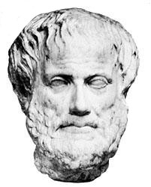
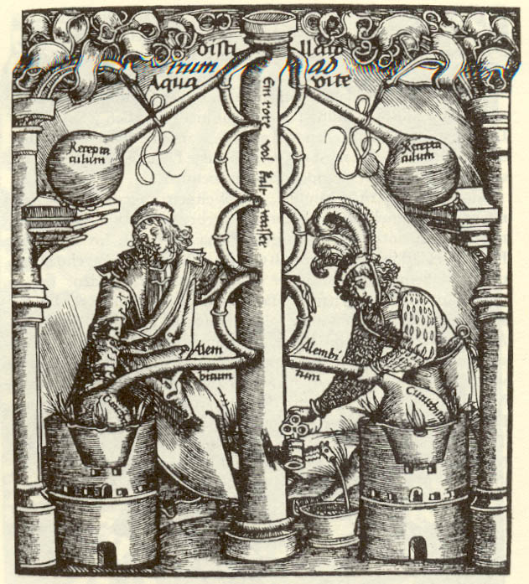
Aristotle (4th century B.C.E.)
“Nothing happens without a liquid”
The view that was adsorbed into alchemistry, reflected in the search for the “Universal Solvent – Alkahest”

Slide 33
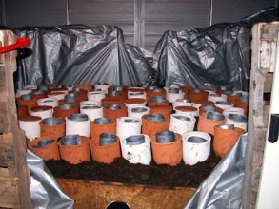
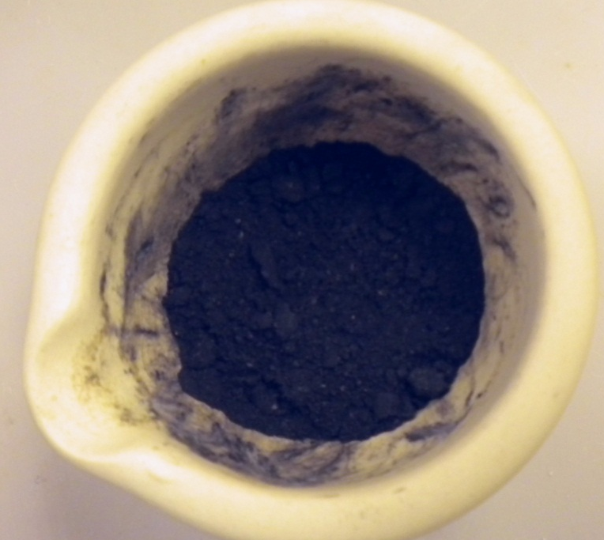
Inspiration from antiquity
Possibly the first documented extraction of a metal from its compound
The “Dutch method” for the synthesis of lead white – the fundamental white pigment until the 20th century
HgS(s) + Cu(s)
Hg(l) + CuS(s)
Theophrastus in his book On Stones
Plinius in Naturalis Historia (AD 77-79).
Described by Theophrastus in 4th century B.C.
Reaction proceeds despite the low solubility of HgS (K_{sp} = 10⁻⁵⁴), by grinding in the presence of acetic acid (vinegar)
Mild temperatures (heated by horse dung) and readily scalable
Avoids the need for high temperature and strong acids!
http://www.geoffreylaurence.com

Slide 34
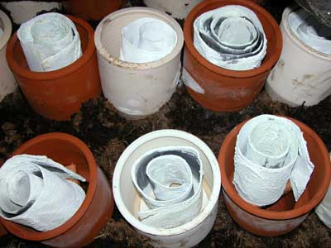
Inspiration from antiquity
Possibly the first documented extraction of a metal from its compound
The “Dutch method” for the synthesis of lead white – the fundamental white pigment until the 20th century
HgS(s) + Cu(s)
Hg(l) + CuS(s)
Theophrastus in his book On Stones
Plinius in Naturalis Historia (AD 77-79).
Described by Theophrastus in 4th century B.C.
Reaction proceeds despite the low solubility of HgS (K_{sp} = 10⁻⁵⁴), by grinding in the presence of acetic acid (vinegar)
Mild temperatures (heated by horse dung) and readily scalable
Avoids the need for high temperature and strong acids!
http://www.geoffreylaurence.com

Slide 35
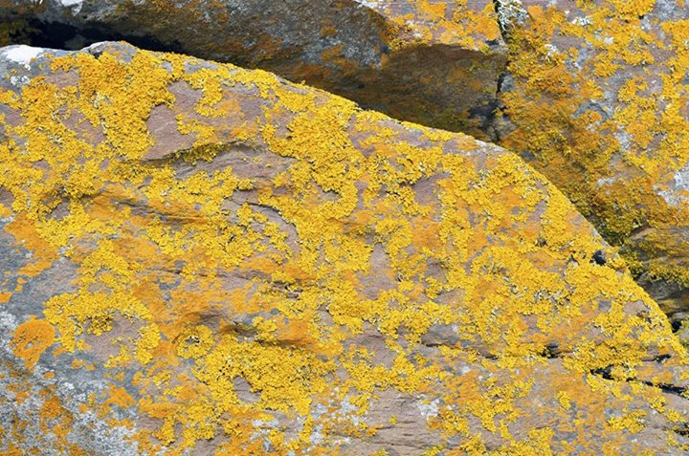
Lichens excrete molecules that bind metal ions - lichen acids. An example is oxalic acid which leads to the formation of secondary minerals (e.g. Moolooite - Cu^{II} oxalate)
see e.g. Echigo, Kimata, Canadian Mineralogist 2010, 48, 1329-1357
Qi et al. Green Chem. 2014, 16, 121

Slide 36
Aqueous Solvents
Water based solvents with generalized applications.
Advantages:
Innocuous.
Well characterized.
Versatility among applications.
One of the most obvious alternatives to VOCs.
Cheap, readily available, and plentiful
In some cases faster reaction (‘on water’ reactions)
Useful in biphasic processes in conjunction with other solvents.
Disadvantages:
Useful for certain types of reaction but limited because of:
Low solubility of organic substrates.
Compatibility with reagents.
Removal of water is energy intensive.
Clean up of aqueous waste difficult.
Notes:
Water, the most popular choice for nature, is undoubtedly the most benign solvent there is. It is easily accessible and cheap to employ, and has the lowest toxicity to the environment. Not only it is non-flammable and non-explosive, but it also has a high heat capacity. With addition of surfactants or other miscible organic co-solvent, water emerges as a new choice in chemical synthesis including oxidations, reductions, nucleophilic substitutions, and electrochemical synthesis. However, water is not perfect and its cons should be considered before it is used in large scale synthesis. Aside from its poor compatibility of organic molecules, distillation of water from reagent requires more demanding condition relatively to other solvents such as methanol. Removal of water, even in vacuum, is more energy intensive (thus less economically viable) than conventional organic solvent. Therefore each solvent selection or replacement needs to be discussed on a case-by-case basis. Replacement of organic solvents to water may be done at least for safety reasons

Slide 37
Synthesis of ziprasidone (Geodon®)
Ziprasidone is atypical anti-psychotic agent, which was not suitable for pilot plant scale-up. Initially, the two fragments were joined by alkylation in the presence of NaI and Na₂CO₃ in organic solvent, to produce ziprasidone in 20% yield. When water was used as the solvent to improve the solubility of the reagents, the yield increased to 90–94%.
Ziprasidone
Cue, B. W.; Zhang, J., Green process chemistry in the pharmaceutical industry. Green Chemistry Letters and Reviews 2009, 2 (4), 193-211.

Slide 38
Organic Reactions in Water
Developing designer surfactants that allow for chemical reactions in ‘nanomicelles’ in water.
Organic molecules are typically insoluble or unreactive in water, which is why toxic, flammable, petroleum-derived organic solvents are used.
Micelles have hydrophilic exteriors and hydrophobic interiors, allowing for the encapsulation (and reaction) of organic molecules in aqueous environments.
Using safe, nontoxic, and inexpensive chemicals, 50-100nm micelles can be formed in water that, by increasing effective concentration, also dramatically increase reaction rates without additional energy input.
This can be applied to several important C-C bond forming reactions.
Recycling of the surfactant is very efficient and the purity of the water being used is not very important.
Bruce Lipschultz
Image: Bruce H. Lipshutz (Wkipedia)

Slide 39
Organic Reactions in Water
Mannich-type reactions in water (Kobayashi group)
- This reaction is catalyzed by Lewis acids -> in the water phase
:
Colloidal Dispersion
Reagents are lipophilic -> inside micelles
The use of surfactant augments the interface between reagents
K. Manabe, Y. Mori, T. Wakabayashi, S. Nagayama, S. Kobayashi, J. Am. Chem. Soc. 2000, 122, 7202.

Slide 40
Supercritical Fluids: CO₂
Advantages:
Similar advantages to water
Natural, inert, non-flammable, cheap, plentiful.
Easily available commercially in > 99.9% pure form.
By-product of brewing, ammonia synthesis, combustion.
Already being adopted in a variety of commercial processes (see later).
Non-toxic and properties well understood.
Easily removed and recycled, and can be disposed of with no net increase in global CO₂.
Simple product isolation, by evaporation to 100% dryness.
No solvent effluent.
Potential for product processing (extraction, particle micronozation, chromatography, textile dyeing, etc.).
Small molecules (e.g., CO₂, H₂O) used under conditions of elevated pressure and temperature to form a fluid that is neither liquid nor gas.
Disadvantages:
High pressure required.
May have poor solvency for polar molecules.
May require Surfactants.
Notes:
scCO₂ is very attractive as a solvent because it can be removed easily by simply decreasing the pressure in the reaction vessels. This eliminates the need of solvent distillation, which is an energy intensive process, while leaving behind a product with high purity. Besides its’ non-toxic profile, scCO₂ is often readily available as an industrial by-product and can be obtained without burning fossil fuels. Several companies offer CO₂ recovery, and turn this industrial by-product into a profitable reagent. Such recovery is especially popular in breweries, distilleries, ammonia or ethylene oxide productions.

Slide 41
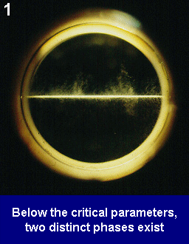
Supercritical Fluid
Moves like a gas and dissolves things like a liquid
CO₂ with a liquid phase: the temperature is below Tc and the pressure below/above Pc.
Pressure is raised: the density of the gas increases.
As temperature raised above Tc:
The gas and the liquid have compatible densities, they mix: one phase which contains a liquid dissolved in scCO₂.
http://www.nottingham.ac.uk/supercritical/scintro.html#further%20reading

Slide 42
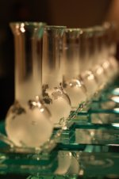
Brief History of SCFs
SCFs have been known for 100+ years, but it wasn’t until the 1980s that their full potential was realized.
Processes that have been operated for years:
High temperature and pressure free radical polymerization of ethene to produce low-density polyethene (LDPE).
The Haber process for ammonia manufacture (operates above the critical point of ammonia).
Presidential Green Chemistry Challenge Awards
Charles Eckert and Charles Liotta – Georgia Institute of Technology, 2004 – Benign Tunable Solvents Coupling Reaction and Separation Processes
Eric Beckman, University of Pittsburgh, 2002 – Design of Non-Fluorous, Highly CO₂-Soluble Materials
SC Fluids, Inc., 2002; SCORR – Supercritical CO₂ Resist Remover
Joseph DeSimone, University of North Carolina at Chapel Hill & North Carolina State University, 1997 – Design and Application of Surfactants for Carbon Dioxide

Slide 43
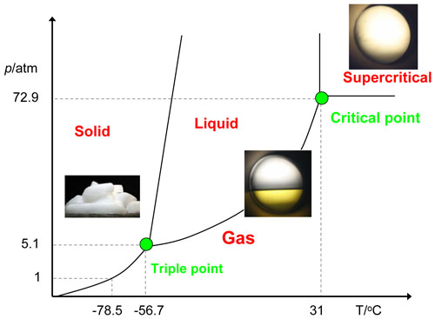
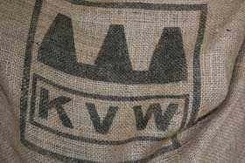
Supercritical carbon dioxide (scCO₂)
scCO₂ can be used for:
separation and purification of oils, flavours and medicinal components.
removal of greasy material.
conversion of azeotropic water-ethanol mixture to an anhydrous ethanol.
fractionation and purification of polymers.
Decaffeination of coffee:
Previously used solvents:
1) benzene: carcinogen
2) methylene chloride, another carcinogen and VOC. Kaffee Veredelungs Werk (KVW) process
Source: wikipedia

Slide 44
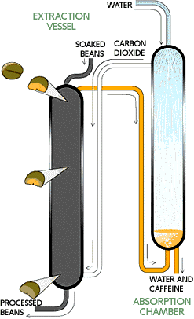
scCO₂ Decaffeination of Coffee
Invented by Kurt Zosel, Max Planck Institute
Zosel, K. Practical Applications of Material Separation with Supercritical Gases. Angew. Chem., Int. Ed. 1978, 17, 702-709.
1.SOAKING green coffee beans in water doubles their size, allowing the caffeine to dissolve into water inside the bean.
2. CAFFEINE REMOVAL occurs in an extraction vessel (70 feet high,10 feet in diameter), suffused with carbon dioxide at roughly 90 °C and 250 atm. Caffeine diffuses into this scCO₂. Beans enter at the top of the chamber and move toward the bottom over 5 hrs.
3. DECAFFEINATED BEANS at the bottom of the vessel are removed, dried and roasted.
4. RECOVERY of dissolved caffeine occurs in an absorption chamber. A shower of water droplets leaches the caffeine out of the supercritical carbon dioxide. The caffeine in this aqueous extract is then often sold to soft-drink manufacturers and drug companies. The purified carbon dioxide is recirculated for further use.
-- Scientific American, June 1997
FDA: CO₂ “not a solvent”

Slide 45
Dry Cleaning: PERC
The dry cleaning industry typically uses the solvent perchloroethylene (PERC), as the cleaning agent. Because clothes are cleaned in a liquid solution that is mostly PERC, and very little if any water is used, the term "dry cleaning" is used.
1998: 344 million lb of PERC was produced in the US. The dry cleaning industry uses approximately 50% of the PERC produced each year.
PERC is not flammable and thus offers a significant advantage over petroleum based cleaners.
Environmental and health impacts of PERC:
EPA classified “groundwater contaminant” and “potential human health hazard”.
Suspected human carcinogen.
Known rodent carcinogen.
Breathing PERC for short periods of time can adversely affect the central nervous system. Effects include dizziness, fatigue, headaches, sweating, loss of coordination and unconsciousness.
Smog formation

Slide 46
Dry Cleaning: scCO₂
Developed by Micell Technologies (Joseph DeSimone, UNC-Chapel Hill).
60 lb garments in rotating basket in MICO₂TM, door closed, vacuum applied
CO₂ pressurized, Liquid CO₂ & MicareTM detergent added to form wash fluid
Clothes are agitated, wash fluid is circulated out, filtered to remove fibers etc
Wash fluid is passed through carbon filter, portion distilled to remove excess dirt & detergent
CO₂ gas is removed from wash tank using a compressor & sent for recycle
Notes:
Approximately 60 pounds of garments are placed inside a large rotating basket in the MICO₂™ machine and the door is closed, sealing the system. Vacuum is applied to remove the majority of the air in the system and CO₂ gas is added to pressurize the wash tank.
Liquid CO₂ is then added from the storage tank along with the Micare™ detergent system in order to form the wash fluid.
The clothes are agitated (delicate, normal, and heavy cycles). Similar to perc drycleaning machines, the wash fluid is circulated out of the wash tank through a lint filter to capture loose fibers and vestige lint. It then passes through a carbon filter and returns to the wash tank. At this point, the wash cycle is complete.
The wash fluid is pumped out of the wash tank to the storage tank. The excess wash fluid left clinging to the garments is further removed by a spin extract cycle. A portion of the wash fluid is then cleaned via a distillation process that removes excess dirt and detergent. The residue from the distillation process is automatically eliminated from the machine and collected for shipment back to Micell for recycling. Carbon dioxide gas is removed from the wash tank using a compressor and the gas is sent back to the storage tank for reuse. The Micare™ system is able to efficiently convert CO₂ from a gas to a liquid, thereby permitting 98 percent of the CO₂ to be recycled. A nominal amount (10 lbs) of CO₂ gas is then vented to the atmosphere. After a cycle time of 35 to 45 minutes, the cleaned garments are removed from the wash tank.

Slide 47
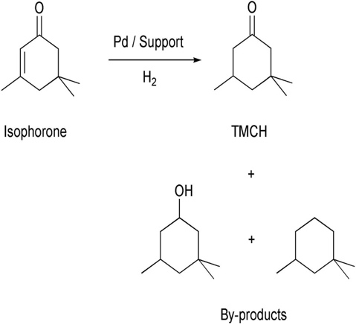
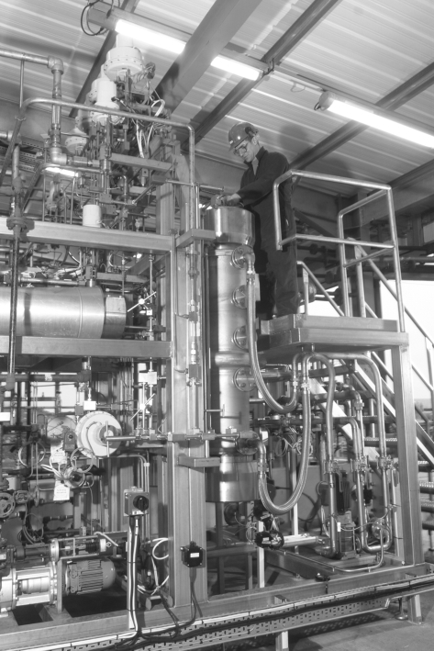
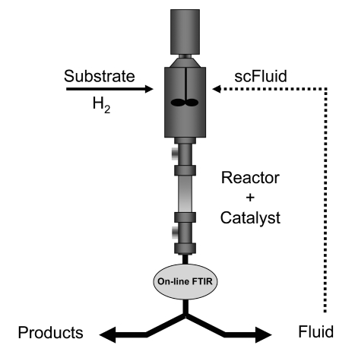
Chemical Reactions in scCO₂
Trimethyl Cyclohexanone (TMCH): Used in paints, coatings, synthesis of small molecules (e.g. pharmaceuticals, vitamin A).
Prof. Martyn Poliakoff of U. of Nottingham and Thomas Swan & Co.
> 99.4% selectivity for TMCH (attributed to biphasic conditions).
Isophorone can be used at up to 48%. concentration (higher conc. = lower pressure, lower energy costs).
No need for downstream purification.
In 2002 a SCF plant for continuous synthesis with capacity of up to 1000 tonnes per year (produces 100 kg/hr)
Side products
Licence, P.; Ke, J.; Sokolova, M.; Ross, S. K.; Poliakoff, M. Chemical Reactions in Supercritical Carbon Dioxide: From Laboratory to Commercial Plant. Green Chem. 2003, 5, 99-104.

Slide 48
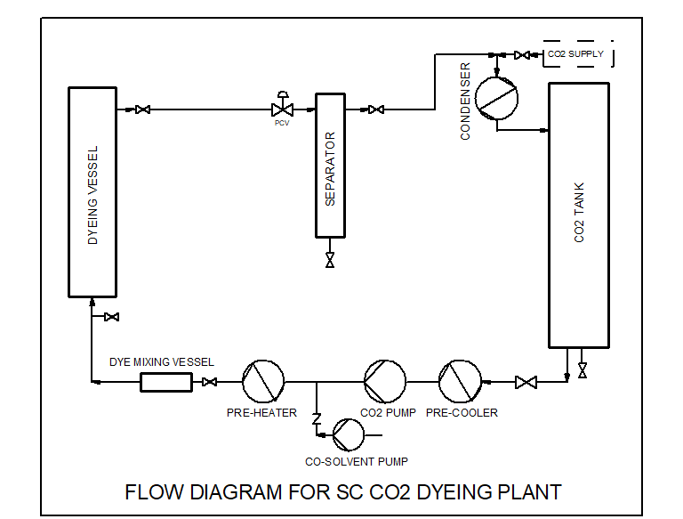
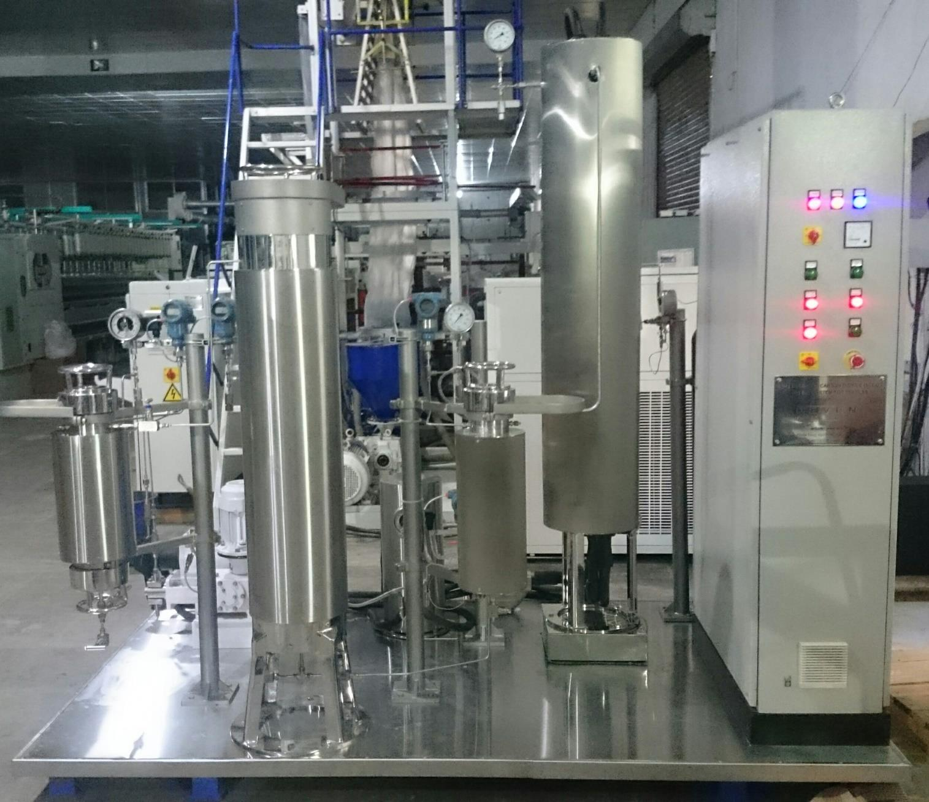
Textile Dyeing with scCO₂ (waterless Dyeing)
More Efficient Process Developed and Patented by Dr. Swapneshu Baser, Deven Supercriticals Pvt. Ltd., India
Process:
Dissolution of Dye in SC CO₂
Swelling of Textile Material by SC CO₂
Efficient Diffusion of Dye in Textile Matrix
Depressurise to Entrap Dye in Textile Matrix
Advantages:
No Water Usage
Zero Discharge process
No ETP requirement
Re-use of unused Dye collected in Separator
Lower overall cost of Dyeing

Slide 49
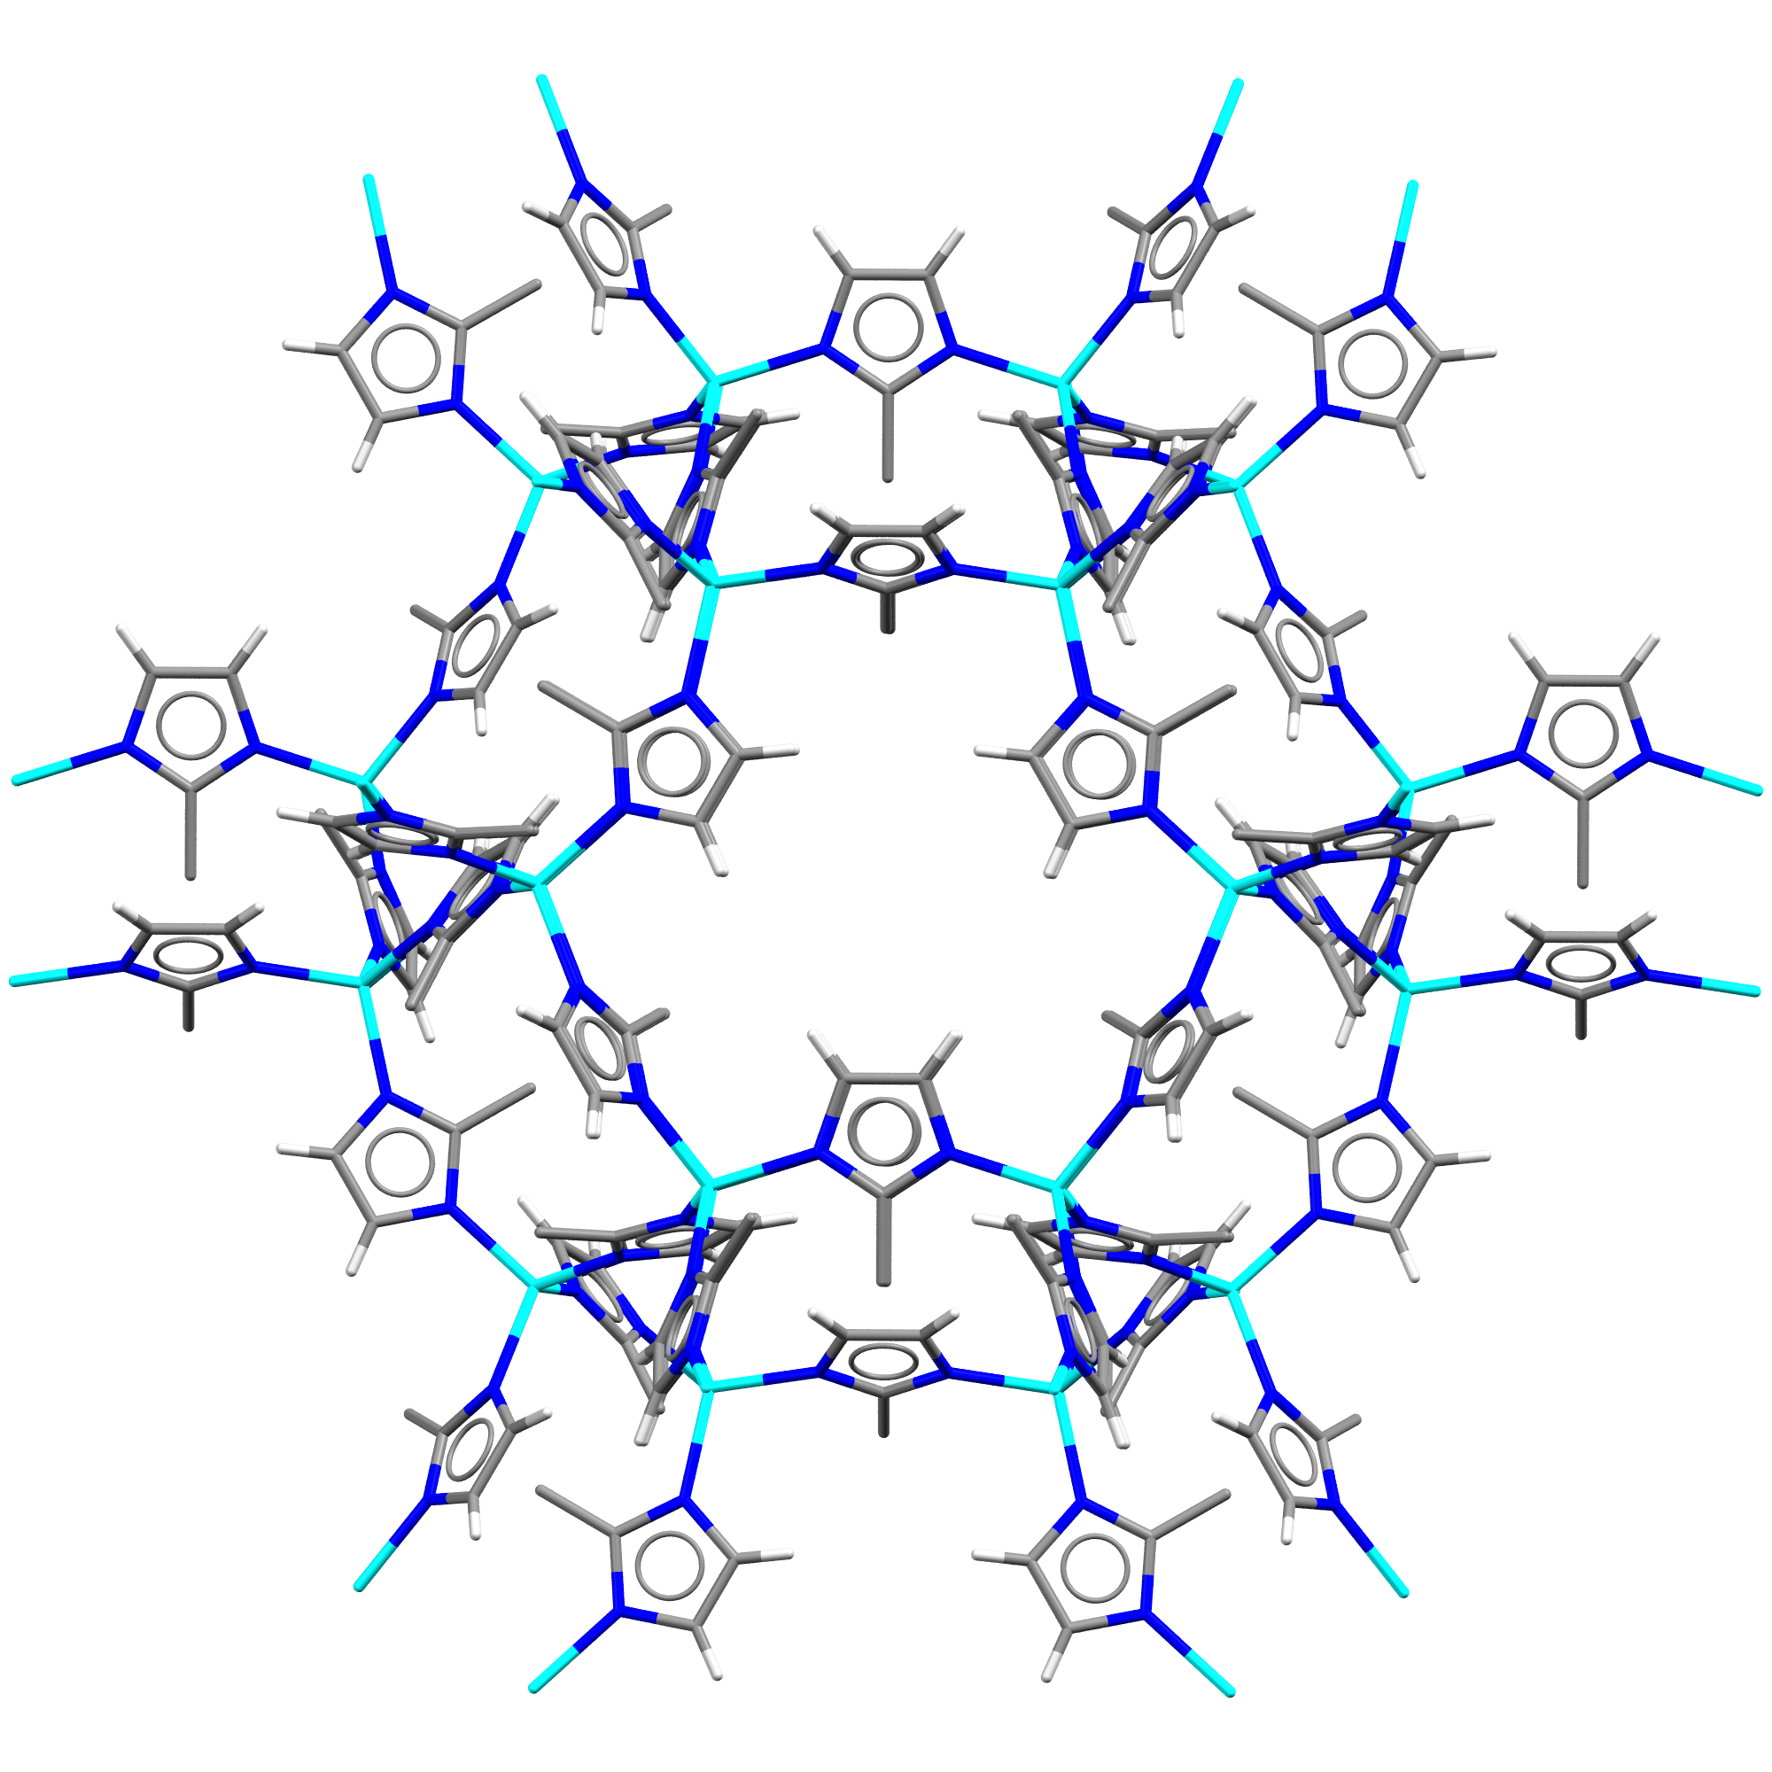
CleanTech business on sustainable manufacturing of new functional materials: Metal-Organic Frameworks
ACSYNAM
ACSNAM Team
http://www.acsynam.com/about/
www.acsynam.com

Slide 50
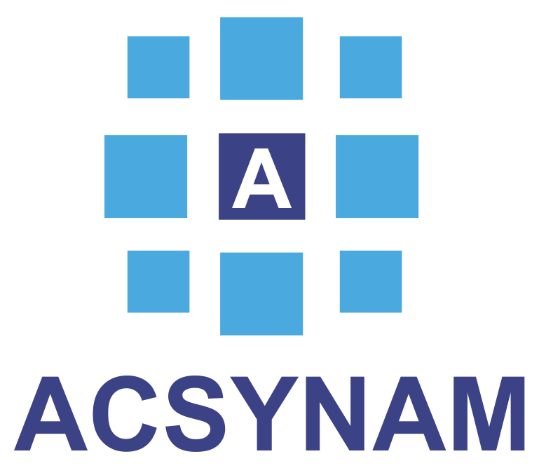
Fast and Environmentally-friendly Metal-Organic Framework (MOF) synthesis
CO₂ out
~250 g batch
Reaction chamber
CO₂ in
Marrett et al., Crystal Growth & Design 2018, 18, 3222;
US Patent US20180043330A1
Starting material is ZnO – a mineral-like inorganic substance!
Reaction times from 5 min to 1 hour, despite insolubility of inorganic oxides

Slide 51
Limitation of using scCO₂
High pressures required:
Standard HPLC apparatus used in lab, reactors made of stainless steel, many commercially available.
Higher initial investment for large scale work.
Weak solvent:
Relatively non-polar, with high quadrupole moment.
For polar molecules, require use of co-solvents (MeOH, MeCN, THF, toluene).
Simple modification of reagents to improve solubility.
Energy considerations:
Compression, Liquification of CO₂ requires energy.
Energy consumption reduced minimal decompression and recycling.
Reacts in the presence of good nucleophiles:
Often reversible, can be exploited synthetically.

Slide 52
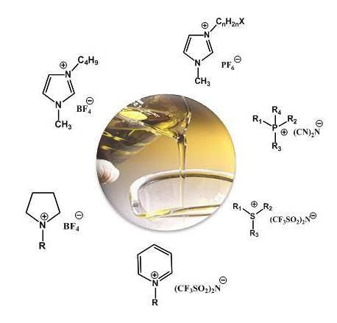
Ionic Liquids
A salt: A cation and an anion
It has to be liquid below 100°C
Wide chemical variability => adapted to applications
http://www.rtil.eu/pmwiki/pmwiki.php/About/IonicLiquids

Slide 53
Ionic Liquids
Charged substance mixtures that form a liquid at ambient temperatures.
“Salts whose crystal structure has been perturbed so they are a liquid at room temperature.”
Advantages:
Very low vapour pressure – attractive alternative to VOCs.
Good solvents for a wide range of organic, inorganic and polymeric compounds.
Anion and cation can be fine tuned to give a wide range of solvent properties (e.g. hydrophilic, hydrophobic) which can be exploited.
Wide range of reactions already demonstrated in this medium.
Can be used in conjunction with other alternative solvents (particularly CO₂).
Claimed to be recyclable (essential for widespread use) although there may be regulatory problems with this.
Effectively, properties similar to many other high boiling, polar solvents.
Disadvantages:
Expensive compared to other solvents although cheaper versions are appearing.
Have to be prepared:
Usually involves use of other solvents.
Work-up to separate/extract products usually involves other solvents.
Recycling also usually involves other solvents to extract unwanted residues.
Questionable toxicity – some certainly are toxic and have been shown to have a detrimental effect on aquatic life – problem as not VOC so will tend to persist in local environment, on land/sea etc.
Still requires disposal at end of life (incineration?).
Notes:
Ionic liquids have been found useful for a wide range of chemical reactions and processes, including hydrogenation reactions, biocatalysis reactions such as transesterification and perhydrolysis, and electrochemical applications such as battery electrolytes
Another use for ionic liquids is as a medium for separation of biologically produced feedstocks from a fermentation broth, such as acetone, ethanol, or butanol

Slide 54
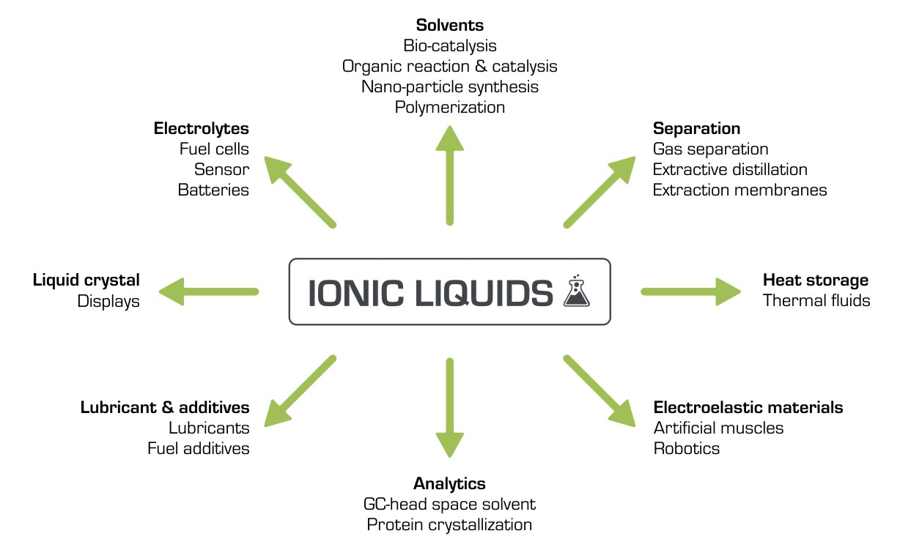
Ionic Liquids
Organic transformations in IL
Diels-Alder reactions
Alkylation reactions
Hydroformylation reactions
Friedel Crafts reactions
Pd-mediated C-C bond formation
Alkene polymerisation
Biotransformations
T. Welton, Chem. Rev., 1999, 99, 2071. http://www.researchinschools.org/projects/ionic_liquids.html

Slide 55
Switchable Ionic Liquids?
A non-ionic liquid (an alcohol and an amine base) converts to an ionic liquid (a salt in liquid form) upon exposure to an atmosphere of carbon dioxide, and then reverts back to its non-ionic form when exposed to nitrogen or argon gas. Such switchable solvents facilitates organic syntheses and separations by eliminating the need to remove and replace solvents after each reaction step.
P. G. Jessop, D. J. Heldebrant, X. Li, C. A. Eckert and C. L. Liotta, Nature, 2005, 436, 1102

Slide 56
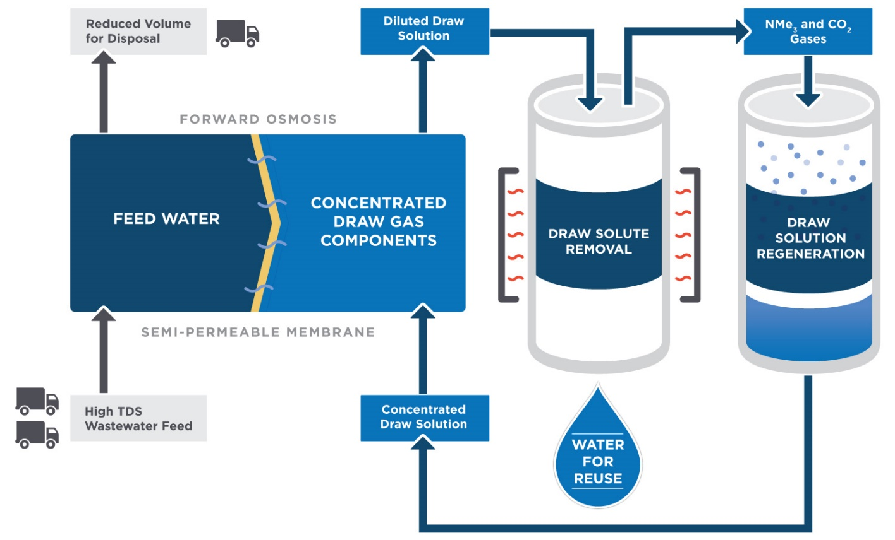
Switchable Ionic Liquids?
Application: Forward Water technology to clean industrial waste waters
Goal: transform waste water into smaller volume solid waste
Osmosis: The feed water is full of salts. To get water through the membrane we need to create a draw water on the other side at a higher concentration.

Slide 57
Switchable Ionic Liquids?
Application: Forward Water technology to clean industrial waste waters
Goal: transform waste water into smaller volume solid waste
Draw solute removal: once water has passed the membrane, the resulting dilute draw mixture is heated. The salt was in fact a switchable salt: it decomposes into NMe₃ and CO₂! Fresh water is that recovered

Slide 58
Switchable Ionic Liquids?
Application: Forward Water technology to clean industrial waste waters
Goal: transform waste water into smaller volume solid waste
Switchable salt regeneration: The gas feed is cooled to recover the switchable salt.

Slide 59
Topics Covered
What are solvents and how are they used?
Conventional Solvents
Alternative Solvents
Solvent Selection
Solvent Replacement

Slide 60
Sponsored by Yale-UNIDO Initiative
QUESTIONS?
CENTER for GREEN CHEMISTRY
and GREEN ENGINEERING at YALE

