Slide 1
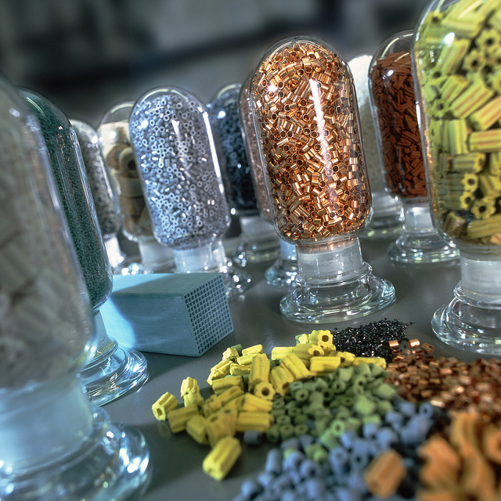
Yale-UNIDO Train-the-Facilitator Workshop in Green Chemistry
Catalysis
CENTER for GREEN CHEMISTRY
and GREEN ENGINEERING at YALE
Image: Flickr, Catalysts, Author: BASF Catalysts

Slide 2
Topics To Be Covered
Activation Energy for Reaction
What is a Catalyst?
Types of Catalysts
Catalysts and Sustainability
Important Improvements Using Catalysts
Enzymatic Reactions
Examples and Considerations

Slide 3
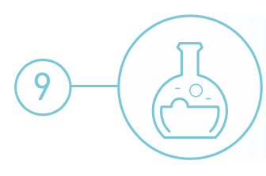
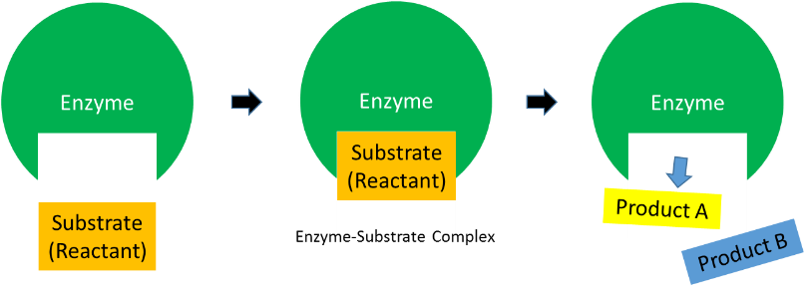
Catalysis
Catalytic reagents (as selective as possible) are superior to stoichiometric reagents.

Slide 4
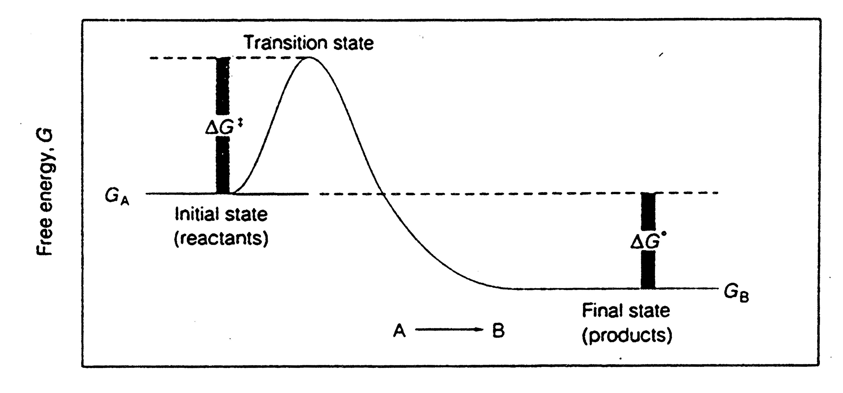
Activation Energy for Reaction
Molecules must be activated before they can undergo a reaction.
Reactants must absorb enough energy from their surroundings to destabilize chemical bonds (the energy of activation).
Transition state
The intermediate stage in a reaction where the reactant molecule is strained or distorted but the reaction has not yet occurred.

Slide 5
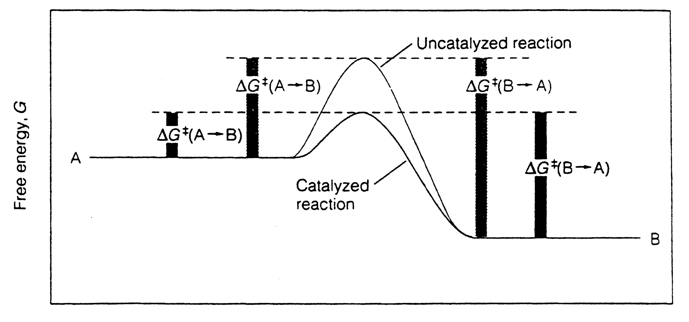
Activation Energy for Reaction
A catalyst lowers the energy of activation by:
Forcing molecules into conformations that favor the reaction.
I.e. the catalyst may re-orientate molecules.
The change in free energy is identical to the uncatalyzed reaction:
The catalyst does not change the thermodynamic equilibrium.

Slide 6
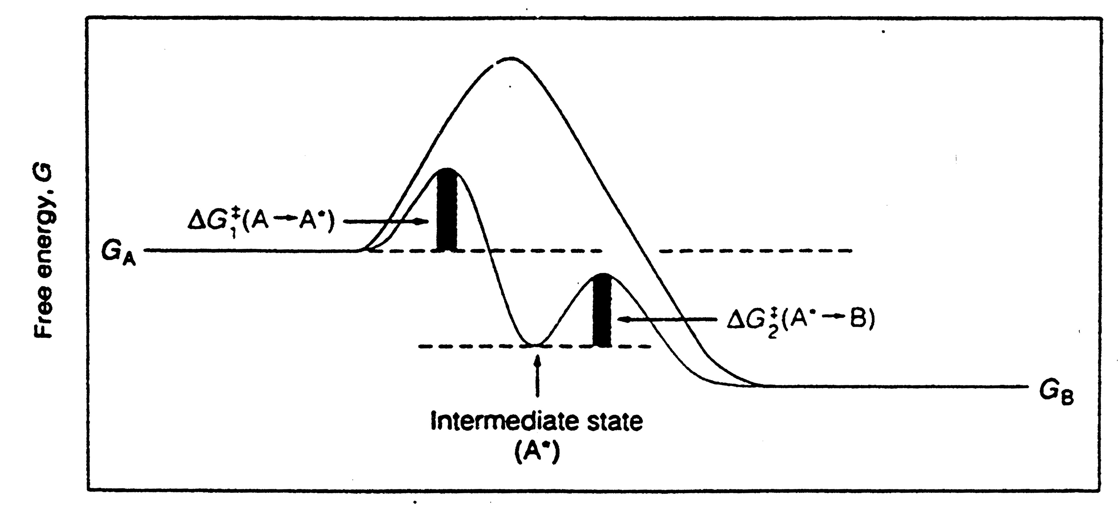
Activation Energy for Reaction
Sometimes catalysts cause one large energy barrier to be replaced by two smaller ones.
The reaction passes through an intermediate stage.

Slide 7
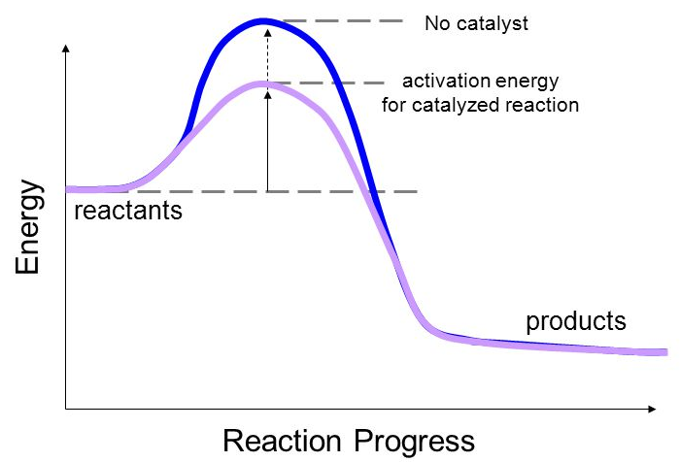
What is a Catalyst?
A catalyst is a substance that increases the rate of a chemical reaction without itself undergoing any permanent chemical change.
Some Advantages of using Catalysts:
They lower the activation energy of the reaction.
They can be recycled and reused.
They are used in minuscule amounts.
Using them shortens the reaction time.
Source: Wikipedia

Slide 8
Terminology: Heterogeneous and Homogeneous Catalysts
An ideal green catalyst would have a preferred parameters from each type.
 | Homogeneous | Heterogeneous
Form | Soluble metal complexes, usually mononuclear | Metals, usually supported, or metal oxides
Active site | Well-defined, discrete molecules | Poorly defined
Temperature | Low (<250ºC) | High (250 – 500°C)
Selectivity | High | Low
Product separation | Generally problematic on large scale | Facile
Green? | Less Green | More Green Separation, Recycle/Regeneration
 | Homogeneous | Heterogeneous
Form | Soluble metal complexes, usually mononuclear | Metals, usually supported, or metal oxides
Active site | Well-defined, discrete molecules | Poorly defined
Temperature | Low (<250 ºC) | High (250 – 500°C)
Selectivity | High | Low
Product separation | Generally problematic on large scale | Facile
Green? | Less Green | More Green Separation, Recycle/Regeneration
Notes:
After click text turns green – what are the criteria to design a green catalyst?

Slide 9
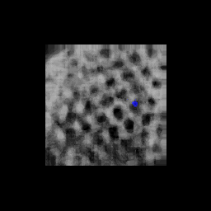
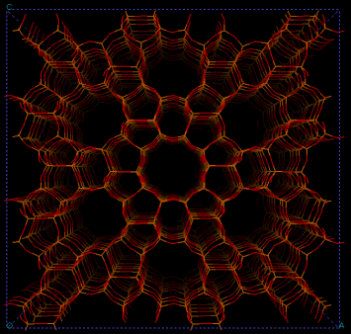
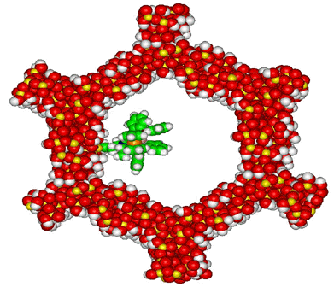
Terminology: Crystalline Microporous Catalysts
Regular crystalline structure.
Porous on the scale of molecular dimensions.
10 – 100 Å
Up to 1000’s m²/g surface area
Catalysis through:
Shape selection.
Acidity/Basicity.
Incorporation of metal particles.
Regular crystalline structure.
Porous on the scale of molecular dimensions.
10 – 100 Å
Up to 1000’s m²/g surface area.
Catalysis through:
Shape selection.
Acidity/Basicity.
Incorporation of metal particles.
10 Å
100 Å
Zeolite (silica-aluminate)
Silico-titanate
MCM-41 (mesoporous silica)
Notes:
Text turns green on click.

Slide 10
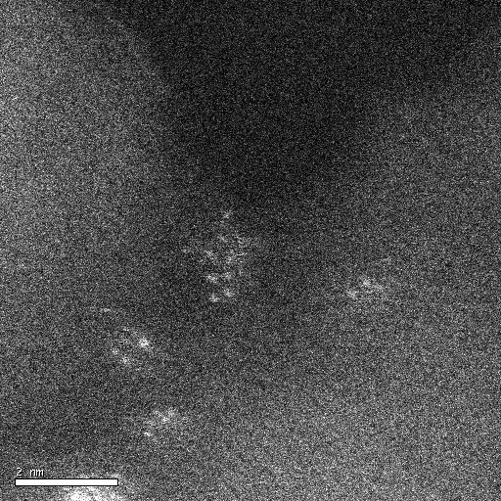
Terminology: Amorphous Heterogeneous Catalysts
Amorphous, high surface area supports:
Alumina, silica, activated carbon, and many more.
Up to 100’s of m²/g of surface area.
Impregnated with catalytic transition metals:
Such as Pt, Pd, Ni, Fe, Ru, Cu, and Ru.
Typically pelletized or on monoliths.
Cheap, high stability, and can catalyze many types of reactions.
Most used, but the least well understood of all classes of catalysts.
SEM micrographs of alumina and Pt/alumina

Slide 11
Terminology: Turnover Frequency and Selectivity
Turnover Frequency, TOF (s⁻¹)
The amount of molecules transformed form per given time = the rate of reaction.
Inorganic Catalyzed Reaction | Enzymatic Reactions
0.01 – 10000 s⁻¹ (Very slow) | 100 up to 40 million s⁻¹ (Extremely fast)
Selectivity (%)
To form one product exclusively despite the presence of other possibilities.
A + B --------------> C + D + E
100 mole
0 mole
0 mole
Selectivity for C = 100%
33 mole
50 mole
17 mole
Selectivity for C = 33%
Selectivity for D = 50%
Selectivity for E = 17%
Notes:
https://en.wikipedia.org/wiki/Turnover_number

Slide 12
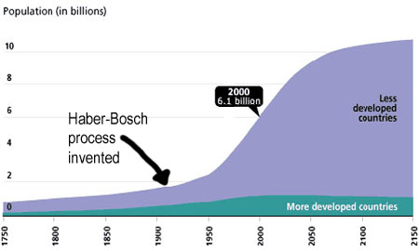
Catalysts are widely used by industry and by nature
Catalyst | Reactions catalyzed
Iron oxide | Ammonia from nitrogen and hydrogen
Chromium-Molybdenum Alloy Nickel-Molybdenum Alloy Zeolite (Porous Aluminum and Silica Oxide) | Petroleum Industry
Acid (HCl, H₂SO₄, HNO₃) | Many organic reactions
Enzymes | Starch into sugars and sugars to ethanol
The Haber-Bosch process, which allows fertilizer production, is facilitated by a catalyst.
The invention of the process led to a global increase in human population.
Source: Wikipedia

Slide 13
Catalysis Drives the Chemical Industry
Petroleum
Fine chemicals
Consumer Products
Pharmaceuticals
Catalytic processes contribute to more than 35% of global GDP.
Source: Wikipedia

Slide 14
Important Heterogeneous Catalytic Processes
Haber-Bosch process:
N₂ + 3 H₂ → 2 NH₃
Fe/Ru catalysts, high pressure and temperature.
Critical for fertilizer and nitric acid production.
Fischer-Tropsch chemistry:
n CO + 2n H₂ → (CH₂)_{n} + n H₂O , syn gas to liquid fuels.
Fe/Co catalysts.
Source of fuel for Axis in WWII.
Fluidized catalytic cracking:
High MW petroleum → low MW fuels, like gasoline.
Zeolite catalysts, high temperature combustor.
Likely in your fuel tank.
Automotive three-way catalysis:
NO_{x}/CO/HC → H₂O/CO₂/H₂O
Pt/Rh/Pd supported on ceria/alumina.
Makes exhaust 99% cleaner.

Slide 15
Designing a Green Catalyst
Not all catalysts are created equal. Chemists need to consider various factors when deciding on a catalyst.
Is the catalyst non-toxic?
Is it actually used in sub-stoichiometric amounts?
Does it require special conditions (sensitivity to solvent, moisture, oxygen)?
Is it derived from abundant/renewable resources?
Can it be reused?
Can it be separated from the products?
Might it lead to dangerous conditions (Runaway/chain reactions)?
Many metals which are used as catalysts are quickly depleting.
http://www.rsc.org/chemistryworld/Issues/2011/January/CriticalThinking.asp

Slide 16
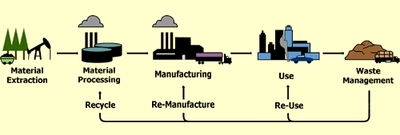
Use a lifecycle as a guide
Material Extraction
Abundance?
Processing/Manufacturing
Energy?
Waste?
Toxicity of materials?
Use
Selectivity?
Turnover number?
Safety?
End-of-life
Reusability?
Ease of separation?

Slide 17
The Need to Develop More Sustainable Catalysts
Raw materials (e.g. rare precious metals) are dispersed around the world and access to them is frequently political.
To gain economic and environmental independence, we must design catalysts which are locally sourced and abundant.
European Commission Press Release, June 2010

Slide 18
Current Trends in Catalyst Design
Reduce Loading
High Surface Area Support
Atomic Layer deposition
Earth Abundant Alternatives
Abundant metal
Alloy - Synergistic Effect
Adjust other parameters
- Solvents
- Surfactants

Slide 19
Current Trends in Catalyst Design
Reduce Loading
High Surface Area Support
Atomic Layer deposition
Earth Abundant Alternatives
Abundant metal
Alloy - Synergistic Effect
Adjust other parameters
- Solvents
- Surfactants

Slide 20
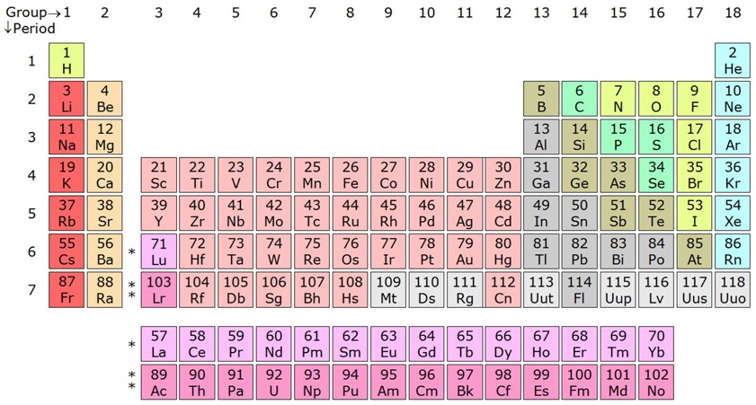
Example: The Haber-Bosch Process
Improving the Haber-Bosch process by using an iron catalyst:
$$N_{2}+3H_{2 }→2NH_{3}$$
Traditionally the H-B reaction was made using Osmium metal as catalyst.
Osmium metal is rare and toxic, which made the reaction unsustainable.
Because Iron is in the same column as Osmium, its properties are similar.
(Fe₃O₄) is an alternative catalyst that will provide a comparable yield.

Slide 21
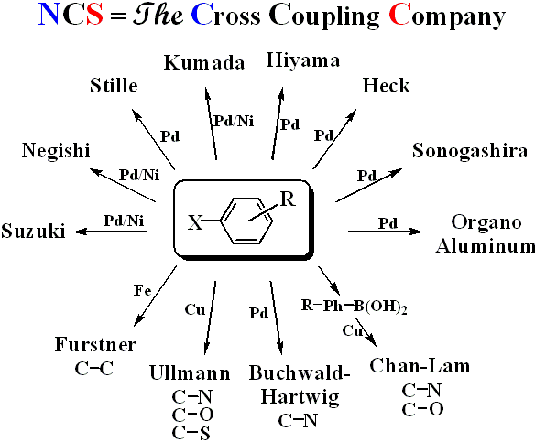
Example: Other catalyst improvements
Cross Coupling Reactions:
→ Connecting two separate organic molecules together with high selectivity and high yield.
 | USD mol⁻¹
Ni | $1.20
Pd | $1,500
New chemistry innovations allowed the replacement of expensive palladium catalysts with nickel.
These reactions were awarded Nobel Prizes.
Notes:
Pd is used catalytically, in small amount, to carry out the reaction In some cases, Pd needs NOT to be purified

Slide 22
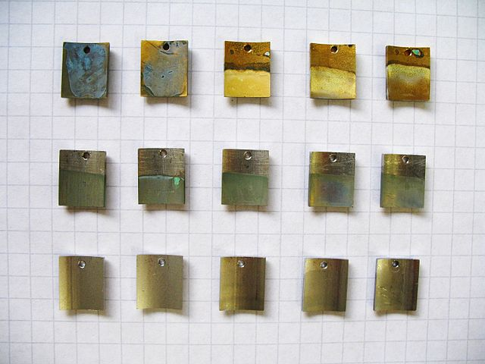
Other catalyst improvements: alloys
In addition to moving away from precious metals, scientists can use metal alloys for synergistic effect:
Alloying of multiple metals:
- Bronze – Copper + Tin (or Zinc)
- Monel – Copper + Nickel
Stainless Steel – Steel (Iron + C) + Chromium
(with many other possibilities)
The surface area:
- Thin layer deposition
- Ultra high area support
Image: Wikimedia Commons, Corrosion of alloys in NaCl, Author: Vvjbp

Slide 23
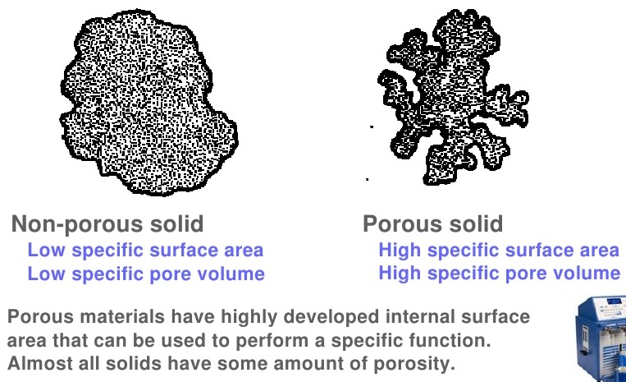
Increased Surface Area
High surface area porous support:
<50 cm² g⁻¹
50 – 4000 cm² g⁻¹

Slide 24
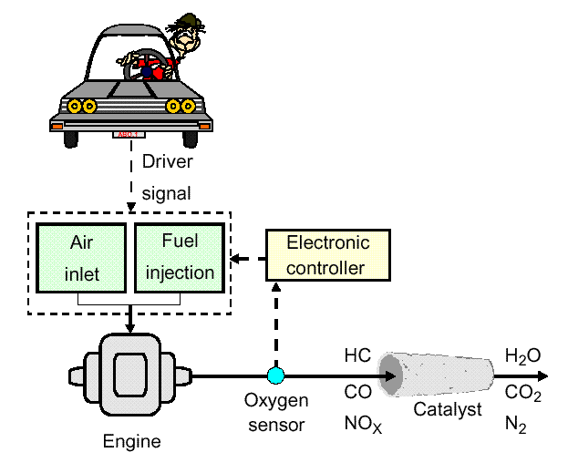
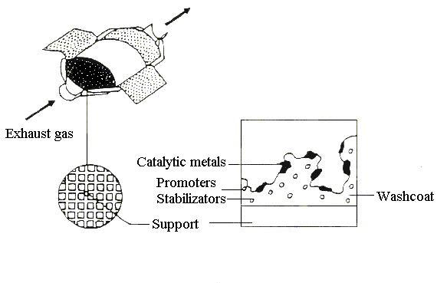
Automotive Emissions Control System
“Three-way” Catalyst
CO → CO₂
HC → CO₂ + H₂O
NO_{x} → N₂
Monolith reactor
Most widely deployed heterogeneous catalyst in the world.
You probably own one!
Pt, Rh, Pd Alumina, ceria, lanthana, etc.

Slide 25
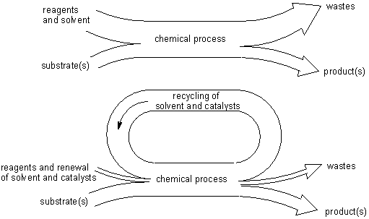
Towards Greener Catalysis – Flow Chemistry
http://www.organic-chemistry.org/topics/green-chemistry.shtm (Accessed on 4/1/2016)

Slide 26
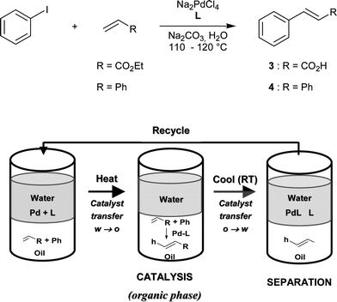
Greener Homogeneous Catalysis
Separation of the catalyst becomes a key drawback
Phase separation – takes advantage of the difference in Log P
Azoui H., Baczko K., Cassel S., Larpent C. Green Chem. 2008, 10, 1197-1203.

Slide 27
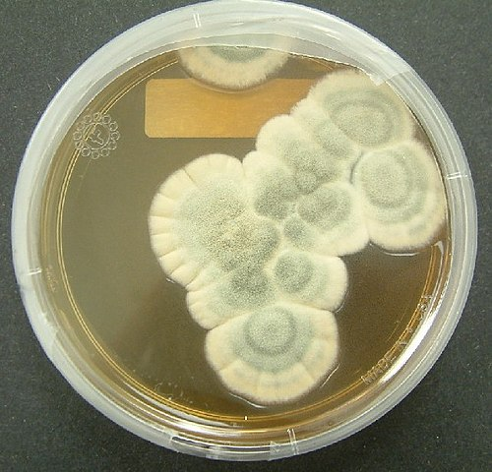
Enzymatic Reactions
Enzymatically driven reactions that occur in nature are often highly specific and compartmentalized.
Many of these reactions occur in ambient temperature and pressure with a water solvent.
Today, over 5000 of enzymatic reactions types have been identified, and that number continues to grow.
Image: Wikimedia Commons, Penicillium notatum, Author: Crulina 98

Slide 28
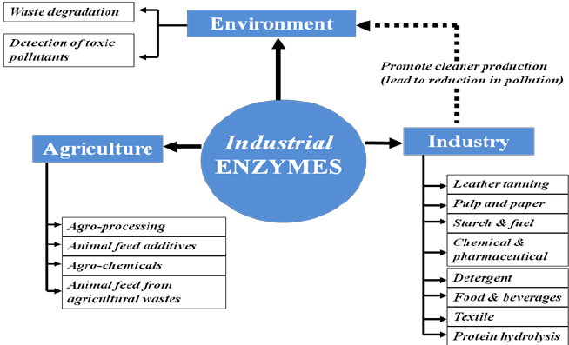
Enzymatic Reactions
Enzymes are biological catalysts and are used in industry, agriculture, and by nature.

Slide 29
Enzymatic Reactions
This is a general representation of enzymatic reactions – the lock and key mechanism.
The substrate (reactant) binds with the enzyme and forms the Enzyme-substrate complex and is transformed into products A and B, which are released from the active site upon reaction completion.

Slide 30
Examples on Enzymatic Catalysis
Conventional manufacturing of 6-aminopenicillanic acid (6-APA) - a key raw material for semi-synthetic penicillin and cephalosporin involved the use of environmentally unattractive reagents – requires a chlorinated hydrocarbon solvent and a reaction temperature of –40C.
In contrast, enzymatic cleavage of penicillin G is performed in water at 37C and the only reagent used is to adjust the pH.
The enzymatic process currently accounts for the majority of the several thousand tons of 6-APA produced annually on a world-wide basis.
Notes:
An illustrative example of the benefits to be gained by replacing conventional
chemistry by biocatalysis is provided by the manufacture of 6-aminopenicillanic
acid (6-APA), a key raw material for semi-synthetic penicillin and cephalosporin
antibiotics, by hydrolysis of penicillin G [115]. Up until the mid-1980s a chemical
procedure was used for this hydrolysis (Fig. 1.37). It involved the use of environmentally
unattractive reagents, a chlorinated hydrocarbon solvent (CH2Cl2)
and a reaction temperature of –40C. Thus, 0.6 kg Me3SiCl, 1.2 kg PCl5, 1.6 kg
PhNMe2, 0.2 kg NH3, 8.41 kg of n-BuOH and 8.41 kg of CH2Cl2 were required
to produce 1 kg of 6-APA [116].
In contrast, enzymatic cleavage of penicillin G (Fig. 1.37) is performed in
water at 37C and the only reagent used is NH3 (0.9 kg per kg of 6-APA), to adjust
the pH. The enzymatic process currently accounts for the majority of the
several thousand tons of 6-APA produced annually on a world-wide basis.
30 1 Introduction: Green Chemistry and Catalysis
Fig. 1.37

Slide 31
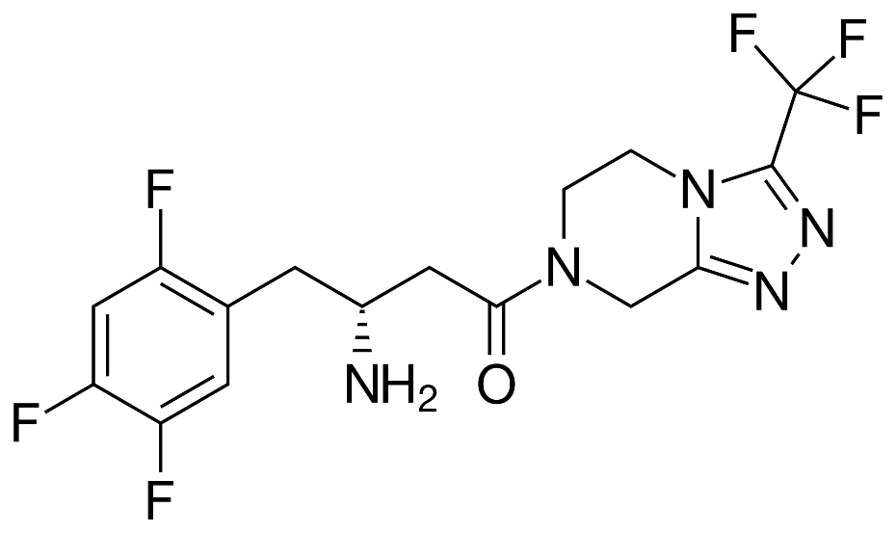
Case Study
Sitagliptin – Rhodium to Enzyme
Sitagliptin is Merck's top-selling diabetes drug.
It brought $1.9 million in sales in 2009.
Traditional synthesis used high pressure and a heavy metal – rhodium.
The new improved synthesis with enzymes allows for 99.95% selectivity to the desired product and eliminates all heavy metal wastes.
Sitagliptin, the active ingredient in Merck's Januvia.
http://www.rsc.org/chemistryworld/News/2010/June/17061002.asp (Accessed on 4/1/2016)
Savile, C. K.; Janey, J. M.; Mundorff, E. C.; Moore, J. C.; Tam, S.; Jarvis, W. R.; Colbeck, J. C.; Krebber, A.; Fleitz, F. J.; Brands, J.; Devine, P. N.; Huisman, G. W.; Hughes, G. J., Biocatalytic Asymmetric Synthesis of Chiral Amines from Ketones Applied to Sitagliptin Manufacture. Science 2010, 329 (5989), 305-309.
Notes:
http://www.rsc.org/chemistryworld/News/2010/June/17061002.asp

Slide 32
The Pros and Cons of Enzymatic Reactions
Pros:
Cons:
Mild conditions.
Aqueous environment.
Atmospheric conditions.
A very specific and high reaction rate.
Separations are often complicated.
They can be expensive to produce.
Some people might experience allergic reactions to some enzymes.

Slide 33
Topics Covered
Activation Energy for Reaction
What is a Catalyst?
Types of Catalysts
Catalysts and Sustainability
Important Improvements Using Catalysts
Enzymatic Reactions
Examples and Considerations

Slide 34
Sponsored by Yale-UNIDO Initiative
QUESTIONS?
CENTER for GREEN CHEMISTRY
and GREEN ENGINEERING at YALE

