Slide 1
Renewable Feedstocks for Energy
Lecture #12
Date:
Course #

Slide 2
Outline
Petroleum industry
Energy sources
Energy consumption & demand
Meeting the future energy demands
Biofuels
First Generation
Corn-based ethanol
Biodiesel
Second generation biofuels
Cellulosics, oils, grasses
Third and Fourth generation biofuels
Algae

Slide 3
Outline
Petroleum industry
Energy sources
Energy consumption & demand
Meeting the future energy demands
Biofuels
First Generation
Corn-based ethanol
Biodiesel
Second generation biofuels
Cellulosics, oils, grasses
Third and Fourth generation biofuels
Algae

Slide 4
Petroleum Industry
90% of all organic chemicals come from natural gas and petroleum.
Olefins: ethylene, propylene, butylenes are derived from natural gas and petroleum
Aromatics: benzene, toluene and the xylenes are derived from petroleum
3% of crude oil and 6% of refinery output in the US are processed into chemicals. The rest go to various fuels.
Survey of Industrial Chemistry, 3rd Edition, Philip J. Chenier

Slide 5
Petroleum Industry: Fractions of Petroleum
Approximate bp (°C) | Name | Uses
<20°C | Gases | CH₄, C₂H₆, C₃H₈, C₄H₁₀-similar to natural gas and useful for fuel and chemicals.
20-150°C | Light naptha (mainly C₅-C₆) | C₄-C₁₀ aliphatic and clycloaliphatic compounds. May contain some aromatics. Useful for both fuel and chemicals.
150-200°C | Heavy naphtha (mainly C₇-C₉) | C₄-C₁₀ aliphatic and cycloaliphatic compounds. May contain some aromatics. Useful for both fuel and chemicals.
175-275°C | Kerosene | Contains C₉-C₁₆ compounds useful for jet, tractor, and heating fuel.
200-400°C | Gas oil | Contains C₁₅-C₂₅ compounds useful for diesel and heating fuel. Catalytically cracked to naptha and steam-cracked to olefins.
>350°C | Lubricating oil | Used for lubrication. May be catalytically cracked to lighter fractions.
>350°C | Heavy fuel oil | Boiler fuel. May be catalytically cracked to lighter fractions.
 | Asphalt | Paving, coating, and structural uses.
Survey of Industrial Chemistry, 3rd Edition, Philip J. Chenier
Notes:
Each fraction of petroleum is used for a specific purpose – with the majority of the fractions being dedicated to fuel and energy generation. The fractions are generally separated by boiling point using fractional distillation where the fraction is collected and then transported for further conversion or use. Each fraction has a mixture of products within it - For example, light naptha may contain nearly 30 aliphatic, noncyclic hydrocarbons, nearly 20 cycloaliphatic hydrocarbons (mainly cyclopentanes and cyclo hexanes) sometimes called naphthenes and 20 aromatic compounds.

Slide 6
Petroleum Industry: Every fraction is used!
Environmental Factor (E-Factor): Very little waste in petroleum refining!
Industry sector | Annual production (t) | E-factor | Waste produced (t)
Oil refining | 10⁶-10⁸ | Ca. 0.1 | 10⁵ – 10⁷
Bulk chemicals | 10⁴-10⁶ | <1–5 | 10⁴ – 5 × 10⁶
Fine chemicals | 10²−10⁴ | 5–50 | 5 × 10² − 5 × 10⁵
Pharmaceuticals | 10–10³ | 25–100 | 2.5 × 10² − 10⁵
Sheldon, R. Chem Tech, 1994, 24, 38
Notes:
Remember E-factor!! The oil refining/petroleum industry is very efficient and produces very little waste (although there are other issues such as energy use and generation and generation of greenhouse gases).

Slide 7
Petroleum versus Biobased Resources
20th century
Organic chemicals, materials and energy based on oil
Process: petroleum refining
Driver: Energy (over 90% of petroleum is used for energy)
21st century
New organic chemicals based on biomass refining
Process: Biorefinery?
Driver: Energy (what fraction of biomass will be used for energy?)
Notes:
The petroleum-based chemical and energy economy has been developed and driven by the demand for energy in the 20th century. As we shift towards renewable resources and biomass, the driver will continue to be energy in the 21st century. This is why it is so important to develop bio-based energy sources.

Slide 8
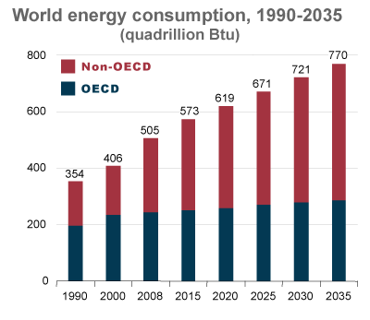
Energy Consumption: The world’s growing energy needs
Figure: Increasing world energy consumption since 1990. The graph includes prediction for year 2035, where the use will reach 770 quadrillion British Thermal Unit [BTU]. Source: U.S. Energy Information Administration [U.S. EIA].

Slide 9
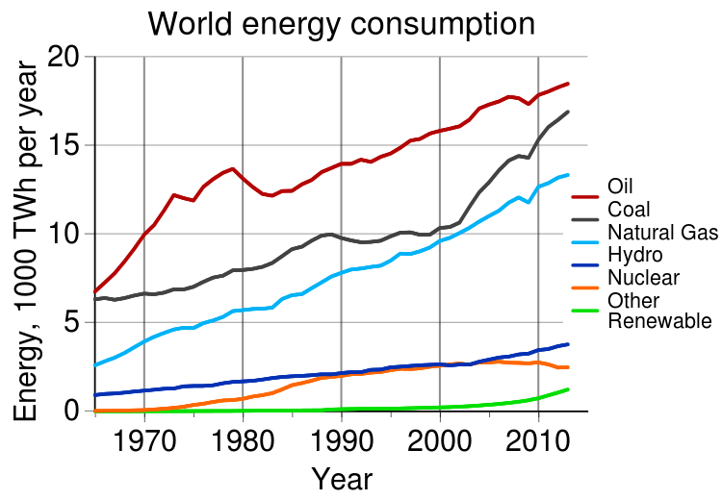
Energy Feedstocks: Historical dependence on depleting resources
Figure: Increasing world energy consumption years 1970-2010. Oil, coal and natural gas are still predominant sources of energy, but renewables are on the increase too. Source: Statistical Review of World Energy.

Slide 10
Current and future energy demands
2010:
Crude oil reserves: 1.5 trillion barrels (OPEC – Organization of Petroleum Exporting Countries) contributes 1.2 trillion barrels (80%)
OPEC produced 29.2 million barrels (mb)/day of crude oil from a world total output of 69.7 mb/day
Future:
International Energy Agency (IEA) predicts increase to 96 mb/day by 2035
OPEC predicts 105.5 mb/day by 2030
Future oil production will not be able to meet demand!
Clark, J.H., Luque, R., Matharu, A.S., Annu. Rev. Chem. Biomol. Eng., 2012, 3: 183-207

Slide 11
Oil as an energy source: Challenges
Negative social and environmental image
i.e., 2010 BP Deepwater oil platform leak in the Gulf of Mexico – 5 mb of oil
Oil and fossil fuels – significant contributors to CO₂ in the atmosphere
Economics
Fluctuation in pricing due to a number of factors (i.e., demand/future supply)
Dependent on regions that have political unrest (Middle East and North Africa)
Clark, J.H., Luque, R., Matharu, A.S., Annu. Rev. Chem. Biomol. Eng., 2012, 3: 183-207

Slide 12
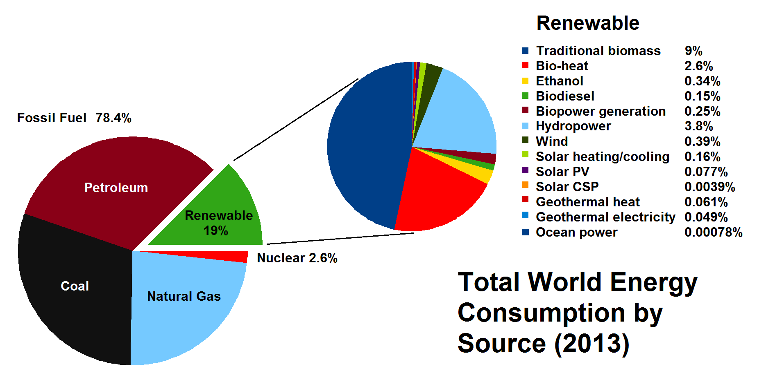
Alternative Energy to Meet Future Demand
Biomass is the largest contributor to renewable energy!
Figure: World energy consumption by source reported in 2013.While fossil fuel is still predominant, in 2013 there has been an increase in renewable source of energy. Most renewable energy comes from biomass. Source: REN21 Renewables 2014 Global Status Report.

Slide 13
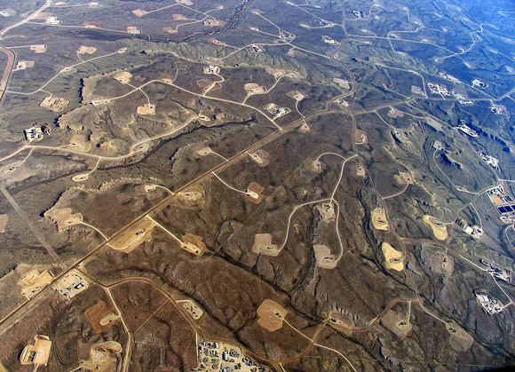
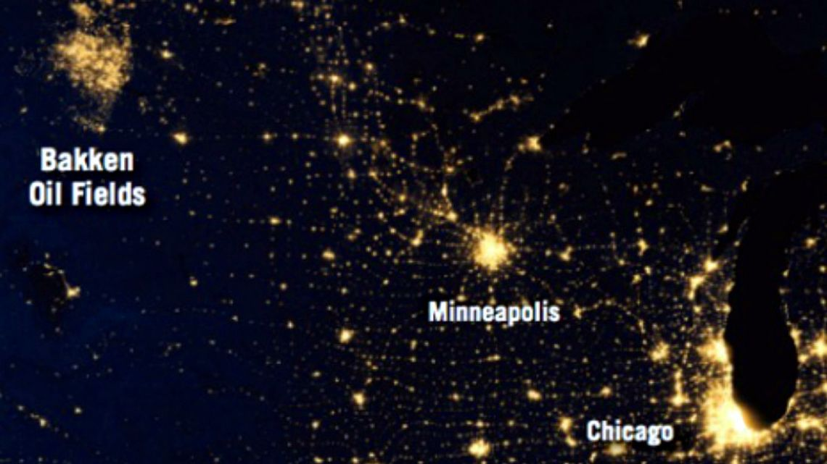
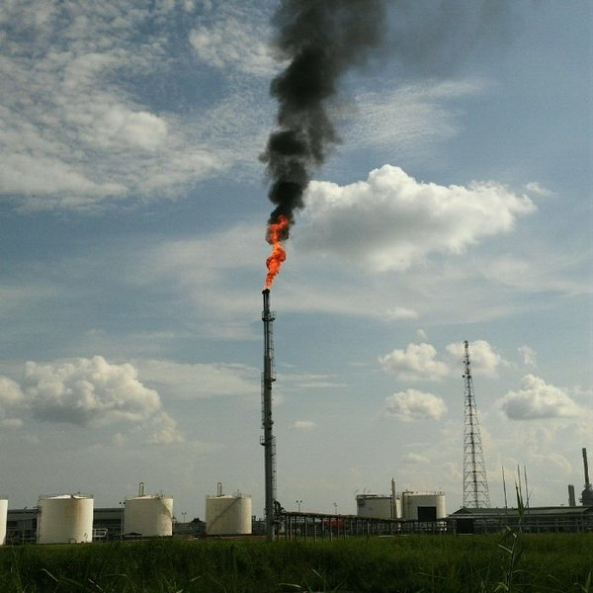
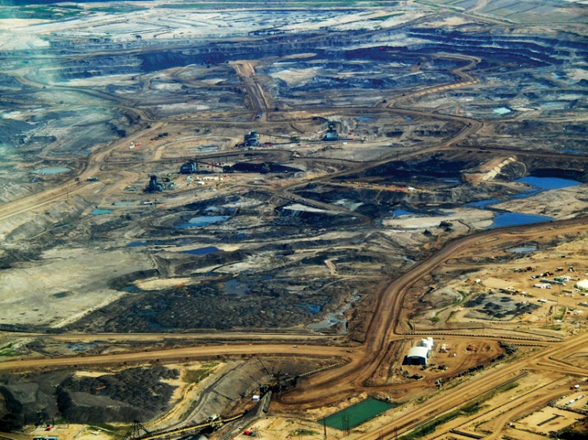
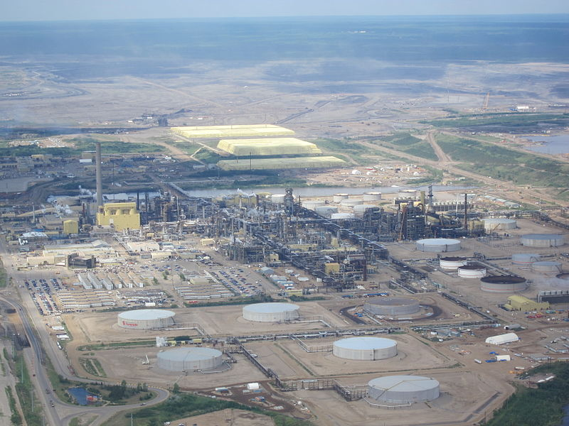
What We Have
Notes:
Image Sources:
Top left: https://www.acs.org/content/acs/en/pressroom/presspacs/2016/acs-presspac-august-17-2016/reducing-gas-flares-and-pollution-from-oil-production.html
Bottom left: Image: Wikimedia Commons, Alberta tar sands, https://commons.wikimedia.org/wiki/File:Tar_sands_in_alberta_2008.jpg
Middle: https://commons.wikimedia.org/wiki/File:Gas_flare,_PetroChina_Jabung_field,_Jambi,_Indonesia.jpg
Top right: https://www.flickr.com/photos/sfupamr/14601885300/in/gallery-132676730@N05-72157661969552260/
Bottom right:: Image: Wikimedia Commons: https://commons.wikimedia.org/wiki/File:SyncrudeWoodBuffalo.JPG

Slide 14
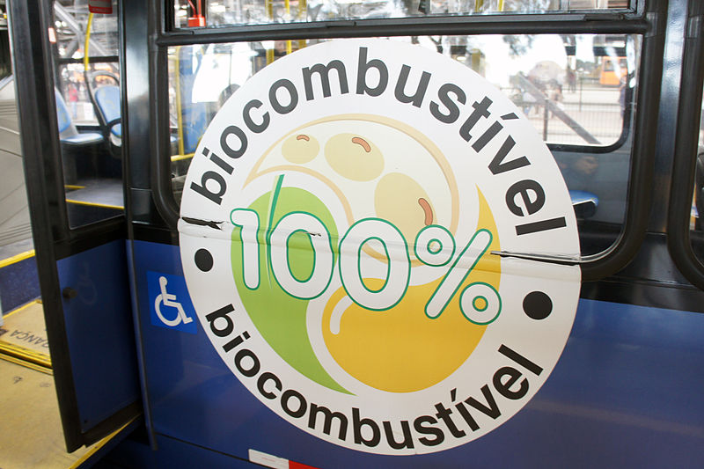
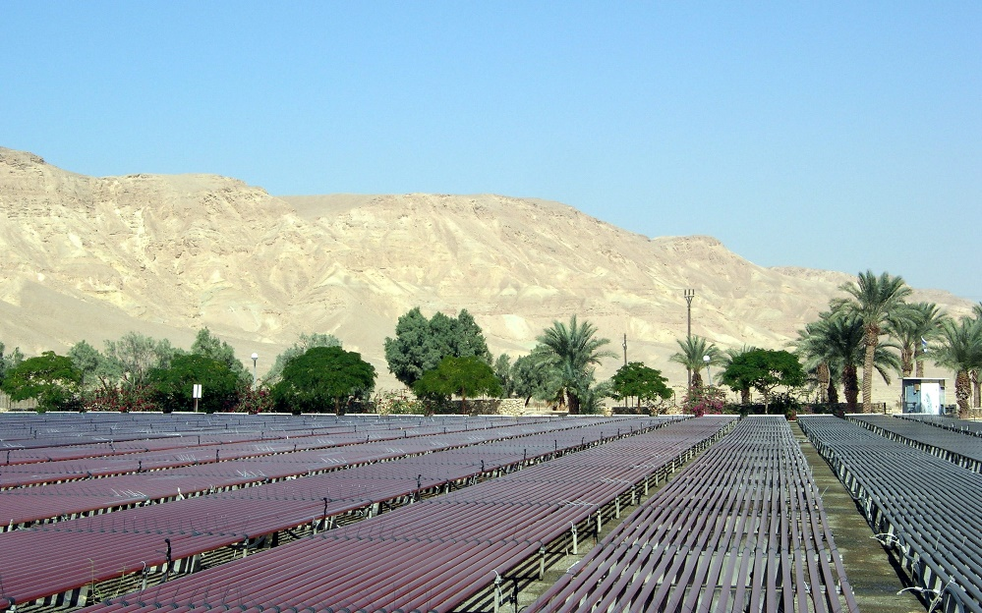
What We Can Have
Notes:
Image Sources:
Boreal forest image: Diego Delso, delso.photo, License CC-BY-SA – from here: https://commons.wikimedia.org/wiki/File:R%C3%ADo_Yuk%C3%B3n,_Carmacks,_Yuk%C3%B3n,_Canad%C3%A1,_2017-08-27,_DD_01-04_PAN.jpg
Biocombustive image: Image: Wikimedia Commons,
https://commons.wikimedia.org/wiki/File:Biodiesel_bus_Linha_Verde_Curitiba_BRT_05_2013_6551.JPG
Photo: © Rémi Jouan, CC-BY-SA, GNU Free Documentation License, Wikimedia Commons
https://commons.wikimedia.org/wiki/File:Algoculture_au_kibboutz_Ketura.JPG

Slide 15
Outline
Petroleum industry
Energy sources
Energy consumption & demand
Meeting the future energy demands
Biofuels
First Generation
Corn-based ethanol
Biodiesel
Second generation biofuels
Cellulosics, oils, grasses
Third and Fourth generation biofuels
Algae

Slide 16
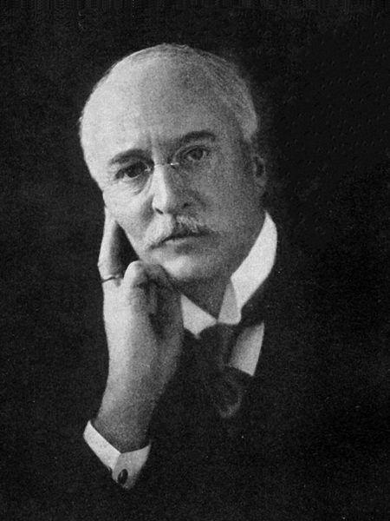
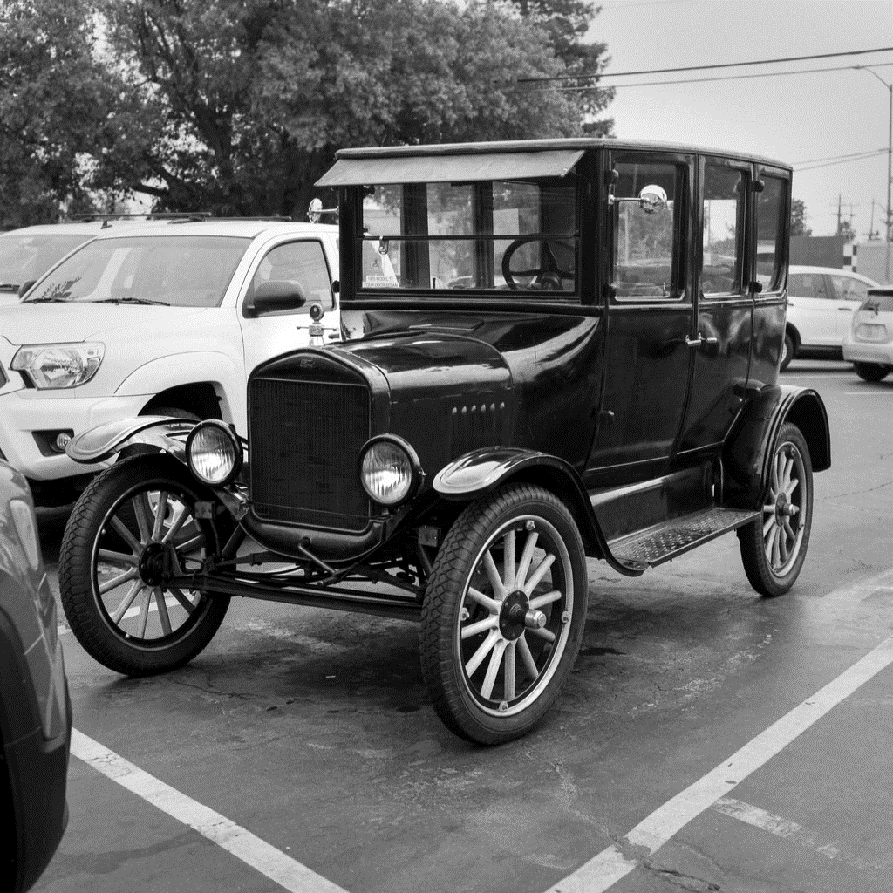
Biofuels: They aren’t new!
Rudolf Diesel: 1900 demonstrated compression engine (diesel engine) running on peanut oil
Ford Model T: designed to run on bioethanol
The Citröen Rosalie: 1st commercial diesel engine passenger car (1933)
Notes:
Citroen Image: https://commons.wikimedia.org/wiki/File:Citroen_Rosalie_002.jpg
Model T image: https://www.flickr.com/photos/29233640@N07/27405552721
Rudolf Diesel: https://commons.wikimedia.org/wiki/File:Rudolf_Diesel.jpg - U.S. work public domain in the U.S. for unspecified reason but presumably because it was published in the U.S. before 1924.

Slide 17
Outline
Petroleum industry
Energy sources
Energy consumption & demand
Meeting the future energy demands
Biofuels
First Generation
Corn-based ethanol
Biodiesel
Second generation biofuels
Cellulosics, oils, grasses
Third and Fourth generation biofuels
Algae

Slide 18
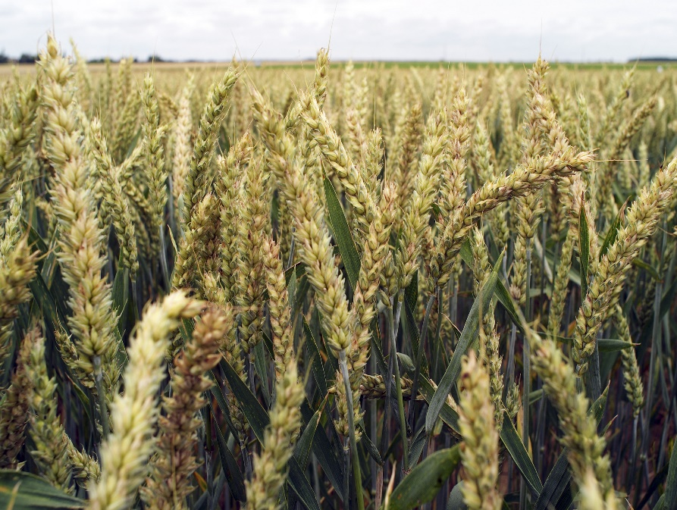
First Generation Biofuels
Bioethanol and biodiesel
Uses agricultural feedstocks (sugarcane, corn wheat, grains, oilseeds, vegetable oils, and rendered animal fats)
Bioalcohols (bioethanol) produced via yeast fermentation of plant sugars and starches (from sugarcane (Brazil), sugar beet, and corn (U.S.))
Biodiesel produced from chemical modification of plant oils (rapeseed, palm tree fruits, soybean, used vegetable oils, rendered animal fats)
Socially and environmentally unsustainable
Compete directly with food/feed production
Negatively impact GHG emissions, biodiversity, land use, water use, and water fouling
Clark, J.H., Luque, R., Matharu, A.S., Annu. Rev. Chem. Biomol. Eng., 2012, 3: 183-207
Image: Creative Commons
Notes:
Picture: https://commons.wikimedia.org/wiki/File:Bl%C3%A9_tendre_hiver_AO_(FOLKLORE)-3-cliche_Jean_Weber_(23787410560).jpg

Slide 19
Future of Biofuels
Ideally need to be:
Produced cheaply from non-food feedstocks
Readily available throughout the year
Drop-in replacement into existing infrastructure
Be as energy dense as gasoline or diesel
Clark, J.H., Luque, R., Matharu, A.S., Annu. Rev. Chem. Biomol. Eng., 2012, 3: 183-207

Slide 20
Corn-based Ethanol Production Process
Average fill up of a 25 gallon SUV gas tank with ethanol requires same amount of grain as it takes to feed 1 person for 1 year.
Every person in the US uses 500 gallons of gasoline per year.
That means that every American would use enough gas to feed 20 people over the course of the year.
There are 300 million people in the US, and 300 million people, each using enough food to feed 20 people to run their cars, would require enough grain to feed 6 billion people.
Notes:
From: Ethics of Biofuels, by Sharon Astyk, December 28, 2006, https://www.resilience.org/stories/2006-12-28/ethics-biofuels/

Slide 21
Why Replacing Fossil-Fuel Oil With Advanced Transportation Biofuels is Important
Peak Oil
Image Source: Colin Campbell, Association for the Study of Peak Oil and Gas, July 2003
Notes:
Image Source: Colin Campbell, Association for the Study of Peak Oil and Gas, July 2003

Slide 22
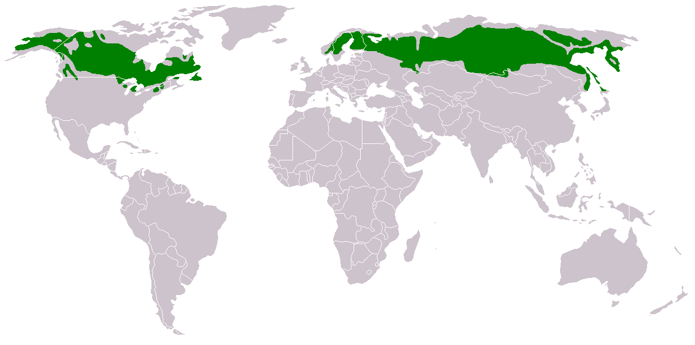
As oil reserves become more scarce, extraction processes devastate natural resources
Alberta, Canada, tar sands expansion
Image: Wikimedia Commons, Alberta tar sands, https://commons.wikimedia.org/wiki/File:Tar_sands_in_alberta_2008.jpg
Syncrude Canadian Oil Sands Partnership
World’s largest producer of synthetic crude oil from sands and the biggest source in Canada (258,000ha in Boreal Forest in Alberta, Canada)
Image: Wikimedia Commons: https://commons.wikimedia.org/wiki/File:SyncrudeWoodBuffalo.JPG
Canada’s boreal forests: 3,000 square miles of mineable oil sands (requires removing forest)
Image: Wikimedia Commons: https://commons.wikimedia.org/wiki/File:Taiga.png
Image (above): Diego Delso, delso.photo, License CC-BY-SA
Notes:
Boreal forest image: Diego Delso, delso.photo, License CC-BY-SA – from here: https://commons.wikimedia.org/wiki/File:R%C3%ADo_Yuk%C3%B3n,_Carmacks,_Yuk%C3%B3n,_Canad%C3%A1,_2017-08-27,_DD_01-04_PAN.jpg
Canada Lead the World.. On Forest Degradation, March 27, 2015 by Rona Fried: https://www.sustainablebusiness.com/canada-leads-the-world-on-forest-degradation-52824/
Alberta, the Home of the Tar Sands, Has “Increasing Income Inequality”, April 21, 2015 by Andy Rowell, Oil Change International, http://priceofoil.org/2015/04/21/alberta-home-tar-sands-increasing-income-inequality/
Info on Syncrude Canadian Oil Sands Partnership: https://www.mining-technology.com/projects/syncrude/
This oil is fossil fuel. It will run out some day. Before it runs out, it becomes very difficult, dangerous and expensive to find and to extract.
Remember the oil spill in the Gulf of Mexico in 2010—drilling for oil very, very deep wells
Also the tar sands in Canada
In Canada’s boreal forests, there are almost 3000 square miles of mineable oil sands. Getting to the oil sands means removing the forests. It means that large scale, heavy equipment moves into the landscape, removing the plants, impacting animal populations, and damaging soil, water and air. Shifting Sands documents the work in the oil sands with photos of the oil sands landscapes during and after this process. Some consider this to be a cost of oil production. Others consider this to be an environmental disaster.
http://www.decodedscience.com/the-tar-sands-fueling-controversy/4981 by Tricia Edgar is a science writer and educator from the beautiful, wet Pacific Northwest. She has a Master’s degree in Environmental Management.
Map: http://www.google.com/imgres?hl=en&sa=X&biw=1280&bih=685&tbm=isch&prmd=imvns&tbnid=YeF5QzLiRLZv9M:&imgrefurl=http://earthobservatory.nasa.gov/Study/BorealThreshold/&docid=omIRY8y0hG362M&imgurl=http://earthobservatory.nasa.gov/Features/BorealThreshold/Images/boreal_forest_map.gif&w=428&h=370&ei=CkO0TrbAJM-CsgKimNnmAw&zoom=1&iact=hc&vpx=607&vpy=226&dur=11401&hovh=209&hovw=241&tx=103&ty=113&sig=117376384788423915804&page=1&tbnh=141&tbnw=163&start=0&ndsp=18&ved=1t:429,r:8,s:0
http://www.platts.com/RSSFeedDetailedNews/RSSFeed/Oil/8662080?WT.mc_id=&WT.tsrc=Eloqua
"The challenge for producers such as the UAE is to continue producing oil and gas from existing reservoirs while, at the same time, developing new opportunities," he said. "It is no secret that the days of easy oil are coming to an end. Increasingly we are being forced to go down the route of enhanced oil recovery and developing ultra sour oil and gas from complex reservoirs." These challenges had turned the oil-rich region to become a center for development of new technologies and innovation, Hamli said, referring to the UAE's expansion into renewable energy and its decision to build the zero-carbon Masdar City in Abu Dhabi. "Our commitment to widening our domestic energy mix and promoting renewable energy does not mean that we have turned our backs to the oil industry," Hamli said. "Our growing population and fast-moving industrial developments have forced us to choose between continuing burning fossil fuels which would otherwise be exported and finding complementary energy solutions for use at home. We realized that by widening our domestic fuel mix, we could release more hydrocarbons for export," he added. The UAE has set a target of switching to nuclear power for 25% of its power generation requirements, Hamli said, adding that national peak demand for electricity was set to more than double by 2020 while demand for other forms of energy is growing. The UAE expects to have its first nuclear power station commissioned in 2017 while at the same time developing solar energy. Abu Dhabi has set a target of generating 7% of its energy needs from renewable sources including solar. "We believe that the best way of securing a sustainable economic future in a carbon constrained world is to develop a balanced portfolio of clean energy sources in which nuclear, renewable energy, oil and natural gas all have a role to play," Hamli said.
Image Sources: http://priceofoil.org/2015/04/21/alberta-home-tar-sands-increasing-income-inequality/
https://www.sustainablebusiness.com/canada-leads-the-world-on-forest-degradation-52824/
https://www.mining-technology.com/projects/syncrude/
https://earthobservatory.nasa.gov/features/BorealThreshold

Slide 23
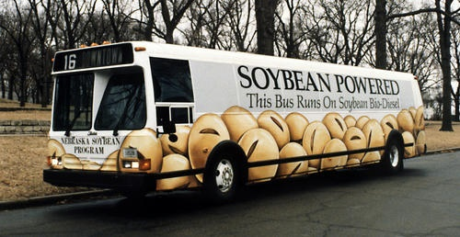
First Generation Biofuels: Biodiesel
Major sources for making biodiesel in the U.S. in 2017:
Soybean oil—52%
Canola oil—13%
Corn oil—13%
Recycled feedstocks, such as used cooking oils and yellow grease—12% (2nd generation biofuel)
Animal fats—10%
Rapeseed oil, sunflower oil, and palm oil are major feedstocks for biodiesel produced in other countries.
Image: Wikimedia Commons,
https://commons.wikimedia.org/wiki/File:Hybrid_bus_11_2015_Curitiba_835.JPG (top)
https://commons.wikimedia.org/wiki/Biodiesel#/media/File:Soybeanbus.jpg (bottom)
Notes:
Note that biodiesel is a first or second generation biofuel, depending on the source! Many new sources of biodiesel are shifting away from food-based oils so as to not compete with food or feed
From U.S. Energy Information Administration (EIA), Independent Statistics & Analysis, https://www.eia.gov/energyexplained/index.php?page=biofuel_biodiesel_home -
Biodiesel is a renewable fuel
Vegetable oil in a bottle
Source: Stock photography (copyrighted)
Biodiesel is a renewable fuel made from biomass. Most U.S. biodiesel is produced from vegetable oils and animal fats. Biodiesel can be used in the same equipment as diesel fuel made from petroleum.
The major sources of feedstock (raw material) for making biodiesel in the United States and their shares of total biodiesel feedstocks in 2017 were
Soybean oil—52%
Canola oil—13%
Corn oil—13%
Recycled feedstocks, such as used cooking oils and yellow grease—12%
Animal fats—10%
Rapeseed oil, sunflower oil, and palm oil are major feedstocks for biodiesel produced in other countries.
Biodiesel is most often blended with petroleum diesel in ratios of 2% (referred to as B2), 5% (B5), or 20% (B20). Biodiesel can also be used as pure biodiesel (B100). Biodiesel fuels can be used in regular diesel engines without making any changes to the engines. Biodiesel blends are also used as heating oil. Biodiesel can be stored and transported using petroleum diesel fuel tanks and equipment.
History of biodiesel
Before petroleum diesel fuel became popular, Rudolf Diesel, the inventor of the diesel engine in 1897, experimented with using vegetable oil (biodiesel) as fuel. Until 2001, only small amounts of biodiesel were consumed in the United States. Since then, biodiesel consumption has increased substantially, largely because of the availability of various government incentives and requirements to produce, sell, and use biodiesel.

Slide 24
First Generation Biofuels: Biodiesel
Benefits:
Burns cleaner than petroleum diesel fuel
Can be carbon-neutral (depends on plant source)
Safe to handle, store & transport
Less toxic, less risk from spills
Higher flash rate = safer in a crash
Challenges:
Some countries have cleared and burned large areas of natural vegetation to grow soybeans and palm oil trees for biodiesel (negative effects may be greater than the potential benefits)
Image: Wikimedia Commons,
https://commons.wikimedia.org/wiki/File:Biodiesel_bus_Linha_Verde_Curitiba_BRT_05_2013_6551.JPG
Notes:
From U.S. Energy Information Administration (EIA), Independent Statistics & Analysis, https://www.eia.gov/energyexplained/index.php?page=biofuel_biodiesel_home –
And
U.S. Department of Energy, Alternative Fuels Data Center Website, “Biodiesel Benefits,” available at http://www.eere.energy.gov/afdc/altfuel/bio_benefits.html
Biodiesel is a renewable fuel
Vegetable oil in a bottle
Source: Stock photography (copyrighted)
Biodiesel is a renewable fuel made from biomass. Most U.S. biodiesel is produced from vegetable oils and animal fats. Biodiesel can be used in the same equipment as diesel fuel made from petroleum.
The major sources of feedstock (raw material) for making biodiesel in the United States and their shares of total biodiesel feedstocks in 2017 were
Soybean oil—52%
Canola oil—13%
Corn oil—13%
Recycled feedstocks, such as used cooking oils and yellow grease—12%
Animal fats—10%
Rapeseed oil, sunflower oil, and palm oil are major feedstocks for biodiesel produced in other countries.
Biodiesel is most often blended with petroleum diesel in ratios of 2% (referred to as B2), 5% (B5), or 20% (B20). Biodiesel can also be used as pure biodiesel (B100). Biodiesel fuels can be used in regular diesel engines without making any changes to the engines. Biodiesel blends are also used as heating oil. Biodiesel can be stored and transported using petroleum diesel fuel tanks and equipment.
History of biodiesel
Before petroleum diesel fuel became popular, Rudolf Diesel, the inventor of the diesel engine in 1897, experimented with using vegetable oil (biodiesel) as fuel. Until 2001, only small amounts of biodiesel were consumed in the United States. Since then, biodiesel consumption has increased substantially, largely because of the availability of various government incentives and requirements to produce, sell, and use biodiesel.

Slide 25
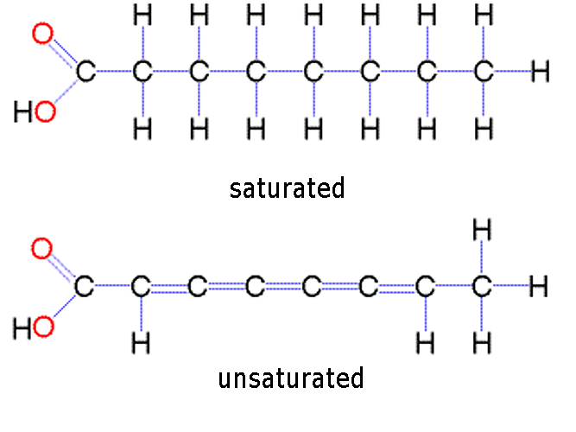
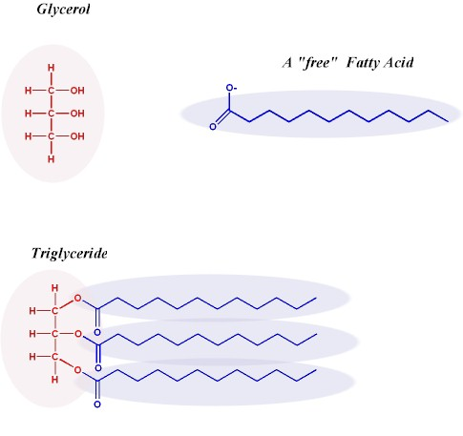
Oils for Biodiesel: Lipids
Waxes- polymers of long fatty acids
Cutins - polymers of short fatty acids; these are unique to plants
Triglycerides - three fatty acid chains bound to a single molecule of glycerol
fatty acid chains

Slide 26
Biodiesel preparation: transesterification
Catalyst
Alcohol (typically methanol or ethanol)
Mixture of esters (R can be R, R₁ or R₂)
Glycerol is a co-product
Triacylglyceride (oil or fat)
Notes:
In order to make biodiesel the triglyceride molecules can be converted into a simpler form through what is called a transesterification reaction. This reaction converts one type of ester group to another. In the reaction scheme above you can see that the ester groups that are attached to the glycerol portion of the molecule are broken and converted to a different type of ester.
The reaction scheme above shows that we use an alcohol, such as ethanol (CH₃CH₂OH) and a catalyst (potassium hydroxide, KOH) to convert the vegetable oil into biodiesel and glycerol, a by-product of the reaction. You can see that since the starting material on the left side of the equation had three fatty acid hanging off the glycerol that we needed 3 ethanol molecules to produce 3 biodiesel molecules.
Keep in mind that since biodiesel is actually a mixture of esters, different types of vegetable oils can produce fuels with different properties

Slide 27
Advantages of Biodiesel
Reduces other pollutants
35% reduction in unburned hydrocarbons through life cycle – smog & ozone precursor
8% reduction in sulfur oxides – acid rain
3% reduction in methane
32% reduction in particulate matter (PM10 68%)
83.6% reduction in PM soot
79% reduction in wastewater
96% reduction in hazardous waste, but double non-hazardous waste
National Biodiesel Board,” Lifecycle Summary,” available at http://www.nbb.org/pdf_files/fuelfactsheets/LifeCycle_Summary.PDF
Notes:
Source: National Biodiesel Board,” Lifecycle Summary,” available at http://www.nbb.org/pdf_files/fuelfactsheets/LifeCycle_Summary.PDF

Slide 28
Is Biodiesel the Answer?
It would be very ambitious to produce the amount of diesel used on farms alone
That would require all of the vegetable oil currently produced in the U. S. & about 15% of our total production land area.
It would be very ambitious to have even a 0.5 billion gallon per year biodiesel industry
This would be only 1.5% of our on-highway diesel fuel or less than 1% of our total fuel oil and kerosene use
would require
all of the surplus vegetable oil (0.13 bil. gal.),
1/2 of the used oil (0.17 bil. gal.), and
all of the oil which could be produced on the 37 million acres of idle crop land (approx. 0.3 billion gal.) or the equivalent by displacing current crops
Notes:
Charles L. Peterson, “Potential Production of Biodiesel” University of Idaho, available at http://www.uidaho.edu/bioenergy/BiodieselEd/publication/02.pdf

Slide 29
Outline
Petroleum industry
Energy sources
Energy consumption & demand
Meeting the future energy demands
Biofuels
First Generation
Corn-based ethanol
Biodiesel
Second generation biofuels
Cellulosics, oils, grasses
Third and Fourth generation biofuels
Algae

Slide 30
Biofuels: Current and Future
First Generation Biofuels
The problem of food vs. fuel
Second Generation Biofuels
use agricultural wastes ←→lignocellulosics
Lignocellulosics for ethanol
Oils for biodiesel
Grasses
but… such crops were not domesticated for biofuels!
Future (3^{d} generation)

Slide 31
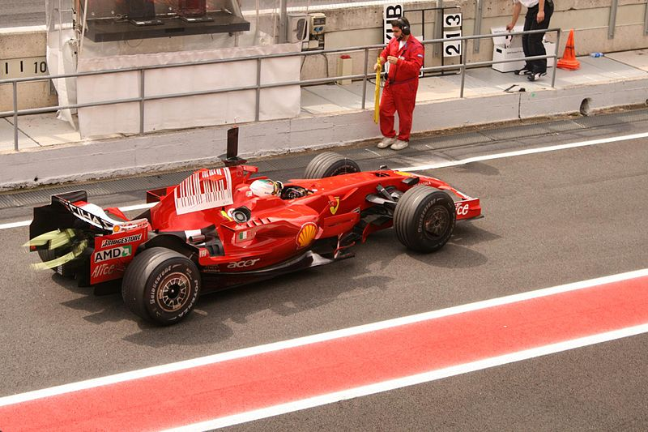
Advanced Biofuels: Second, Third and Fourth Generation Biofuels
Shifting away from food-based feedstocks to not compete with food/feed
Derived from lignocellulosic materials, biowaste, and algae
Most are in developmental stage
Formula 1: since 2008 the rules state that at least 5.75% of all Formula 1 fuel must be derived from plants. Ferrari was first to use non-edible parts of plants (lignocellulose based)
Graham-Rowe, D., Nature, 474, S6-S8, 2011
Photo: Creative Commons
Notes:
“ Agriculture: Beyond food versus fuel”, Graham-Rowe, D., Nature, 474, S6-S8, 2011, https://www.nature.com/articles/474S06a
Photo: https://commons.wikimedia.org/wiki/File:Formula_1_Ferrari.jpg

Slide 32
Biofuels: First to Fourth Generation
First generation:
Feedstocks: Food crops, grains, easily extractable sugar, starch, oils (competes with food)
Bioconversion process: Fermentation (i.e., ethanol), transesterification (i.e., biodiesel)
Carbon balance: weak (corn, canola) to good (sugarcane)
Energy balance: weak (corn) to excellent (sugarcane)
Third generation:
Feedstocks: Purpose designed energy crops – improved bioconversion, higher yields (i.e., algae)
Bioconversion process: Fermentation, gasification, fast-pyrolysis
Carbon balance: carbon-neutral to slightly carbon-positive
Energy balance: depends on feedstock, process integration
Second generation:
Feedstocks: Ligno-cellulosics, residues, dedicated energy crops
Bioconversion process: Fermentation, gasification, fast-pyrolysis
Carbon balance: carbon-neutral to slightly carbon-positive
Energy balance: depends on feedstock, process integration
Fourth generation:
Feedstocks: Purpose designed energy crops – improved carbon storage, higher yields (i.e., algae)
Bioconversion process: Fermentation, gasification, fast-pyrolysis
Carbon balance: carbon-negative (takes CO₂ out of atmosphere)
Energy balance: waste heat used for carbon capture & storage
Adapted from: Biopact, https://global.mongabay.com/news/bioenergy/2007/10/quick-look-at-fourth-generation.html

Slide 33
Second Generation Biofuels
sustainability of a feedstock is defined by its availability, its impact on greenhouse gas emissions, its impact on land use, and by its potential to threaten the food supply.
To qualify as a second generation, a feedstock must not be suitable for human consumption and
Should grow on marginal (non-agricultural) land
Should not require a great amount of water or fertilizer
Certain food products can become second generation fuels when they are no longer useful for consumption
waste vegetable oil (2nd generation feedstock)
Virgin vegetable oil (1st generation feedstock)

Slide 34
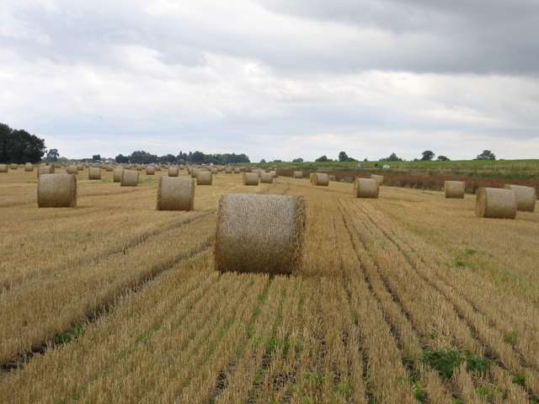
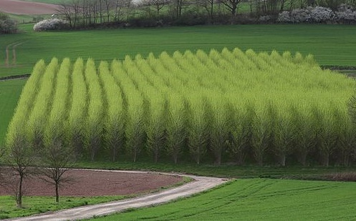
Second Generation Biofuels
Common cellulosic feedstocks:
Switchgrass
Wheat Straw
Hybrid Poplar
Corn Stalks
Image: USDA public-domain, Wikimedia Commons: https://commons.wikimedia.org/wiki/File:USDA_switchgrass.jpg
Image: Rodney Burton, Wikimedia Commons, https://commons.wikimedia.org/wiki/File:Bales_of_wheat_straw,_Sutton,_Cambs_-_geograph.org.uk_-_227322.jpg’
Image: Wikimedia Commons, https://commons.wikimedia.org/wiki/File:Populus-short-rotation.jpg
Image: Wikimedia Commons, https://commons.wikimedia.org/wiki/File:Corn_stalks_at_sunset.jpg
Notes:
Important to note that

Slide 35
Second Generation Biofuels: Switchgrass vs. Corn
Benefits of switchgrass:
Can grow on marginal lands of little agricultural value
Requires less chemical fertilizer than corn
Can survive for 10 years or more (which corn must be sown at the start of each growing season
Reduces erosion by holding soil in place while providing habitat for birds, insects and other wildlife
Low-impact, fast-growing
Image: USDA public-domain, Wikimedia Commons: https://commons.wikimedia.org/wiki/File:USDA_switchgrass.jpg
Image: Wikimedia Commons, https://commons.wikimedia.org/wiki/File:Corn_stalks_at_sunset.jpg
Notes:
Article: “Switchgrass may unlock the future of biofuel”, Phys.Org, March 3, 2017, Silke Schmidt, University of Wisconsin – Milwaukee, https://phys.org/news/2017-03-switchgrass-future-biofuel.html

Slide 36
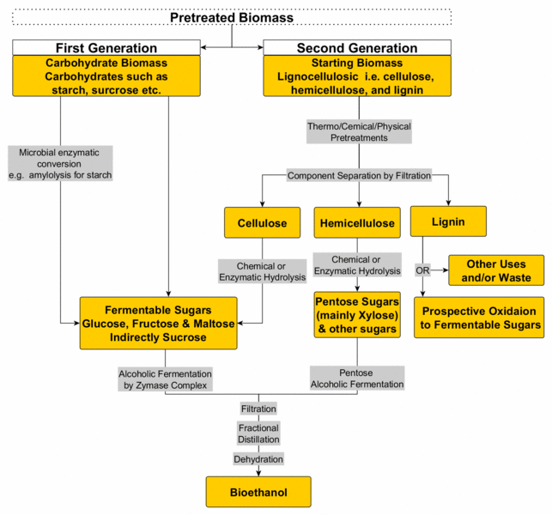
Bioethanol: First vs. Second Generation Processes
First Generation:
Starting Material is a fermentable sugar or a polysaccharide easily converted to one by the yeast.
Much less efficient in reducing GHG emissions
GMO strains or, exogenous enzymes can be used to increase productivity.
Second Generation:
Starting material is much more abundant as waste e.g. rice husk, straw, switchgrass, etc. (not a food-based feedstock)
Requires pre-treatment due to composition
Requires physical separation
Cellulose and hemicellulose can be converted to fermentable sugars through either a chemical or enzymatic process
Lignin is still hard to break down – but, there are research groups exploring the processing of lignin at industrial scales
Image: Creative Commons
Notes:
Image: https://commons.wikimedia.org/wiki/File:First_and_Second_Generation_Bioethanol_Production_by_Alcoholic_Fermentation.gif
First Generation:
Starting Material is a fermentable sugar or a polysaccharide easily converted to one by the yeast.
Much less efficient in reducing GHG emissions.
GMO strains or , exogenous enzymes can be used to increase productivity.
Second Generation:
Much more abundant as waste e.g. rice husk, straw, chaff etc.
Second Generation Pretreatments –cellulose, hemicellulose and lignin build up plant cell walls and need to be treated to break these components
The components are then separated physically – different stages to give the different components isolated.
Enzyme can act upon once broken and -Cellulose is made up of beta1,4 linked glucose – broken down by enzymes – cellulases �-Xylose is a major component of hemicellulose. The latter can be hydrolised, however a different biochemical pathway acts on xylose to give ethanol. Yeast, GMOs used immobilised exogenous enzyme could also be. �-Lignin cannot be fermented there is scientific focus on converting it to a fermentable sugar on industrial scale.

Slide 37
Outline
Petroleum industry
Energy sources
Energy consumption & demand
Meeting the future energy demands
Biofuels
First Generation
Corn-based ethanol
Biodiesel
Second generation biofuels
Cellulosics, oils, grasses
Third and Fourth generation biofuels
Algae

Slide 38
Biofuels: First to Fourth Generation
First generation:
Feedstocks: Food crops, grains, easily extractable sugar, starch, oils (competes with food)
Bioconversion process: Fermentation (i.e., ethanol), transesterification (i.e., biodiesel)
Carbon balance: weak (corn, canola) to good (sugarcane)
Energy balance: weak (corn) to excellent (sugarcane)
Third generation:
Feedstocks: Purpose designed energy crops – improved bioconversion, higher yields (e.g., algae)
Bioconversion process: Fermentation, gasification, fast-pyrolysis
Carbon balance: carbon-neutral to slightly carbon-positive
Energy balance: depends on feedstock, process integration
Second generation:
Feedstocks: Ligno-cellulosics, residues, dedicated energy crops
Bioconversion process: Fermentation, gasification, fast-pyrolysis
Carbon balance: carbon-neutral to slightly carbon-positive
Energy balance: depends on feedstock, process integration
Fourth generation:
Feedstocks: Purpose designed energy crops – improved carbon storage, higher yields (i.e., algae)
Bioconversion process: Fermentation, gasification, fast-pyrolysis
Carbon balance: carbon-negative (takes CO₂ out of atmosphere)
Energy balance: waste heat used for carbon capture & storage
Adapted from: Biopact, https://global.mongabay.com/news/bioenergy/2007/10/quick-look-at-fourth-generation.html

Slide 39
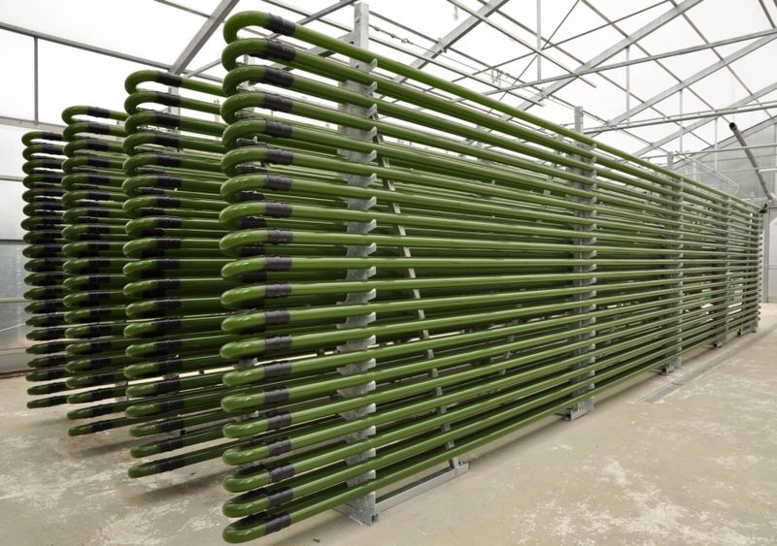
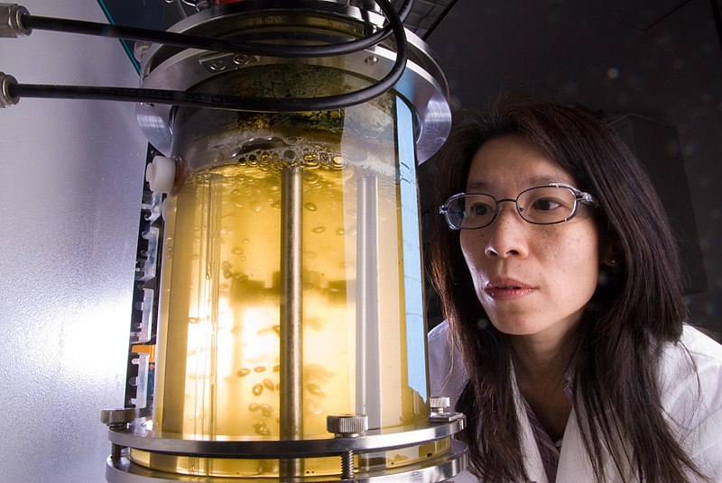
Third Generation Biofuels: Algae as a feedstock for biodiesel
A NREL researcher examines an algae photobioreactor, which uses light energy and carbon dioxide to grow algae by photosynthesis. The researchers are studying microalgae as a potential source of biofuels.
Image: Wikimedia Commons, Public domain
Photobioreactor for the cultivation of microalgae
Image: Wikimedia Commons, Creative Commons
Notes:
Image Source: https://commons.wikimedia.org/wiki/File:U.S._Department_of_Energy_-_Science_-_298_042_003_(9525866984).jpg
Image Source:https://commons.wikimedia.org/wiki/File:Photobioreactor_PBR_4000_G_IGV_Biotech.jpg

Slide 40
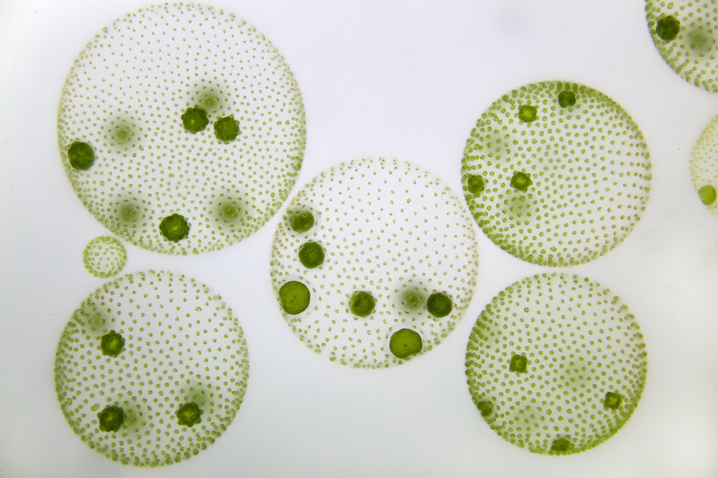
What is algae?
A large and diverse group of simple, usually autotrophic organisms that can have either unicellular or multicellular forms.
Notes:
https://commons.wikimedia.org/wiki/File:Mikrofoto.de-volvox-8.jpg

Slide 41
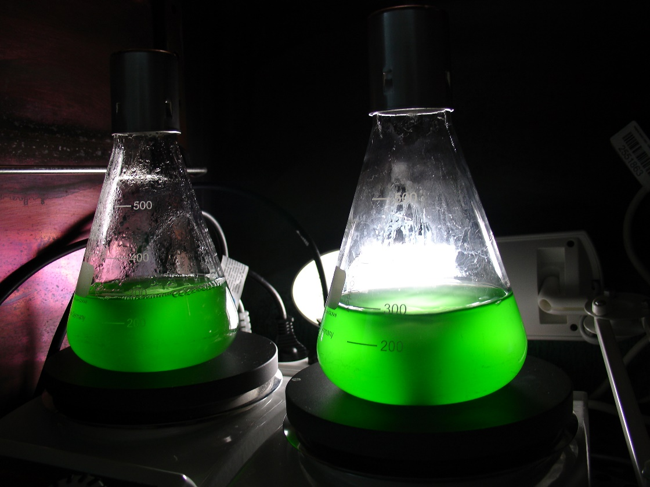
What algae needs to grow
Carbon dioxide
Sunlight
Water
Notes:
https://commons.wikimedia.org/wiki/File:Synechococcus_cyanobacteria-cultures.jpg

Slide 42
Third Generation Biofuels: Algae
Benefits:
Based on algal matter (micro- and macroalgae) and cyanobacteria
Yields carbohydrates, proteins, vegetable oils (lipids) → can be converted to biodiesel
Higher oil and biomass yields:
Has potential to yield 61,000 liters/ha vs. 200-450 liters/ha from soybean and canola crops
Microalgae Chlorella vulgaris and Chlorella protothecoides are rich sources of lips for biofuels (lipids are over 50% of their biomass)
Little or no competition with food production:
Can be cultivated in saltwater or wastewater ponds on marginal land or in constructed photobioreactors
Reduced resource use:
Amount of water needed to produce a unit of energy is estimated to be 74% smaller for microalgal biodiesel production than for rapeseed
Clark, J.H., Luque, R., Matharu, A.S., Annu. Rev. Chem. Biomol. Eng., 2012, 3: 183-207
Notes:
Video by UniVerve: https://www.youtube.com/watch?time_continue=118&v=TvEE1ODfniM – the Story of Algae
https://www.univerve.co.il/
Article “Algae smoothie anyone?” by Abigail Klein Leichman, February 28, 2016, Israel 21c, Uncovering Israel, https://www.israel21c.org/algae-smoothie-anyone/

Slide 43
Third Generation Biofuels: Algae
Challenges:
High cost (currently)
High capital investment for infrastructure
Costly harvesting of microalgal biomass
Space:
Large space requirement
Energy:
High energy consumption during drying of harvested microalgae biomass (due to high water content)
Photo: © Rémi Jouan, CC-BY-SA, GNU Free Documentation License, Wikimedia Commons
https://commons.wikimedia.org/wiki/File:Algoculture_au_kibboutz_Ketura.JPG
Clark, J.H., Luque, R., Matharu, A.S., Annu. Rev. Chem. Biomol. Eng., 2012, 3: 183-207
Notes:
Business are mass producing micro-algae for specific purposes – some for harvesting active ingredients for the pharmaceutical sector and many are also considering as a source for energy (biodiesel).
Founded in 1998 at Kibbutz Ketura and acquired by the British firm Grovepoint in 2013, Algatechnologies developed a way to mass-produce microalgae in Israel’s hot Arava desert near Eilat. Algatech was one of the first in the business.

Slide 44
Pros Cons
Versatility in growth methods
Versatility in uses
Speed of production
Potential for huge production levels
CO₂ reduction
Energy intensive
Not competitive against foreign oil (yet)
Needs funding
Technology still in development

Slide 45
Biofuels: First to Fourth Generation
First generation:
Feedstocks: Food crops, grains, easily extractable sugar, starch, oils (competes with food)
Bioconversion process: Fermentation (i.e., ethanol), transesterification (i.e., biodiesel)
Carbon balance: weak (corn, canola) to good (sugarcane)
Energy balance: weak (corn) to excellent (sugarcane)
Third generation:
Feedstocks: Purpose designed energy crops – improved bioconversion, higher yields (e.g., algae)
Bioconversion process: Fermentation, gasification, fast-pyrolysis
Carbon balance: carbon-neutral to slightly carbon-positive
Energy balance: depends on feedstock, process integration
Second generation:
Feedstocks: Ligno-cellulosics, residues, dedicated energy crops
Bioconversion process: Fermentation, gasification, fast-pyrolysis
Carbon balance: carbon-neutral to slightly carbon-positive
Energy balance: depends on feedstock, process integration
Fourth generation:
Feedstocks: Purpose designed energy crops – improved carbon storage, higher yields (e.g., algae)
Bioconversion process: Fermentation, gasification, fast-pyrolysis
Carbon balance: carbon-negative (takes CO₂ out of atmosphere)
Energy balance: waste heat used for carbon capture & storage
Adapted from: Biopact, https://global.mongabay.com/news/bioenergy/2007/10/quick-look-at-fourth-generation.html

Slide 46
Fourth Generation Biofuels
Genetically optimized feedstocks that capture large amounts of carbon
For example: the next generation of genetically engineered algae
Key to 4th generation biofuels: technologies that carbon sequester and therefore are carbon negative!
Notes:
Interesting article about an example of a 4th generation biofuel study: Solar-to-Fuel System Recycles CO2 to Make Ethanol and Ethylene, September 21, 2017, https://advancedbiofuelsusa.info/solar-to-fuel-system-recycles-co2-to-make-ethanol-and-ethylene/

Slide 47
Biofuels as an Alternative
Biofuels are not THE answer to sustainable energy, but biofuels may be part of the answer
Biofuels may offer advantages over fossil fuels, but the magnitude of these advantages depends on how a biofuel crop is grown and converted into a usable fuel

Slide 48
Summary
Petroleum industry: shifting our energy sources from depleting to renewable resources is a challenge! But, we must meet the needs for future energy demands.
Biofuels offer promising alternatives
The First Generation of biofuels relied on food and feed as feedstocks for producing fuels
Second Generation biofuels shift away from food based sources, but may still have challenges in terms of growing and harvesting
Third and Fourth Generation biofuels are in development and have great potential! What is next?

