Slide 1
Sustainability
Lecture #9
Date:
Course #

Slide 2
Overview
Sustainability – Myths and Facts
Society, Economy, and the Environment
Business and Sustainability
Applying Green Chemistry to Management
Different Models of Sustainability

Slide 3
Learning Objectives
What is really means to Sustainable.
Common misconception and the facts.
How sustainability is beneficial for businesses and not just chemistry!
Sustainability is being pursued and propelled in companies you interact with on a daily basis.
Notes:
By the end of the class period, students should have a better understanding of what sustainability is really about and how it can be used in various business operations today.

Slide 4
Sustainability
When a word becomes so popular you begin hearing it everywhere, in all sorts of marginally related or even unrelated contexts, it means one of two things. Either the word has devolved into:
A meaningless cliché, or
It has real conceptual heft.

Slide 5
Sustainability
For example, the phrase “Green” or “Going Green” is a meaningless cliché. It has been used so frequently that it has sometimes led to Green Washing.
Anything or anyone can “be green” these days.
Think Green
Image Source: pxhere, Public Domain
Notes:
Image: lightbulb, https://commons.wikimedia.org/wiki/File:Green_energy.svg
Image: http://www.publicdomainfiles.com/show_file.php?id=13937515212257

Slide 6
Sustainability
“Sustainable“, which at first conjures up a similarly vague sense of environmental virtue, actually belongs in the second category:
It has real conceptual heft.
Despite its simplicity, sustainability is a concept many people have a difficult time wrapping their minds around.

Slide 7
Overview
Sustainability – Myths and Facts
Society, Economy, and the Environment
Business and Sustainability
Applying Green Chemistry to Management
Different Models of Sustainability

Slide 8
Myth #1:
Nobody knows what sustainability really means.

Slide 9
What is Sustainability?
Take a moment to write a sentence or two about what sustainability is.

Slide 10
The Definition of Sustainability
UN World Commission on Environment and Development: “Sustainable development is development that meets the needs of the present without compromising the ability of future generations to meet their own needs.”
Sustainability presumes that resources are finite and should be used conservatively and wisely with a view to long-term priorities and consequences of the ways in which resources are used.
In simplest terms, sustainability is about our children and our grandchildren, and the world we will leave them.
- The Brundtland Report (Our Common Future)

Slide 11
The Definition of Sustainability
Sustainability wants to avoid this…
while also making sure we can lead comfortable lives.
Image Source: Slideshare
Notes:
Image Source: https://www.slideshare.net/drsuneel/ecological-footprint-11736726

Slide 12
Myth #2:
Sustainability is all about the environment.

Slide 13
Sustainability is Not Just About the Environment
Sustainability include a broad group social and economic development issues including: poverty, hunger, health, education, climate change, water, sanitation, energy, and environment.
This requires giving all countries access to natural resources such as water, energy, and food - all of which come, one way or another, from the environment.

Slide 14
Sustainability is Not Just About the Environment
Sustainability has transformed into an environmental term because the economy is driven by natural resources.
If too many of us use resources inefficiently or generate waste too quickly for the environment to absorb and process, future generations won’t be able to meet their needs.
Image Source: Slideshare
Notes:
Image Source: https://www.slideshare.net/drsuneel/ecological-footprint-11736726

Slide 15
Myth #3:
“Sustainable” is a synonym for “green”.

Slide 16
Sustainability ≠ Green
Although there’s a fair amount of overlap between the terms, “green” usually suggests for the public a preference for the natural over the artificial.
With more than six billion people on the planet today, and another three billion expected by the middle of the century, society cannot hope to give future generations a comfortable standard of living without a heavy relying on technology and innovations such as genetically altered food products.

Slide 17
Myth #4:
Sustainability is all about recycling.

Slide 18
A question we need to ask: Is recycling sustainable?
Sustainability and Recycling

Slide 19
Sustainability and Recycling
Material | Energy savings
Aluminum | 95%
Cardboard | 24%
Glass | 5-30%
Paper | 40%
Plastics | 70%
Steel | 60%
Recycling
Converting waste materials into new materials and objects.
Available for metals, plastic, paper, glass.
Cost-benefit of recycling: energy savings

Slide 20
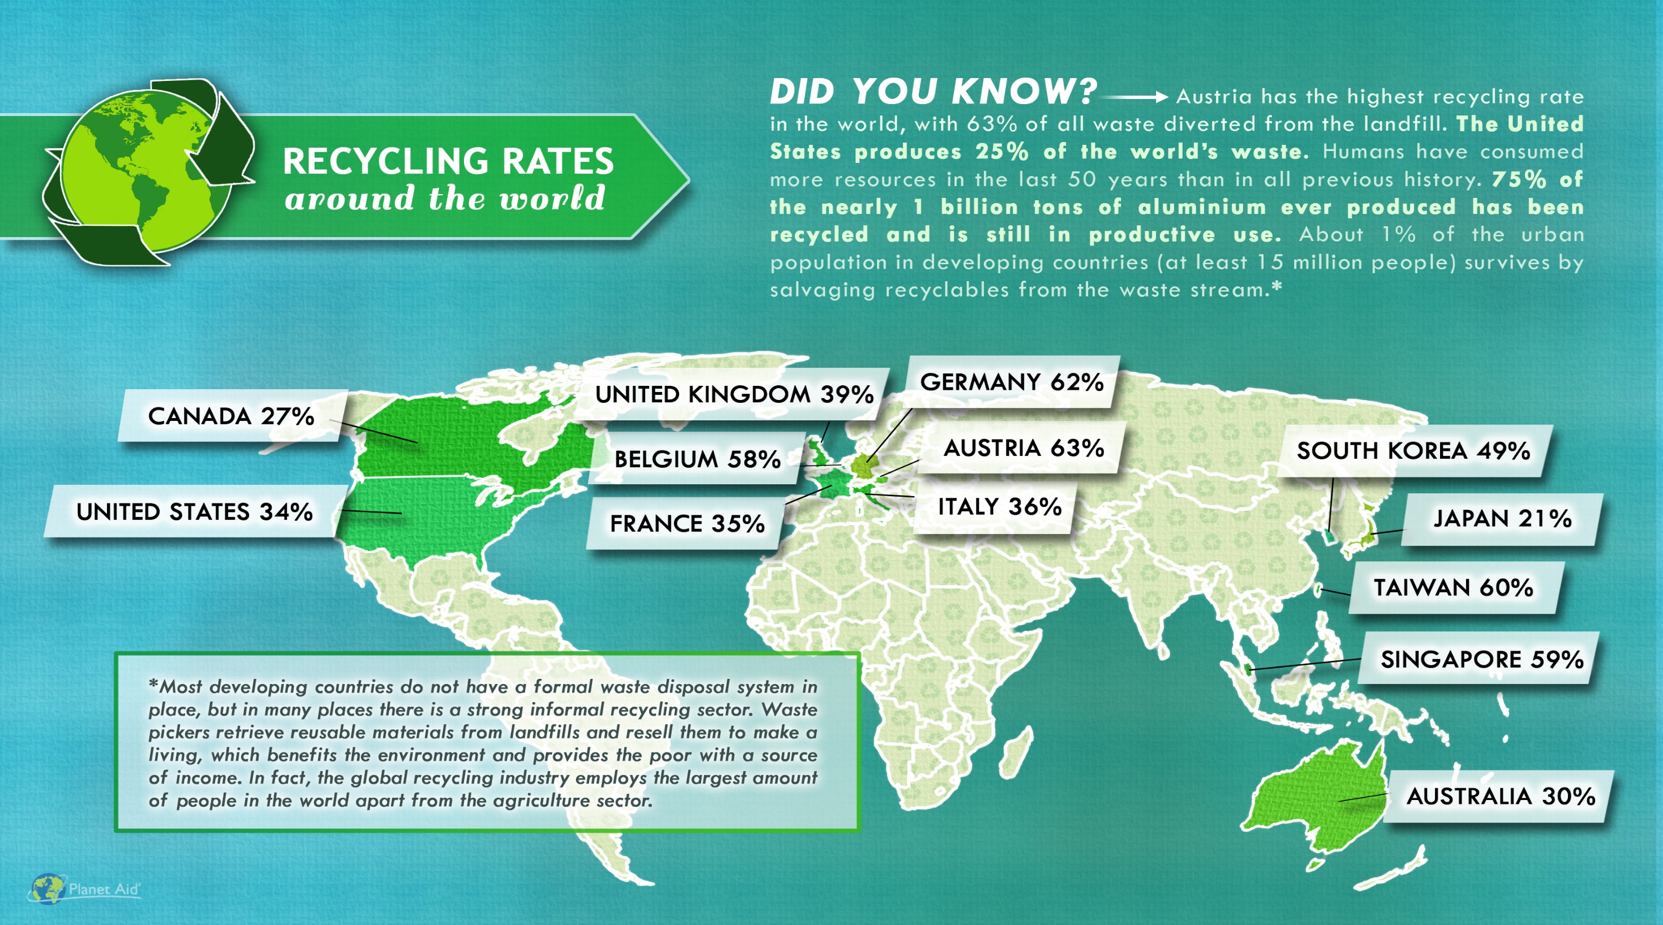
http://www.planetaid.org/blog/recycling-rates-around-the-world
Notes:
http://www.planetaid.org/blog/recycling-rates-around-the-world

Slide 21
Myth #5:
Sustainability is too expensive.

Slide 22
Sustainability and Expense
If there is an 800-pound gorilla in the room of sustainability, this myth is it. That’s because there’s a grain of truth to it.
But only a grain. It’s only true in the short term and under certain circumstances, but certainly is not true in the long term.

Slide 23
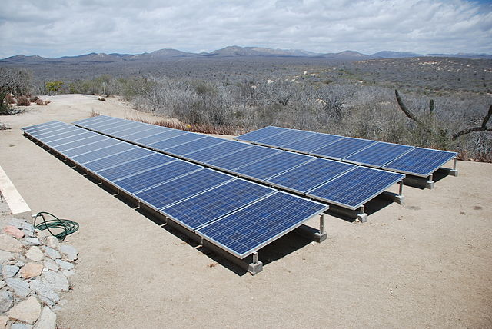
Sustainability and Expense
More sustainable ways of doing things usually costs less over the life-time of a product or service.
It is the upfront costs that can sometimes be higher.
Image: Wikimedia Commons, Solar panels installed in Baja Sur California, Author: BishopBandita

Slide 24
Myth #6:
Sustainability means lowering our standard of living.

Slide 25
Sustainability and Standard of Living
Once we start becoming organized and innovate, the breakthroughs can be extraordinary.
These innovations will allow us to use resources more productively, which in turn will allow us to be prosperous, fed, entertained, and secure.
The innovation at the heart of sustainable living will be a powerful economic engine.

Slide 26
Myth #7:
Consumer choices and grassroots activism, not
government intervention, offer the fastest and most
efficient routes to sustainability.

Slide 27
Sustainability and The Government
Popular grassroots actions are helpful and essential to creating change. But progress on some reforms, such as curbing CO2 emissions, can only happen if central authorities commit to making it happen. That is why tax credits, mandatory fuel-efficiency standards, and other government regulations are both practical and necessary.

Slide 28
Myth #8:
New technology is always the answer.

Slide 29
Is new technology the answer to sustainability?
Sustainability and Technology
Notes:
Or, should we make sure that whatever we develop is sustainable for many years to come?

Slide 30
Water treatment technologies for developing world
“Pure” Water Bottle Filters 99.9% of Bacteria with UV Light
https://inhabitat.com/pure-water-bottle-filters-99-9-of-bacteria-with-uv-light/
Life Sack Is Not Your Ordinary Grain Sack
http://www.tuvie.com/life-sack-is-not-your-ordinary-grain-sack/
Solar-Powered Hamster Ball Purifies Water for Drinking
https://www.treehugger.com/clean-technology/solar-powered-hamster-ball-purifies-water-for-drinking.html
Lifestraw®
The Lifestraw cleans water you normally couldn’t drink
https://curiosity.com/topics/the-lifestraw-cleans-water-you-normally-couldnt-drink-curiosity/
Bike purifies water with pedal power
https://www.wired.com/2011/02/bike-purifies-water-with-pedal-power/
Notes:
Image Source: https://inhabitat.com/6-water-purifying-devices-for-clean-drinking-water-in-the-developing-world/cycloclean-water-purifying-bike-537x395/
”Pure” water bottle video: https://www.youtube.com/watch?v=eAPXRaq9FfU
Lifestraw video: https://www.youtube.com/watch?v=i82YD7uvi2s

Slide 31
Myth #9:
Sustainability is ultimately a population problem.

Slide 32
Sustainability and Population
This is not a myth, but it represents a false solution.
Every environmental problem is ultimately a population problem. If the world’s population were only 100 million people, we would be hard-pressed to generate enough waste to overwhelm nature’s cleanup systems. We could dispose all our trash in a landfill in some remote area, and nobody would notice.

Slide 33
Sustainability and Population
Population experts agree that the best way to limit population is to educate women and raise the standard of living overall in developing countries.
But that strategy cannot possibly happen quickly enough to put a dent in the population on any useful timescale.
The U.N. projects that the planet will have to sustain another 2.6 billion people by 2050. But even at the current population level of 7 billion people, we’re using up resources at an unsustainable rate.

Slide 34
Myth #10:
Once you understand the concept, living sustainably is easy to figure out.

Slide 35
Sustainability ≠ Simple
All too often, a choice that seems sustainable turns out on closer examination to be problematic.
Probably the best current example is the rush to produce ethanol for fuel from corn.
What are the issues with ethanol?

Slide 36
Sustainability ≠ Simple
Corn Cultivation:
Competition with food supply
Land demand
Nutritional needs
Diseases
Initial investment
Ethanol Demand and Corn Prices:
Large increase in demand for corn for ethanol production.
Current production capacity is at over 5 billion gallons.
It is projected to increase to over 9 billion gallons with current plants currently under construction.
Bushels of corn sold for over $8 (USD) each in July 2012.
Corn prices continue to fluctuate.

Slide 37
Sustainability ≠ Simple
You cannot really declare any practice “sustainable” until you have done a complete life-cycle analysis of its environmental costs.
Even then, technology and public policy keep evolving, and that evolution can lead to unforeseen and unintended consequences.
The admirable goal of living sustainably requires plenty of thought on an ongoing basis.

Slide 38
Overview
Sustainability – Myths and Facts
Society, Economy, and the Environment
Business and Sustainability
Applying Green Chemistry to Management
Different Models of Sustainability

Slide 39
Society, economy, and the environment are the key dimensions of sustainability.
Society, Economy, and the Environment
Why?
Economic or physical water scarcity, poor air quality, and destroyed ecosystems that sustain life not only in terms of food but also employment, are all signs that we lack sustainability in day-to-day practices.

Slide 40
The traditional view of economy, society, and the environment:
Society, Economy, and the Environment
When society, economy, and the environment are viewed as separate unrelated parts of a community, the community’s problems are also viewed as isolated issues. Economic development councils try to create more jobs. Social needs are addressed by health care services and housing authorities. Environmental agencies try to prevent and correct pollution problems.
Economy
Society
Environment

Slide 41
The current view of economy, society, and the environment: The Triple Bottom Line
Society, Economy, and the Environment
Economy
Society
Understanding the three parts and their links is key to understanding sustainability, because sustainability is about more than quality of life. It is about balancing society, economy, and the environment.
Environment

Slide 42
Triple Bottom Line (TBL)
Society, Economy, and the Environment
TBL measures the impact of an organization's activities on the world by looking at profitability and shareholder values through its social, financial, and environmental capital.
Economy
Society
Environment
Most of major companies that include sustainability in their business plan use this model.

Slide 43
A representation of the ideal economy, society, and the environment:
Society, Economy, and the Environment
Environment
The economy exists entirely within society because all parts of the human economy require interaction among people. However, society is much more than just the economy. Friends and families, music and art, religion and ethics are all important elements of society, but are not primarily based on the exchanging of goods and services.
Society, in turn, exists within the environment. Our basic requirements – air, food, and water – come from the environment as do the energy and raw materials for housing, transportation, and the products we depend on.
Society
Economy

Slide 44
Overview
Sustainability – Myths and Facts
Society, Economy, and the Environment
Business and Sustainability
Applying Green Chemistry to Management
Different Models of Sustainability

Slide 45
Why are Businesses Paying Attention?
Pollution, contamination, and waste are increasing along with population.
We blame society and corporations for encouraging increased customer demand, pushing consumption of life supporting resources further and further.
Even as these resources decline, consumption of these resources is still rising.
Image Source: Futureearth.org
Notes:
Image Source: http://www.futureearth.org/blog/2015-jan-16/great-acceleration

Slide 46
Why are Businesses Paying Attention?
The problem of declining resources is not felt as acutely in developed areas as it is in less developed parts of the world.
The UN Human Development Report from 2012 suggests that the richest 1% of the world, approximately 70 million people, receive as much income as the poorest 56%, or 4 billion people.
Companies are at risk of losing access to raw materials and to employees.
Unfortunately, we are not acting upon knowledge that we have as quickly as we need to in order to prevent the continuous degradation of the Earth and our ability to survive. This creates a sense of urgency in today’s corporate boardroom.
Green Chemistry & Chemical Stewardship Online Certificate Program: https://osha.washington.edu/pages/green-chemistry-chemical-stewardship-online-certificate-program

Slide 47
Pressures that companies are facing:
Sustainability and Business
Fiduciary responsibility to make profit: CEOs in public companies have a fiduciary responsibility to shareholders. It is the law for them to deliver profits. Even private companies and small companies have a fiscal responsibility to investors or venture capitalists to return profit on their investment. While there may be a desire to be more sustainable, it has not yet been included within the scope of fiduciary responsibility.
Fear of increased costs, process complexity, and reduced quality of the end product: There is an underlying assumption that being sustainable will drive up costs, erode profits, and threaten the ability of the company to maintain standards and ultimately survive in a competitive marketplace.
Measurement and Monitoring: Challenges surround what to measure along the three dimensions of the Triple Bottom Line. This includes internal agreement as to what to measure, how to measure, and finally how to put auditing procedures in place. Even if a company wanted to be sustainable, the methodology for setting objectives and measuring the results are often in nascent states.
Green Chemistry & Chemical Stewardship Online Certificate Program:
https://osha.washington.edu/pages/green-chemistry-chemical-stewardship-online-certificate-program

Slide 48
Sustainability and Business
Sustainability and Green Chemistry are imperative to business practices, can provide solutions at lower costs, use fewer resources, and the processes and results can be measured.

Slide 49
How?
Sustainability and Business
With the ability to establish multiple value creation levers over the short and long term such as:
Stronger brand and greater pricing power.
Increased margins, producing greater profits and maximizing total shareholder return.
Improve customer loyalty and reduce the rate of churn.
Boosting market share and revenue growth.
Create the culture aligned with sustainability goals: “maximize resource efficiency”, “eliminate and minimize hazards and pollution”, and “design systems holistically and use life cycle thinking” by focusing on design.
B. Torok and T. Dransfield (eds), 1st edn, JAN 2018, Elsevier, Amsterdam, The Netherlands, ISBN-13: 978-0128092705, 1058 pp.

Slide 50
Who?
Sustainability and Business
An awareness of the Principles of GC&GE should not be limited to the members of the design teams of sustainable and innovative products and processes.
Green chemistry requires top-down implementation of sustainable innovation from managers and leaders in addition to the bottom-up (emergence) implementation from designers (followers).
Managers must be aware of the principles in order to implement sustainable approaches across multiple scales.
Leaders must be aware of the principles in order to develop business models and strategies that are sustainable in the long term.
B. Torok and T. Dransfield (eds), 1st edn, JAN 2018, Elsevier, Amsterdam, The Netherlands, ISBN-13: 978-0128092705, 1058 pp.

Slide 51
Framework of Innovation Management Process: Seven Opportunities to Apply Green Chemistry
Inputs
Human - The multidisciplinary approach requires innovative teams with diverse skill sets and knowledge. Actors require the ability to network and collaborate within the departments of an organization and beyond.
Physical/Natural - Renewable materials and energy; designing new materials, products, processes, and systems that are benign to human health and the environment.
Financial - A positive impact on value creation levers (stronger brand and greater pricing power) that can lead to increased total shareholder return.
B. Torok and T. Dransfield (eds), 1st edn, JAN 2018, Elsevier, Amsterdam, The Netherlands, ISBN-13: 978-0128092705, 1058 pp.

Slide 52
Framework of Innovation Management Process: Seven Opportunities to Apply Green Chemistry
Innovation Strategy
Companies that follow a sustainable business should be able to derive competitive advantages that are based on a sustainable value proposition.
By reducing the costs associated with waste, companies can improve operational efficiencies and gain a competitive advantage via a cost advantage.
A greener product that’s certified as sustainable can be sold at a higher price.
B. Torok and T. Dransfield (eds), 1st edn, JAN 2018, Elsevier, Amsterdam, The Netherlands, ISBN-13: 978-0128092705, 1058 pp.

Slide 53
Framework of Innovation Management Process: Seven Opportunities to Apply Green Chemistry
Knowledge Management
The leaders and managers of sustainability will require new core competencies that include sustainability literacy, external collaboration, and systems thinking.
Project teams that pursue sustainability initiatives, or that are involved in the creation of a new product or process, will require diverse skill sets.
B. Torok and T. Dransfield (eds), 1st edn, JAN 2018, Elsevier, Amsterdam, The Netherlands, ISBN-13: 978-0128092705, 1058 pp.

Slide 54
Framework of Innovation Management Process: Seven Opportunities to Apply Green Chemistry
Organization and Culture
At the executive level, prioritization decisions based on values take the form of decisions to invest, or not, in new products, services, and processes.
Employees should prioritize decisions that lead to sustainable innovation and ultimately sustainable development.
Organization and culture can also attract top talent that pays close attention to a firm’s behavior and could reduce employee turnover.
B. Torok and T. Dransfield (eds), 1st edn, JAN 2018, Elsevier, Amsterdam, The Netherlands, ISBN-13: 978-0128092705, 1058 pp.

Slide 55
Framework of Innovation Management Process: Seven Opportunities to Apply Green Chemistry
Project Management
Awareness of Green Chemistry can guide project managers as they operate within the multiple levels of reporting (middle, upper manager, and executive levels).
As for project management, designers and managers should consider the entire life cycle of a product, including those of the materials and energy inputs.
B. Torok and T. Dransfield (eds), 1st edn, JAN 2018, Elsevier, Amsterdam, The Netherlands, ISBN-13: 978-0128092705, 1058 pp.

Slide 56
Framework of Innovation Management Process: Seven Opportunities to Apply Green Chemistry
Portfolio Management
Leaders and managers can evaluate the sustainability of the projects that make up a portfolio in the context of the Green Chemistry
A challenge for leadership is the development of performance metrics for sustainability efforts that are different from the usual metrics of portfolio management, such as patent portfolio size and R&D expenditure.
B. Torok and T. Dransfield (eds), 1st edn, JAN 2018, Elsevier, Amsterdam, The Netherlands, ISBN-13: 978-0128092705, 1058 pp.

Slide 57
Framework of Innovation Management Process: Seven Opportunities to Apply Green Chemistry
Commercialization
The most effective methods of ideation for product innovation are customer visit teams, ethnographic research, leader user analysis, and focus groups.
Feedback from marketing and sales teams involved in the diffusion stage will help the designers of new products in the ideation phase since these teams will best understand market orientation or pull.
B. Torok and T. Dransfield (eds), 1st edn, JAN 2018, Elsevier, Amsterdam, The Netherlands, ISBN-13: 978-0128092705, 1058 pp.

Slide 58
Overview
Sustainability – Myths and Facts
Society, Economy, and the Environment
Business and Sustainability
Applying Green Chemistry to Management
Different Models of Sustainability

Slide 59
Different Models of Sustainability
Adidas & Parley for the Ocean
Joined forces to combat ocean plastic pollution and create more sustainability products.
Ocean plastic is a big environmental problem with Estimates of 8 million metric tons of plastic end up in the ocean every year.
Photodegradation from the sun break down plastics and creates microplastics that harm aquatic life and local ecosystems.
Ocean plastics created a unique opportunity to redesign old plastics for new applications.
Source: https://pxhere.com/en/photo/802303
Source: https://pxhere.com/en/photo/841080
Notes:
Source: https://pxhere.com/en/photo/841080
Source: https://pxhere.com/en/photo/802303

Slide 60
Adidas & Parley Video
Watch Video:
https://www.youtube.com/watch?v=iisMyJdkyqg
Notes:
Image: https://www.flickr.com/photos/designmilk/23463663593
Image: https://www.flickr.com/photos/designmilk/19954437605

Slide 61
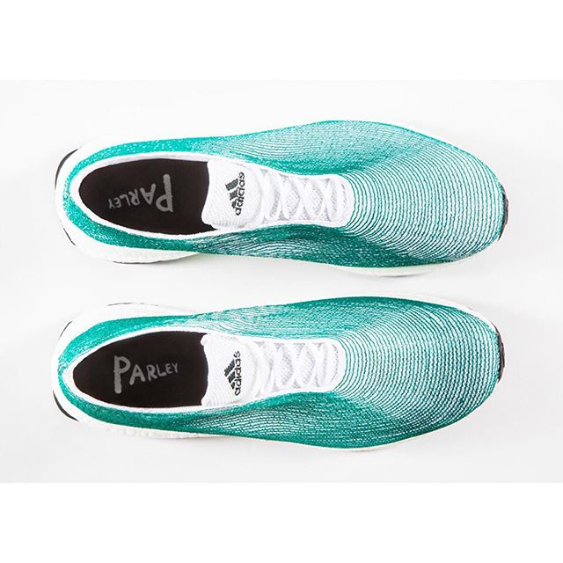
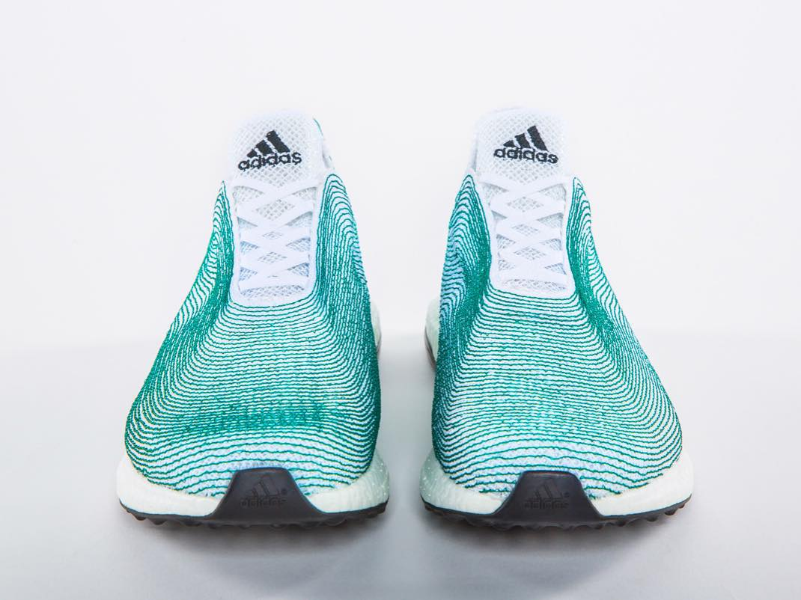
Adidas & Parley
Through much research, Adidas has be able to use old fishing nets from the ocean
and created athletic apparel! This is just one example of how sustainability is entering
the consumer market.
Image Source: Flickr
Notes:
Image: https://www.flickr.com/photos/designmilk/23463663593
Image: https://www.flickr.com/photos/designmilk/19954437605

Slide 62
Different Models of Sustainability
Nike – low carbon, closed loop model
The company is reducing the use of petroleum-derived solvents (PDSs) across the manufacturing process of their footwear product lines. Since 1995, there has been an actual 96% reduction in the use of PDSs per pair of shoes through the adoption of water-based adhesives.
Watch Video
https://www.youtube.com/watch?v=tw3ESEeO2hY
https://news.nike.com/news/sustainable-innovation

Slide 63
Different Models of Sustainability
Unilever
As a result of their sustainability initiatives, Unilever factories are releasing 37% less emissions than in 2008, and waste is down 85%.
This example highlights how innovators are attempting to utilize matter and energy in a way that enhances performance and value while protecting the environment.
Watch Video:
https://www.youtube.com/watch?v=cpYhgqPRivw
https://www.nytimes.com/2015/11/22/business/unilever-finds-that-shrinking-its-footprint-is-a-giant-task.html?_r=0

Slide 64
Summary
Sustainable development is development that meets the needs of the present without compromising the ability of future generations to meet their own needs.
Sustainability is a broad discipline that has a lot of moving parts and variables to consider when deciding a path to sustainability. There is not one universal system.
Businesses are starting to see the importance of sustainability for future growth and so should you!
Prioritization is key!

