Slide 1
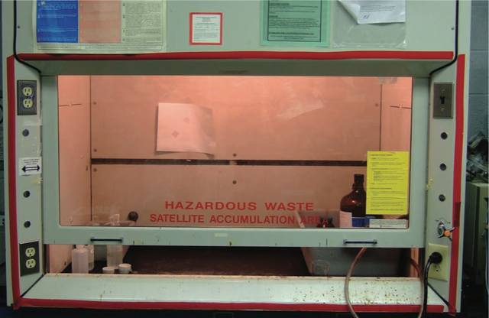
Yale-UNIDO Train-the-Facilitator Workshop in Green Chemistry
Designing for Reduced Hazard
CENTER for GREEN CHEMISTRY
and GREEN ENGINEERING at YALE
Image: Wikimedia Commons, Fume Hood , Author: U.S. National Institute for Occupational Safety and Health

Slide 2
Topics To Be Covered
Hazard and Risk – Past and Present
Toxicology
Assessing Hazards and Exposure
  What Happens When You’re Exposed?
Hazard Minimization Through Molecular Design
QSAR - Quantitative Structure Activity Relationship
Molecular Design Research Network (MoDRN)

Slide 3
The Challenge of Environmental Risk
There are over 100,000 chemicals in global circulation.
700+ chemicals are introduced to the US Market each year.
85% of these chemicals lack experimental data.
There has been unintended biological activity which has led to increased hazard as well as toxic endpoints for humans and the environment.
Source: Wikimedia Commons

Slide 4
Hazard
The ability cause adverse consequence.
What types of chemical hazards are there?
  Global Hazards (global warming, acid rain, security threat, ozone depletion)
  Physical Hazards (explosivity, corrosivity, oxidizers/reducers)
  Toxicological
    Environmental (aquatic toxicity, avian toxicity, mammalian toxicity)
    Human (e.g., carcinogenicity, neurotoxicity, hepatotoxicity, dermal toxicity)

Slide 5
Risk Equation
Risk = f(Hazard, Exposure)
Environmental risk is resulting from exposure to a potential environmental hazard
Risk can be reduced by in two ways:
If as hazard , exposure needs to be reduced to 0
If hazard = 0, exposure can be
Ultimate goal is to use BENIGN materials

Slide 6
Why Use Benign Materials?
Exposure becomes irrelevant
Less dependence on systems which can fail or be sabotaged
Competitive advantage – reduces costs associated with toxic materials

Slide 7
Mitigation of Risk through Design
The traditional approach to hazards focuses on reducing risk by minimizing exposure.
For example, wearing personal protective equipment or space ventilation if the chemical is volatile.
Green chemistry focuses on reducing risk by reducing hazard.
If there is no hazard, exposure becomes irrelevant

Slide 8
How have we dealt with chemicals and the environment in the past?

Slide 9
Historical Approach to Environmental Problems
Waste treatment, control, and disposal; pollutant monitoring; hazardous waste site cleanup.
Development of standards for emissions to air, releases to water, and disposal by land, as well as regulation of these standards.
“Command and Control”

Slide 10
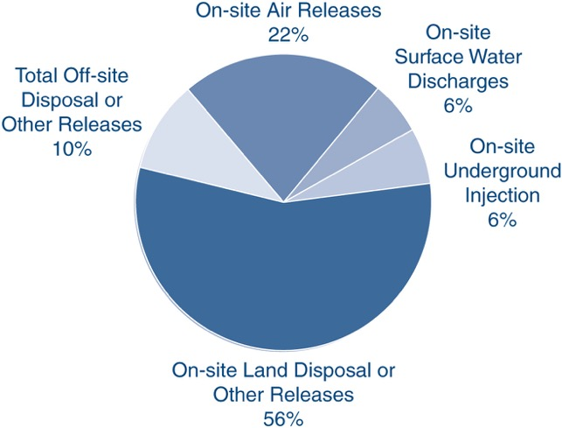
Chemicals in the Environment
In U.S., 3.93 billion lbs. of toxic chemicals were released directly to air, water, and land in 2011
Only 650 of toxic chemicals and toxic chemical categories out of 100,000 in commerce are tracked by Toxic Release Inventory
Mihelcic, J. R.; Zimmerman, J. B., Environmental engineering: Fundamentals, sustainability, design. Wiley Global Education: 2014.

Slide 11
Why should we care?

Slide 12
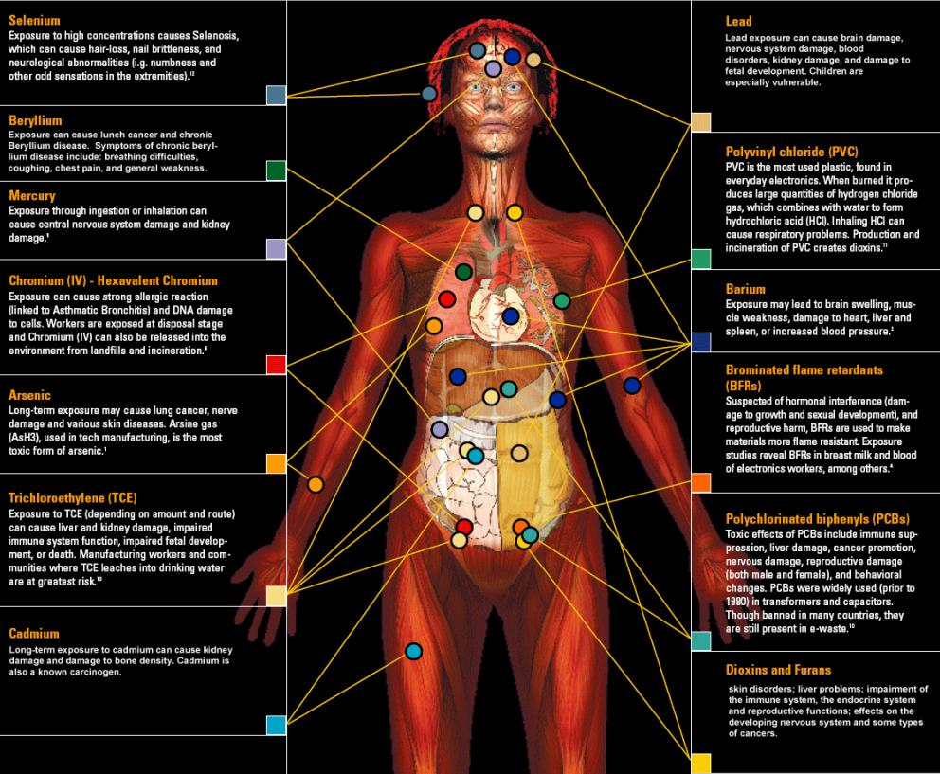
Body Burden
148 xenobiotics in the body
Of the chemicals found:
  76 cause cancer in humans or animals,
  94 are toxic to the brain and nervous system, and
  79 cause birth defects or abnormal development.
The dangers of exposure to these chemicals in combination has never been studied.
One of Green Chemistry’s greatest strengths is the ability to design for reduced hazard.
Image Source: http://svtc.org/our-work/e-waste/

Slide 13
What is Toxicology
The traditional definition of toxicology is "the science of poisons."
A more descriptive definition of toxicology is
"the study of the adverse effects of chemicals or physical agents on living organisms".

Slide 14
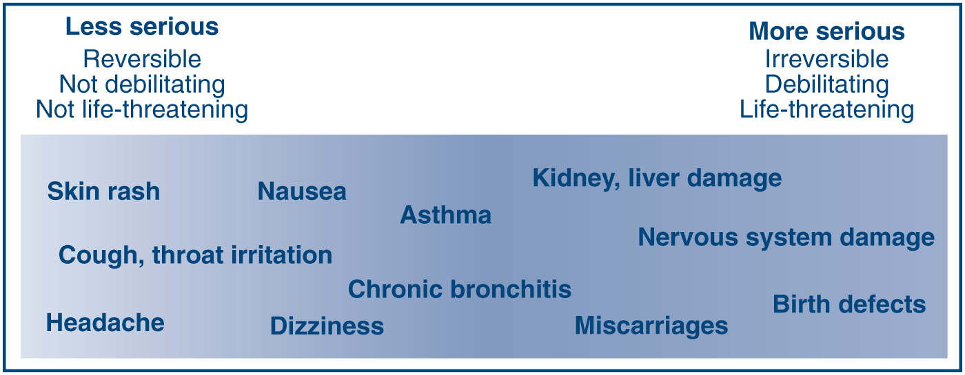
What Counts as Toxic
Mihelcic, J. R.; Zimmerman, J. B., Environmental engineering: Fundamentals, sustainability, design. Wiley Global Education: 2014.

Slide 15
Relating Toxic Endpoints to Molecular Features & Properties
Acute toxicity | Carcinogenicity | Bioconcentration
Subchronic & chronic toxicity | Neurotoxicity | Degradation & transport
Reproductive toxicity | Immunotoxicity | Aquatic toxicity
Developmental toxicity | Genotoxicity | Terrestrial organism toxicity
Molecular weight | Molecular volume | Dipole moment
Hydrophilic surface area | Hydrophobic surface area | Rotatable bonds
Hydrogen bonds | Ionization potential | Electron affinity
Partition coefficients | Acid/base properties | Polarizability

Slide 16
Definitions
A toxic agent is anything that can produce an adverse biological effect.
It may be chemical, physical, or biological in form.
For example, toxic agents may be
chemical (such as cyanide),
physical (such as radiation), and
biological (such as snake venom)

Slide 17
What is the most important factor in bringing about the adverse biological impact?

Slide 18
Dose
Dose is the amount of a substance administered at given times.
For example:
  650 mg Tylenol as a single dose
  500 mg Penicillin every 8 hours for 10 days

Slide 19
Dose Makes the Poison
An apparently nontoxic chemical can be toxic at high doses. (Too much of a good thing can be bad)
Highly toxic chemicals can be life saving when given in appropriate doses.
Source: Wikimedia Commons

Slide 20
Lethal Doses
Approximate Lethal Doses of Common Chemicals
(Calculated for a 160 lb. human from data on rats)
Chemical Lethal Dose
Sugar (sucrose) 3 quarts
Alcohol (ethyl alcohol) 3 quarts
Salt (sodium chloride) 1 quart
Herbicide (2, 4-D) one half cup
Arsenic (arsenic acid) 1-2 teaspoons
Nicotine one half teaspoon
Food poison (botulism) microscopic
Source: Marczewski, A.E., and Kamrin, M. Toxicology for the citizen, Retrieved August 17, 2000: www.iet.msu.edu/toxconcepts/toxconcepts.htm.

Slide 21
How is toxicity testing done?

Slide 22
Dose-Response
The dose-response relationship is a fundamental and essential concept in toxicology. It correlates exposures and the spectrum of induced effects.
The dose-response relationship is based on observed data from experimental animal, human clinical, or cell studies.

Slide 23
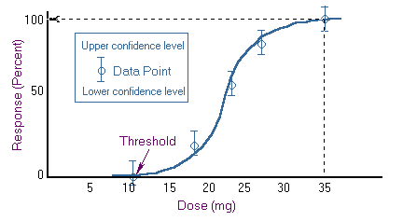
Dose-Response
Knowledge of the dose-response relationship:
  establishes causality that the chemical has in fact induced the observed effects
  establishes the lowest dose where an induced effect occurs - the threshold effect
  determines the rate at which injury builds up - the slope for the dose response.

Slide 24
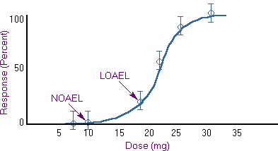
LD50, NOAEL, LOAEL, and RfD
LD 50- A common dose estimate for acute toxicity is the LD50 (Lethal Dose Response 50%).
This is a statistically derived dose at which 50% of the individuals will be expected to die.
NOAEL - No Observed Adverse Effect Level
Highest data point at which there was no adverse effect
LOAEL - Low Observed Adverse Effect Level
Lowest data point at which there was an adverse effect
LD 50
UF = Uncertainty factor (10-1000)
RfD – estimate of a daily oral exposure to the human population, that’s likely to be without risk of an effect

Slide 25
In-Class Discussion- Which Solvent Would You Use?
Solvent 99-2
100
90
Solvent 99-7
80
70
60
% Mortality
50
40
30
20
10
0
0 50 100 150 200 250 300 350
Inhaled Dose (ppm)
Plotted here are two theoretical curves for the toxicity of solvents used in the cleaning of silicon compounds. Both solvent 99-2 and 99-7 performed equally well against a variety of manufactured silicon compounds. The task at hand for you is to determine which solvent would you pick to be “safer” for use. As you can see from the accompanying data both compounds have an equivalent Lethal dose 50 value (LD50). These are based on average values during a 6 hour exposure period.

Slide 26
In-Class Discussion- Which Solvent Would You Use?
Solvent 99-2
100
90
Solvent 99-7
80
70
60
% Mortality
50
40
30
20
10
0
0 50 100 150 200 250 300 350
Inhaled Dose (ppm)
Solvent 99-7 causes lethality at much lower levels than 99-2 (20ppm versus 100ppm respectively), and the response is much more predictable (i.e. less population heterogeneity). Solvent 99-2 because higher levels can be inhaled before any harmful effects should begin.

Slide 27
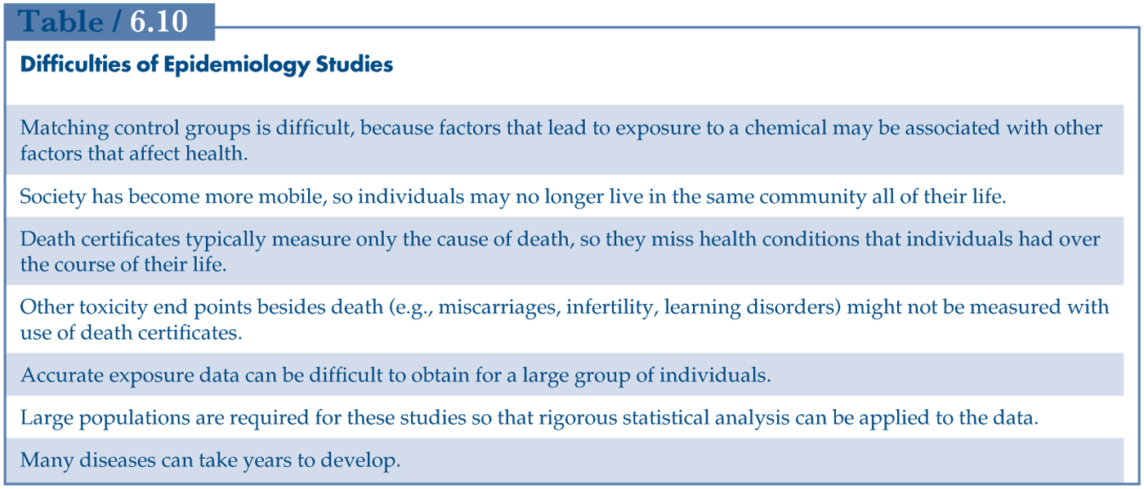
Hazard Assessment
Review and analysis of toxicology data and assessing if the substance causes toxic effects
Sources include animal and human studies and computational data
These studies have difficulty with showing causation (if a risk factor lead to disease)
Mihelcic, J. R.; Zimmerman, J. B., Environmental engineering: Fundamentals, sustainability, design. Wiley Global Education: 2014.

Slide 28
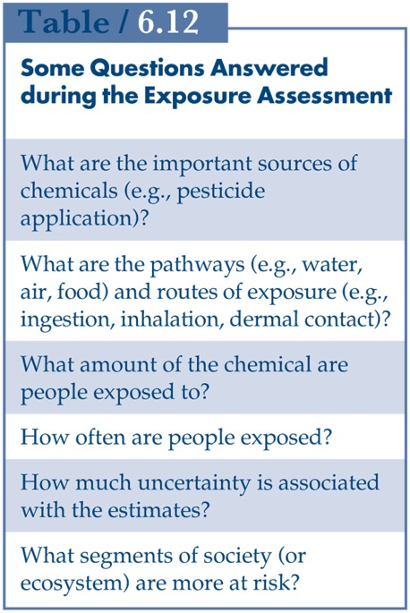
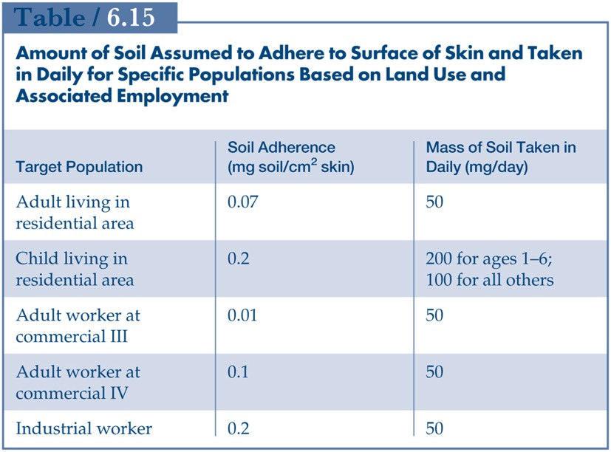
Exposure Assessment
Determines the extent and frequency of human exposure to target chemicals.
Guidelines for residential, industrial and commercial sites
For engineers, the knowledge of risk and exposure provides information whether the site needs to be remediated.
Mihelcic, J. R.; Zimmerman, J. B., Environmental engineering: Fundamentals, sustainability, design. Wiley Global Education: 2014.

Slide 29
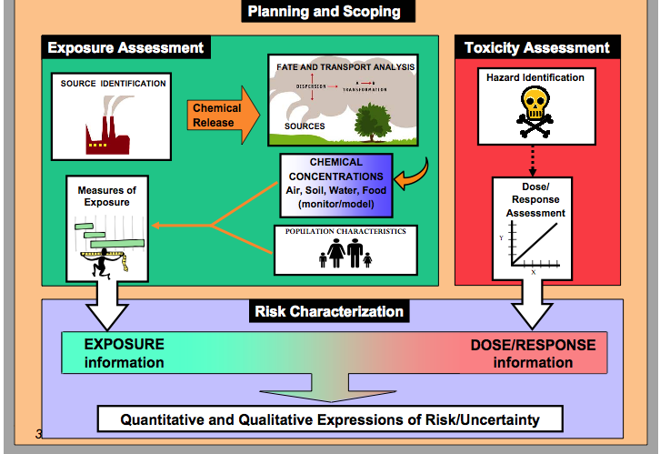
Hazard assessment, dose-response & exposure assessment
Risk Characterization

Slide 30
Tools For Hazard Characterization
ChemHAT - easy way to access summarized information on chemical hazards in the workplace
ChemSpider
Protox
Safer Choice - for consumers, businesses, and purchasers to find products that perform and are safer for human health and the environment.
toxicity assessment based on experimental or predicted LD 50
Notes:
Show tools

Slide 31
What happens once you are exposed to a toxicant?

Slide 32
ADME
ABSORBTION
DISTRIBUTION
METABOLISM
EXCRETION
http://blog.gyrosproteintechnologies.com/spinblog/adme-of-therapeutic-proteins

Slide 33
Chemical Processes in ADME
Source: Wang and Skolnik, Chemistry and Biodiversity, 2009
Notes:
More complex
ADME can be controlled by these parameters

Slide 34
Absorption
Dermal
Respiratory
Digestive
Skin is the first barrier to absorption for the chemical. The skin can keep chemicals out of the body, or it can let them in, depending on the physical and chemical properties of the chemical. Skin absorption depends on molecular weight, lipid solubility (log P), and physical state. These parameters determine if the chemical passes through the skin cell membranes into the body. Absorption of a chemical will result in the chemical circulating inside the body and perhaps causing adverse effects.
As chemicals are inhaled, they may reach the lungs. The lung surface is a poor barrier against the entry of many chemicals into the body, which means that absorption of chemicals into the lung can be rapid and efficient. Respiratory absorption depends on many factors such as molecular weight, log P and vapor pressure.
If chemicals are swallowed, either intentionally or unintentionally, they enter the gastrointestinal tract (GI). From there, they may either pass through the body or be absorbed into the body. GI absorption depends on many factors such as molecular weight, log P and physical state.

Slide 35
Absorption
Dermal
Respiratory
Digestive
Parameter | Preferred | Not Preferred
Physical state | solid | liquid
LogP | Less than 0 or greater than | Between 0 and 5
Molecular weight | More than 400 Da | Less than 400 Da
Parameter | Preferred | Not Preferred
Particle size [nm] | More than 5 | Less than 5
LogP | Less than 0 or greater than 5 | Between 0 and 5
Molecular weight [Da] | More than 400 | Less than 400
Vapor pressure [mmHg] | Less than 0.001 | More than 0.001
Parameter | Preferred | Not Preferred
Particle size [nm] | More than 100 | Less than 100
LogP | Less than 0 or greater than 5 | Between 0 and 5
Phase | solid | liquid
Molecular Weight [Da] | More than 500 | Less than 400

Slide 36
Distribution
Distribution is the movement of a chemical throughout the bloodstream and into other organs, such as the brain and the bones. Pharmaceuticals such as antibiotics and painkillers are designed to have high distribution rates so they can reach their target organs and have therapeutic effects. For chemicals such as detergents, distribution should be limited.
Distribution depends on many factors such as log P, polar surface area, acidic/basic properties, and molecular weight.
Distribution as opposed to absorption is more difficult to control.
Courtesy of Molecular Design Research Network and Dr. Karolina Mellor

Slide 37
Metabolism
As a chemical is distributed through the body, it will most likely undergo metabolism. Metabolism is the body’s way of facilitating the excretion (removal) of the detergent through the kidneys. The rate at which a chemical is metabolized is usually dependent on its accessibility to enzymes.
Metabolism is more difficult to control than Absorption, and it can lead to detoxification or toxification of the organism.
Courtesy of Molecular Design Research Network and Dr. Karolina Mellor

Slide 38
Elimination
After the chemical is absorbed, the body can eliminate it by a process called excretion which can occur through the kidneys, the skin, the GI tract, and the lungs. If the detergent is not eliminated from the body, it can accumulate, or stay in the blood, which can lead to disease.
Excretion as opposed to absorption is more difficult to control.
Courtesy of Molecular Design Research Network and Dr. Karolina Mellor

Slide 39
In-Class Exercise
Go to chemspider.com and put in following CAS number:
  Benzene 71-43-2
Using discussed parameters, predict respiratory, dermal and digestive absorption of compounds.
Benzene:
Colorless sweet smelling liquid; highly flammable
Used as precursor to many complex chemicals: polystyrenes, polycarbonates, epoxy resins, nylon
Toxic- known carcinogen

Slide 40
DERMAL
 | 71-43-2
LogP
Molecular weight [g/mol]
Phase
RESPIRATORY
 | 71-43-2
LogP
Molecular weight [g/mol]
Vapor pressure [mmHg]
DIGESTIVE
 | 71-43-2
LogP
Molecular weight [g/mol]
Phase

Slide 41
DERMAL
 | 71-43-2-Benzene
LogP | 2.22
Molecular weight [g/mol] | 78.112
Phase | liquid
RESPIRATORY
 | 71-43-2-Benzene
LogP | 2.22
Molecular weight [g/mol] | 78.112
Vapor pressure [mmHg] | 100.9
DIGESTIVE
 | 71-43-2-Benzene
LogP | 2.22
Molecular weight [g/mol] | 78.112
Phase | liquid

Slide 42
Conclusions
Benzene is volatile–it will absorb through the respiratory system
Once benzene is in the body, it has a moderate lipid and water solubility, therefore some of it will absorb in digestive track
Since it is a liquid, it will absorb easier than solid
Skin absorption is also probable

Slide 43
For Additional Practice: Safer Chemical Design Game
Educational game based on ADME and scientific data for surfactants to make connection between physico-chemical properties and health.
http://gwiz.yale.edu
Courtesy of Molecular Design Research Network and Dr. Karolina Mellor

Slide 44
Approaches to Hazard Minimization through Molecular Design

Slide 45
Green Chemistry Molecular Design Pyramid
Toxicodynamics
Not well understood and relatively complex
Receptor
binding
Key events
Bioaccumulation/
Persistence
Bioavailability Structure/Shape Activity Mechanism of Action
Shape/
Molar Volume
Reactive
Functional
Groups
That’s what we want to target
Solubility
Electronic
Charge
Chemists can control quite well
Molecular
Weight
Volatility
Particle
size
Toxicokinetics

Slide 46
Approaches to Hazard Minimization Through Molecular Design
Elimination of the molecular initiating event that activates pathway
Changing reactive functional groups
Reducing or eliminating bioavailability
Reduction of need for associated hazardous substances
Design for End-of-Useful product life

Slide 47
Elimination of the molecular initiating event that activates pathway
Where the mechanistic pathway of action is known, molecular structures can be design such that the necessary reactions necessary are either impossible or highly disfavored resulting in significant toxicity reduction.

Slide 48
B. Changing Reactive Functional Groups
In the absence of specific mechanistic information, chemists can modify structure such that certain reactive functional groups, e.g., cyano, electrophilic, etc, can be minimized or eliminated from the chemical structure where feasible.

Slide 49
C. Reducing or Eliminating Bioavailability
In order for a chemical to manifest its intrinsic hazard, it must be able to reach the toxicological target, human, animal, environmental or global. Through structural molecular design, properties such as solubility, log Kow, and volatility can adjusted to reduce hazard manifestation.

Slide 50
D. Reduction of Need for Associated Hazardous Substances
Many chemical substances, if not hazardous themselves, require the use of other hazardous substances e.g., paints with VOCs, surfaces requiring specific cleaners, plastics with various additives.
Through molecular design, these associated substances can be eliminated by making the desired properties integral to the product

Slide 51
E. Design for End-of-Useful Product Life
Persistence of chemical in the environment is a problem that can be designed out of molecular structure.
By creating products that degrade to innocuous by-products under designed conditions, e.g., heat, light, time one a can reduce or eliminate this hazard.
Design for utilization of waste as a feedstock is an important goal.

Slide 52
By Changing the Molecular Charge: Cephalosporins
Clinical nephrotoxicity was recognized early – damage to proximal tubular epithelia.
Mechanism: the drug is rapidly transported across basolateral membrane via the organic anion transporter, OAT1. Transport out of cell into lumen is less well characterized (involves other OAT, OAT4).
Cephalosporin has a very low affinity for OAT4 due to its zwitterionic character, resulting in considerable intracellular accumulation
Cephaloridine
Notes:
Cephalosporins are a type of beta-lacatam antibiotic.
First generation:Cephaloridine

Slide 53
Cephalothin
In contrast, cephalothin, an anionic analog of the original zwitterionic drug, rapidly moves across the epithelia from blood into urine
Is thus not a neurotoxin
Cephalothin
Notes:
Kidney International (1999) 56, 2128–2136; doi:10.1046/j.1523-1755.1999.00789.x
http://www.nature.com/ki/journal/v56/n6/full/4491152a.html
Page 34

Slide 54
By Manipulating Sterics: Paraquat and Diquat
Diquat
Paraquat
Mechanism: After oral ingestion, a very small fraction is absorbed, but the blood levels remain constant for many hours as paraquat is not metabolized by the liver. Instead, it accumulates in the lung and is retained there even after blood concentrations decrease.
Paraquat was found to enter the lung via carrier-mediated transmembrane transport, specifically the polyamine transport system.
Notes:
Paraquat is s non-selective contact herbicide of the diphenyl class. It was introduced in the 1960s and became used worldwide.
However it was soon recognized that paraquat also cause selective pulmonary toxicity to humans (damage to alveolar cells type I and II, causing edema, inflammation and hermorrhage, lung fibrosis).

Slide 55
Through SAR Data: Nonylphenols and Glycidyl Ethers
Polyethoxylatednonylphenols
Emulsifiers, surfactants
When n = 14-19, intense myocardial necrosis at 40 mg/kg day in dogs and guinea pigs
When n<14>19, no myocardial effects
Glycidyl ethers
When n = 7-9, mutagenic, cause testicular lesions
When n = 11-13+, non-mutagenic

Slide 56
By Manipulating Electrophilicity: Acrylates
Acrylate is understood to be carcinogenic because it can readily undergo Michael addition reactions
The addition of a methyl group to form methacrylate decreases the electrophilicity of the b-carbon, and decreases tendency for Michael reactions.
While this does not reduce the commercial efficacy, but whereas acrylate causes cancer is experimental assays, methacrylate does not.
Acrylate
carcinogenic
Methacrylate
non-carcinogenic
Notes:
Electr

Slide 57
By Facilitating Detoxification: Benzene
Benzene is known to cause hematoxicity and leukemia in humans
This is understood to be due to one of its metabolites, (E,E)-muconaldehyde.
Toluene is comparatively much less toxic, as the methyl group is oxidized more easily than the benzene ring to give benzoic acid

Slide 58
By Isosteric Substitution: Carbon with Silicon
DDT
(Toxic to insects)
Si-DDT Analog
(Non-toxic to insects)
DDT is well known to be environmentally persistent
DDT analog with Silicon above was synthesized.
While less persistent, the analog turned out to be non-toxic to insects
This is due to the more readily oxidized (metabolized) Si-H bond compared to C-H and also the larger size of the molecule

Slide 59
Designing New Molecules is Not a Trivial Task
Even if chemists design one chemical, it has to undergo tests

Slide 60
QSAR-Quantitative Structure Activity Relantionship
Assumes that similar chemicals behave similarly
Behavior of the chemical is derived from the structure
QSAR seeks for a relationship between chemical structure and activity
Identifies changes that lead to different activity (activity to avoid or keep)

Slide 61
When to use QSAR?
Not sufficient data on majority of chemicals
Not all chemicals will be tested
QSAR has been used for over 60 years
Better to predict than have nothing

Slide 62
QSAR Basics
They are associated with a specific endpoint [like LC50 or oxidative stress]
They ‘group’ chemicals based on activity like toxicity
Predict endpoints directly from chemical structure

Slide 63
Predictors of function, toxicity, properties
Lipinski rule of five
Number of rings
Number of rotatable bonds
Degree of branching
Connectivity
Overall shape

Slide 64
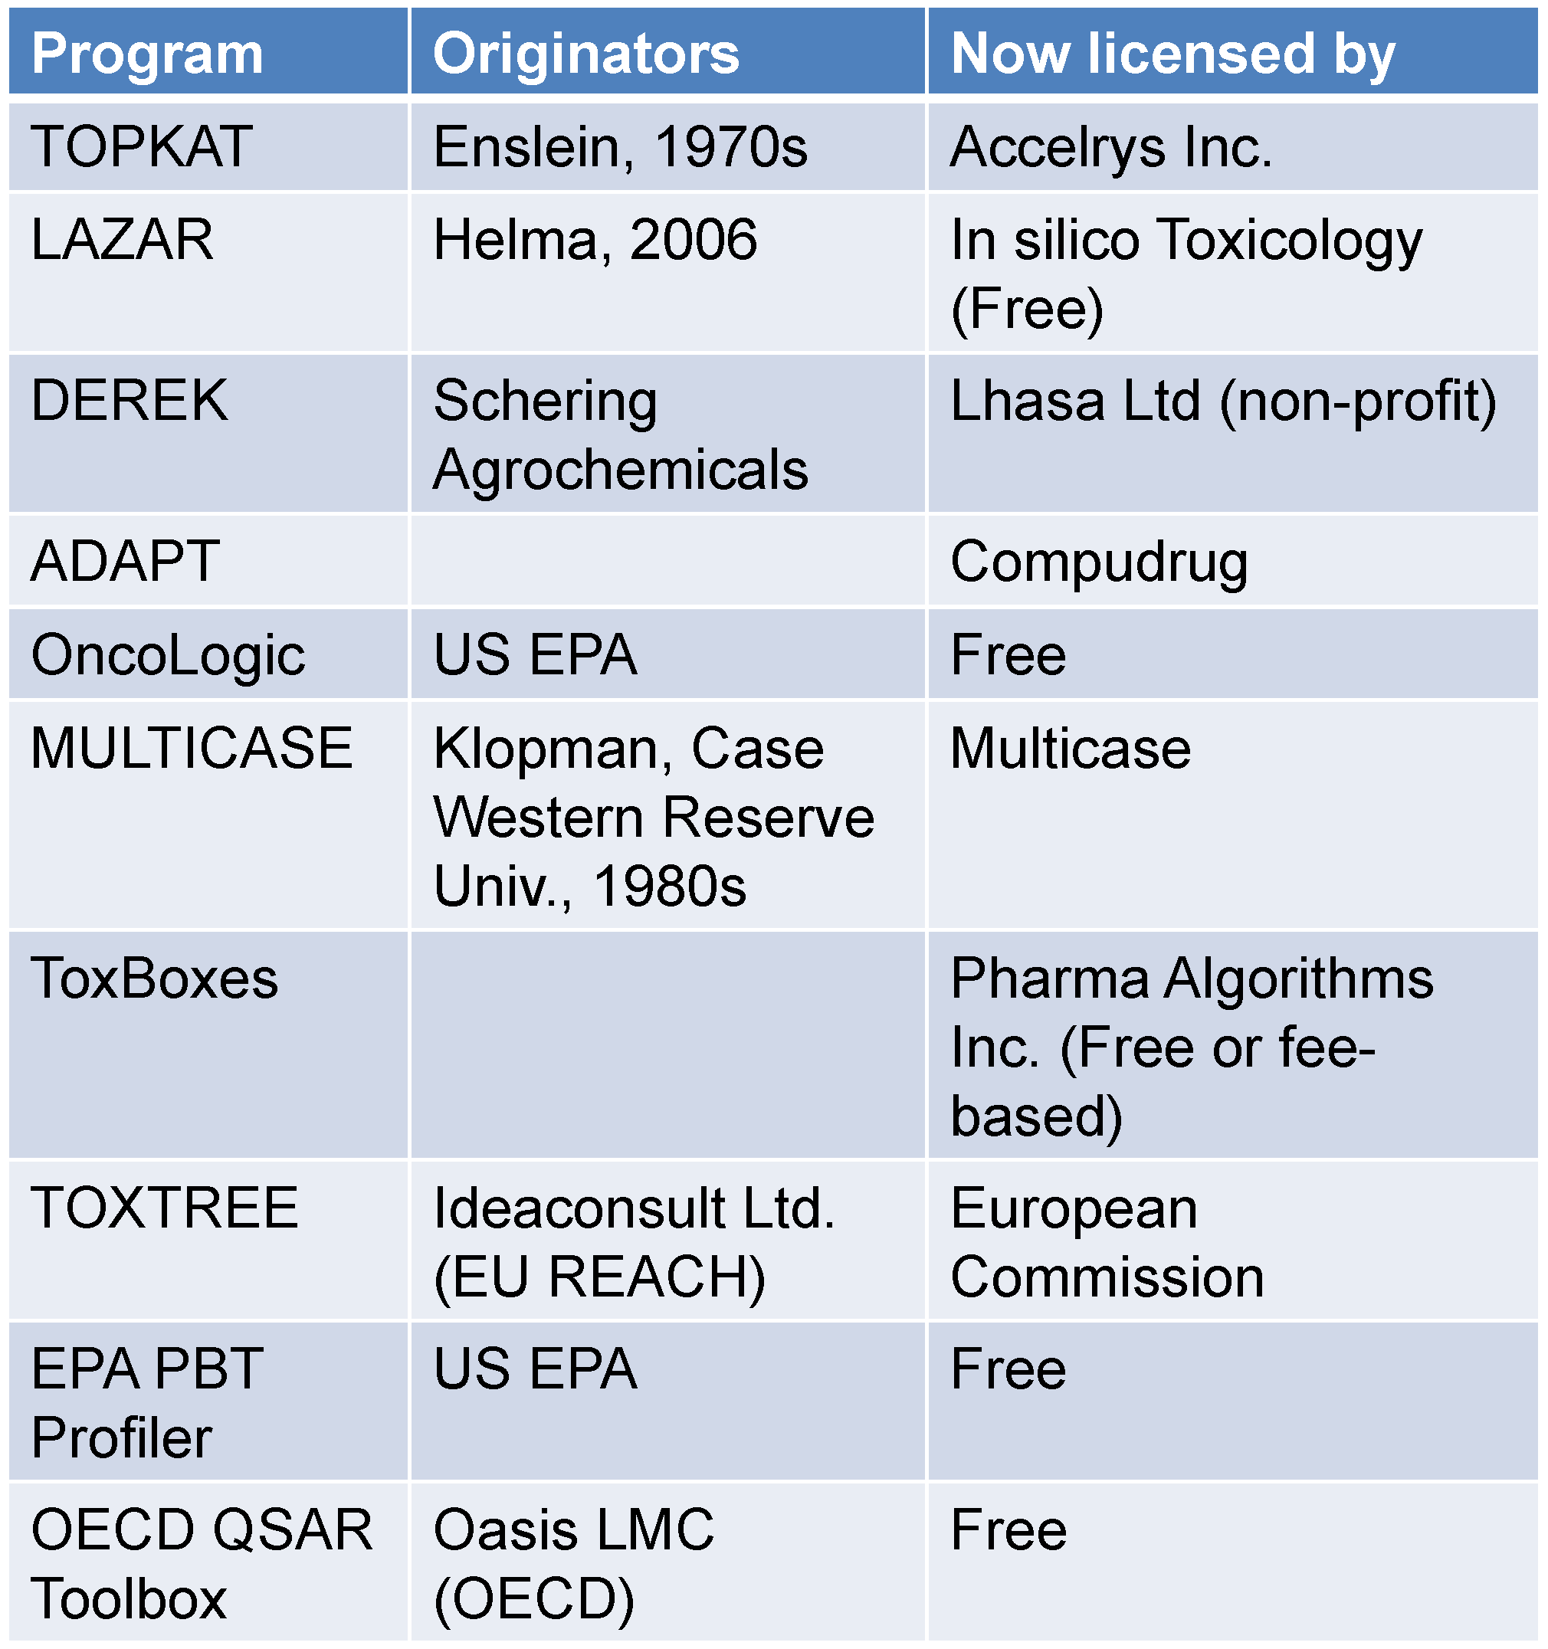
Examples of Popular Toxicity Prediction Tools
Current limitations
Prediction accuracy not higher than 65-70% for non-carcinogenic chemicals.
Lack of validation with up-to-date data
Application to a narrow range of chemical structures
Qualitative output

Slide 65
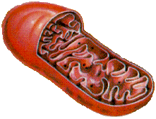
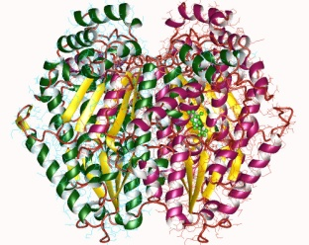
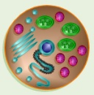
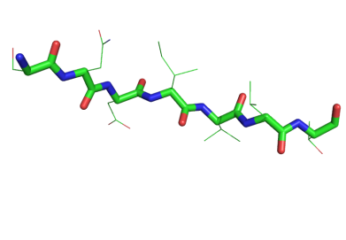
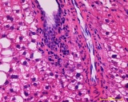
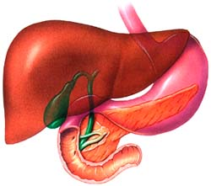
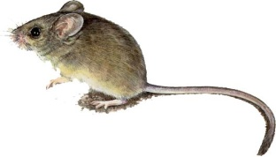
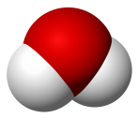
New Approach: Crossroads of Computational Chemistry & Toxicology
Computational chemistry
Toxicology
Organelles
Technological and
Scientific Advances
Enzymes
Receptors
Genes
Cells
Tissues
Polypeptide
DNA strands
Organs
Small molecules
Whole organisms
System size
As toxicology has increased its understanding of underlying biological processes leading to toxicity, computational chemistry can now describe the chemical transformations involved in these processes
Notes:
Jakub’s slide

Slide 66
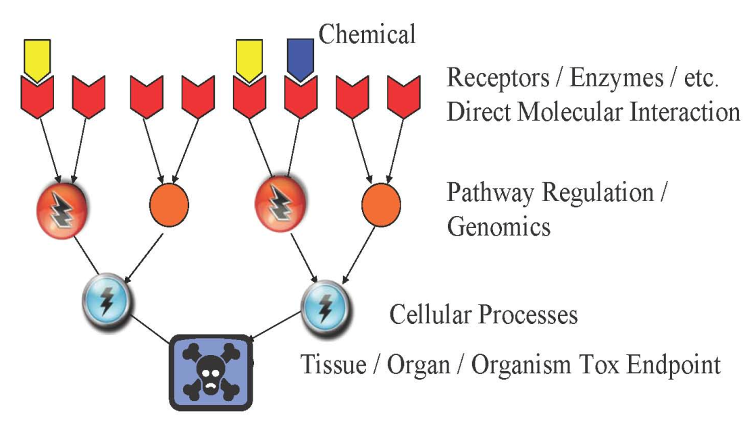
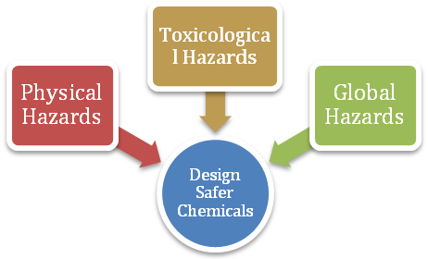
Understanding Physicochemical Properties Associated with Reduced Hazard
DESIGN
DESIGN
Chemical and Physical Properties
pKa chain branching log P molecular refractivity mol. wt. hydrolyzable groups
E_{HOMO} E_{LUMO} electronegativity hardness dipole log D_{7.4} # H-bond accep/donor
Flammability
Radioactivity
Risk of Explosion
Chemical Reactivity
Pollution
Persistence
Depletion of resources

Slide 67
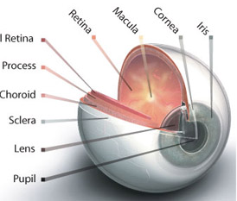
Property-Based Guidelines for Bioavailability
Acidic substance
Chemical
Basic substance
pKa<7
pKa>7
Absorption organs
GI tract
Skin
Lungs
Eyes
Unionized at pH>pKa
Lipid soluble
Un-ionized at pH>pKa
Absorbed across intestine membrane intoblood
Notes:
Different absorption mechanisms - GI tract has largest SA, resp has largets blood flow & thinnest membrane, skin has variable thicknes; different requirements for water sol

Slide 68
Property-Based Guidelines for Bioavailability
water solubility molecular size
vapor pressure < 0.001 mmHg
molecular size < 500 Da
log P_{ow} 0 - 5
Non-ionization at GI pH
Absorption organs
GI tract
Skin
Lungs
Eyes
Particle size < 5um
molecular size < 400 Da
vapor pressure < 0.001 mmHg
molecular size < 400 Da
log P_{ow} 0 - 6
presence of solvents
Ionization (polar, ionized)
Voutchkova, A.; Osimitz, T.; Anastas, T. Chem. Rev. 2010, 110, 5845

Slide 69
Adverse Outcome Pathways
Molecular
Cellular
Tissue
Organ
Organ System
Individual
Population
Ecosystem
Macro-Molecular
Interactions
Cellular
Responses
Organ
Responses
Organism
Responses
Population
Responses
Toxicant
Chemical
Properties
Receptor/Ligand
Interaction
DNA Binding
Protein Oxidation
Gene activation
Protein production
Altered signaling
Altered physiology
Disrupted homeostasis
Altered tissue development/ function
Lethality
Impaired
Development
Impaired
Reproduction
Structure
Recruitment
Extinction
Mechanistic understanding is critical for evaluating toxicity pathways
Design guidelines will be rationalized according to molecular initiation events
Ankley et al. 2010 ET&C; Source: Gary Ankley & Dan Villeneuve, EPA

Slide 70
Create a reliable tool for chemists which will not only predict the toxicity of existing chemicals but will allow a design of future molecules with reduced hazard

Slide 71

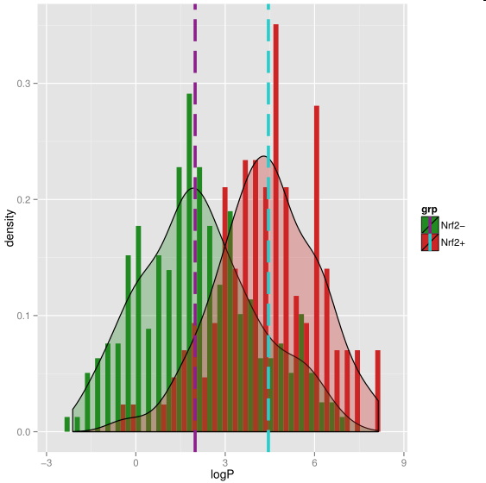
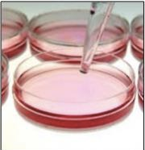


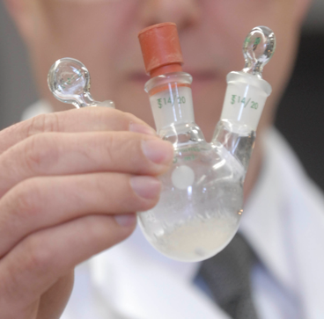





Molecular Design Research Network
Toxicology
Chemistry
Molecular Biology
Computational Chemistry
Notes:
MoDRN is the collaboration between 4 universities Baylor, GW, UWASH and Yale that uses advances in biology, toxicology, computational chemistry and engineering to develop a robust and well validated computer software that will not only predict toxicity of existing compounds but it will serve as a tool to redefine guidelines for the next generation molecules with reduced hazard. Our network will employ the newest strategies of computer modeling to build a computer software which will allow to understand what causes toxic endpoints and what can we do to avoid it. Our efforts will not only limit to research. To have the biggest possible impact we will engage educators and students on undergraduate and high school level to by including safer chemical design in students’ lesson plans and by developing interactive and hands-on teaching tools for undergraduate and high school students. Finally we plan to work with our colleagues across academia, colleagues across many industry sectors and policymakers on the government level to further inform and disseminate safe chemical concepts.

Slide 72
Where is Data Coming from?
EPA ToxCast
Tox21
Network lab assays
High throughput assay
Low throughput assay

Slide 73
What is an Assay?
Assay can test almost any biological effect
In vitro assay →in cell
In vivo assay →outcome in organism
Ideal assay is:
Reproducible: same result when repeated
Reliable: same result with different people repeat it
Sensitive: won’t miss an effect
Specific: won’t say there is an effect if there is not
Predictive of outcome of interest

Slide 74
Data from ToxCast
Set | Chemicals | Assays | Endpoints | Completion | Available
ToxCast Phase I | 293 | ~600 | ~700 | 2011 | Now
ToxCast Phase II | 767 | ~600 | ~700 | 03/2013 | 10/2013
ToxCast Phase IIIa | 1001 | ~100 | ~100 | Just starting | 2014
E1K (endocrine) | 880 | ~50 | ~120 | 03/2013 | 10/2013
Tox21 | 8,193 | ~25 | ~50 | Ongoing | Ongoing
~600
Assays
0
Chemicals
~8,200
Notes:
It’s important to note that this is not just a data collection exercise. ORD has assembled the infrastructure to house, QA, and analyze the tens of thousands of data points.
AND make all of this data publically available.

Slide 75
Data from ToxCast
ToxCast phase I: primarily pesticides
ToxCast phase II: industrial chemicals
ToxCast phase III: diverse chemical space; high production

Slide 76
Data Endpoints

Slide 77
Topics Covered
Hazard and Risk – Past and Present
Toxicology
Assessing Hazards and Exposure
  What Happens When You’re Exposed?
Hazard Minimization Through Molecular Design
QSAR - Quantitative Structure Activity Relationship
Molecular Design Research Network (MoDRN)

Slide 78
Sponsored by Yale-UNIDO Initiative
QUESTIONS?
CENTER for GREEN CHEMISTRY
and GREEN ENGINEERING at YALE

